Slide 1
Landing CV Algorithms
Based on Large-scale Pre-Trained Models
Speaker: Lingxi Xie
2021.10.10
VALSE 2021 @ Hangzhou

Slide 2
Outline
Why large-scale pre-trained models?
The knowledge-based paradigm for real-world applications
Are CV pre-training algorithms effective?
Existing pre-trained algorithms and their drawbacks
Our past research and the proposed learning-by-compression framework
Practices of landing CV applications
The AI workflow: what is it and why is it effective?
Looking into the future: where are we now; what will happen?

Slide 3
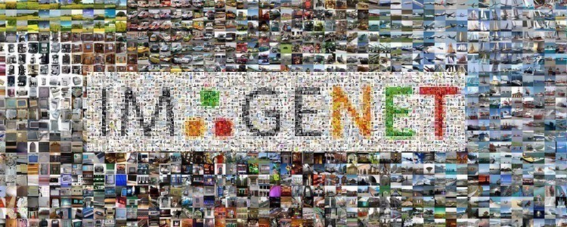
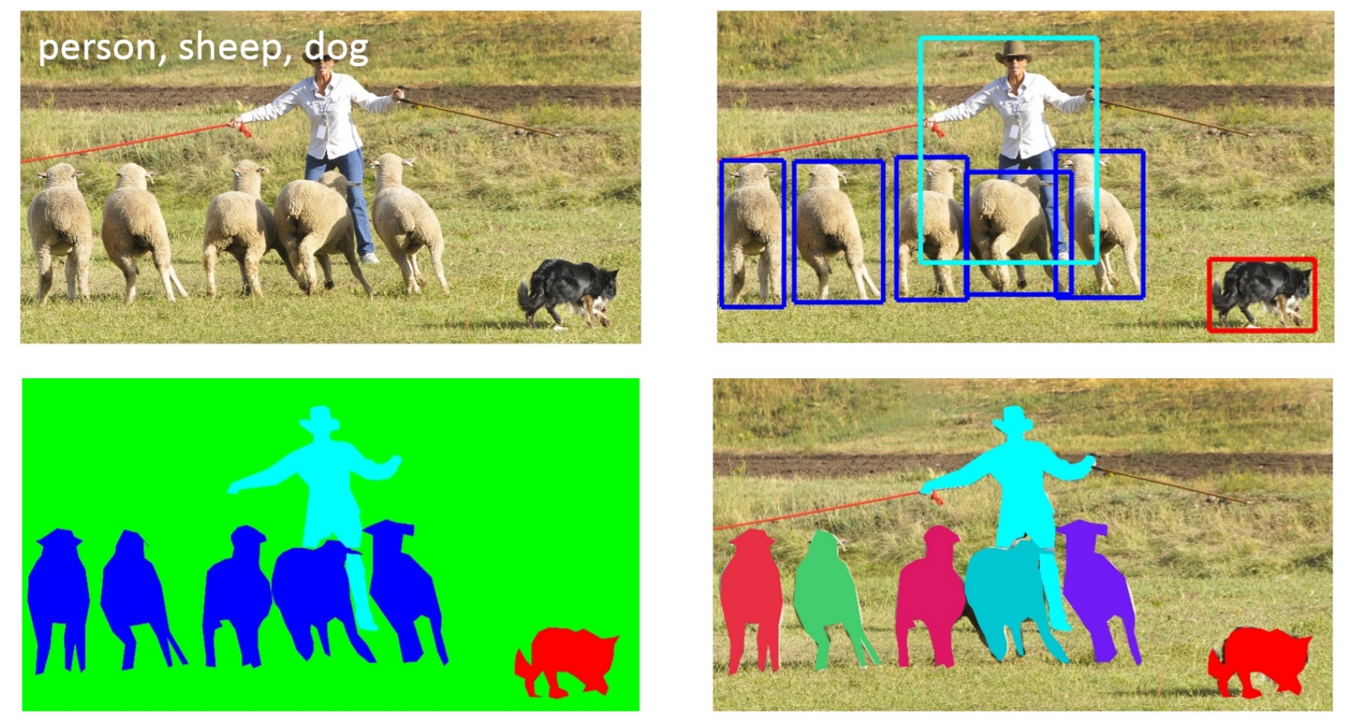
Why?
How?
Future
Why Using Pre-trained Models in CV?
Large-scale datasets laid the foundation of computer vision, but...
Annotations are expensive and subjective
The portion of unlabeled data is continuously growing with time
One cannot expect to collect sufficient data especially in rarely seen domains
Solution: pre-training on large data, then fine-tuning on small data
The ImageNet dataset^{[Deng, 2009]}
~15M images, ~21K categories, ~1.5TB
The MS-COCO dataset^{[Lin, 2014]}
detection, segmentation, pose estimation, etc.

Slide 4
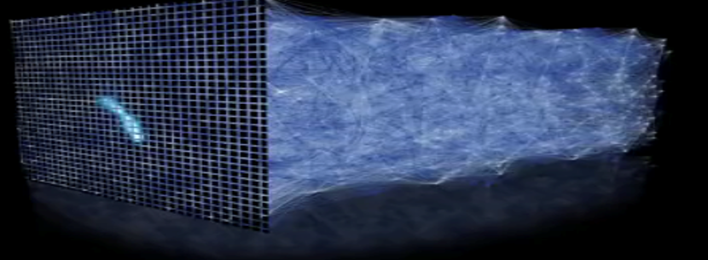
Why?
How?
Future
Why Using Pre-trained Models in CV?
Challenges of AI service: applications are fragmented
The key to pre-trained models: learning and extracting "knowledge"
The Application of AI (CV, NLP, etc.) Algorithms
Education
Energy
Vehicle
Communic.
Medicine
Traffic
Finance
Lightweight module
Pipeline 1
Pipeline 2
Pipeline 3
Pipeline 4
Pre-trained AI Models
Pipeline 5
Pipeline 6
Pipeline 7

Slide 5
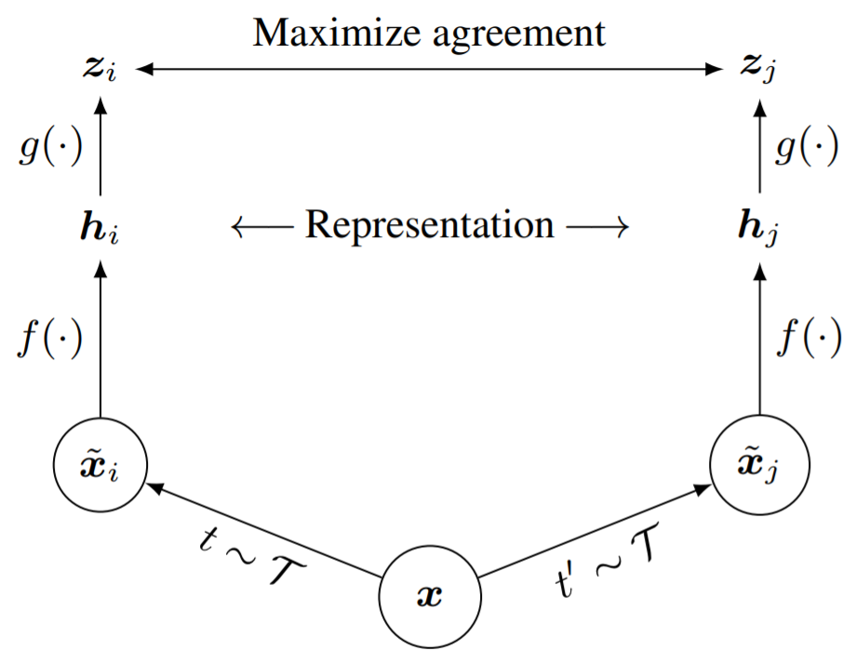
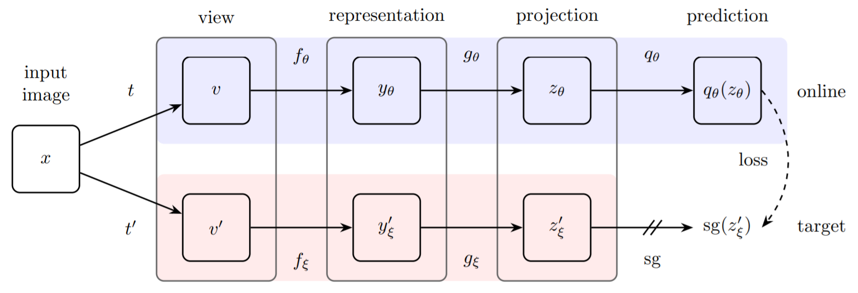
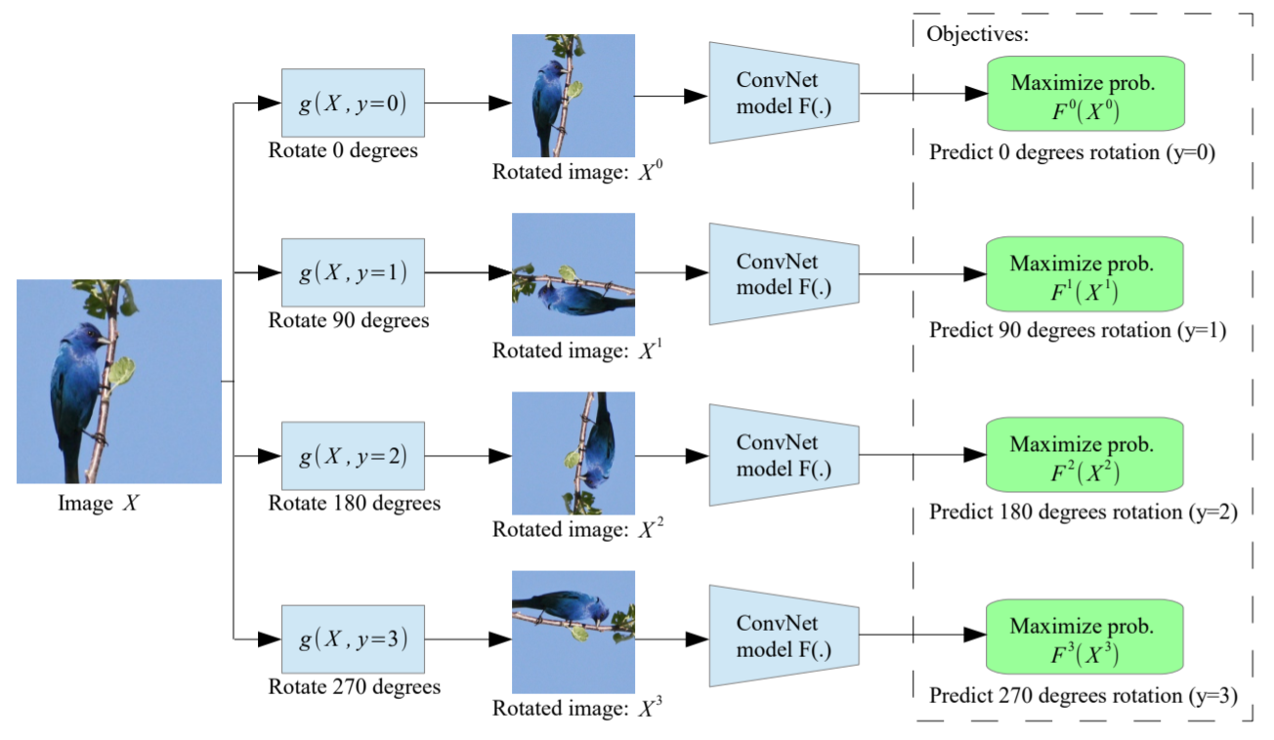
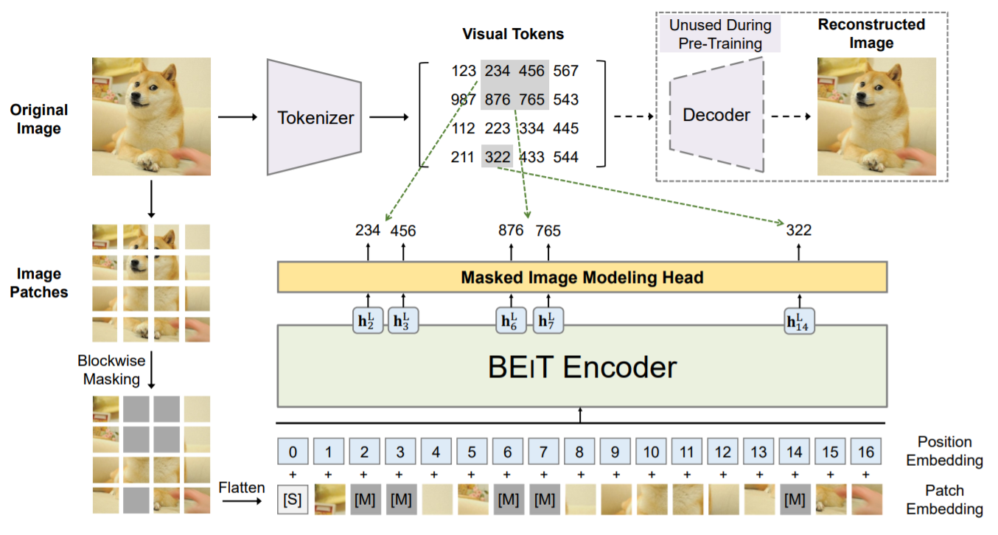
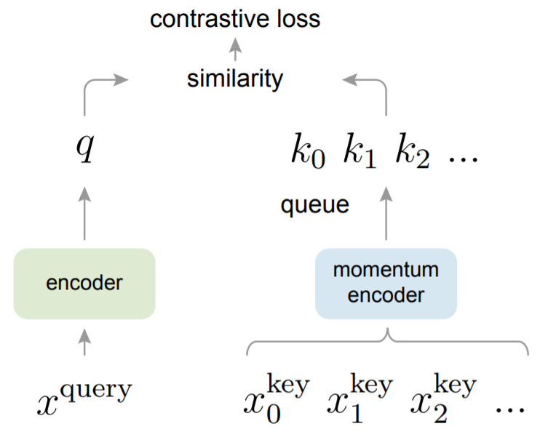
Why?
How?
Future
Review: Pre-training Methods in CV
Pre-training Algorithms in Computer Vision
Supervised Pre-training
Unsupervised Pre-training
Downstream Fine-tuning
Geometric learning^{[Noroozi, 2016][Gidaris, 2018]}
Contrastive learning^{[Chen, 2020][He, 2020]}
Predictive learning^{[Grill, 2020][Bao, 2021]}

Slide 6
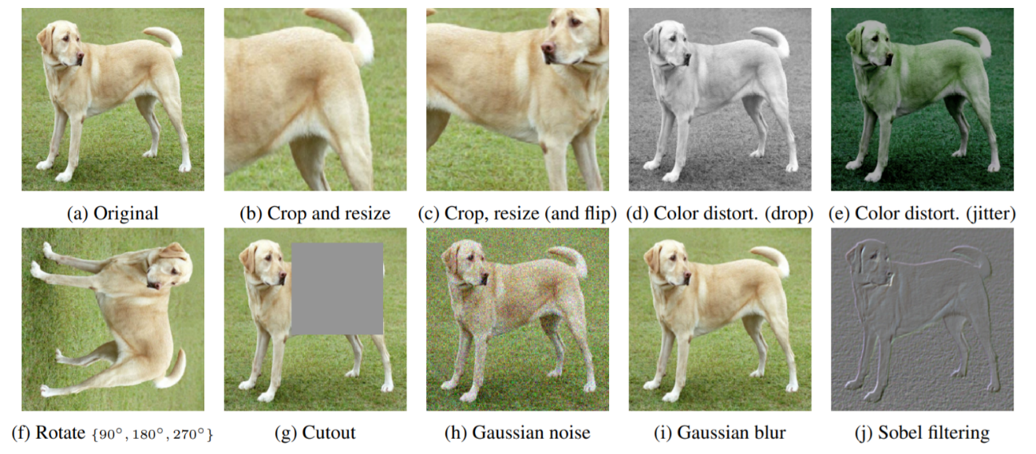
Why?
How?
Future
Is CV Pre-training Effective Enough?
The major properties of image signals?
Objectiveness: obtained from sensors, reflection of real-world appearance
Redundancy: low-frequency signals, relatively sparse semantic information
In comparison, linguistic signals are subjective and efficient
What is the key to state-of-the-art self-supervised learning algorithms?
Self-supervised learning benefits from priors
For contrastive/predictive learning, the prior mainly comes from intensive data augmentation
In comparison, the mask language modeling task is much more informative, but CV could not copy
Data augmentation plays a crucial role in contrastive learning^{[Chen, 2020]}

Slide 7
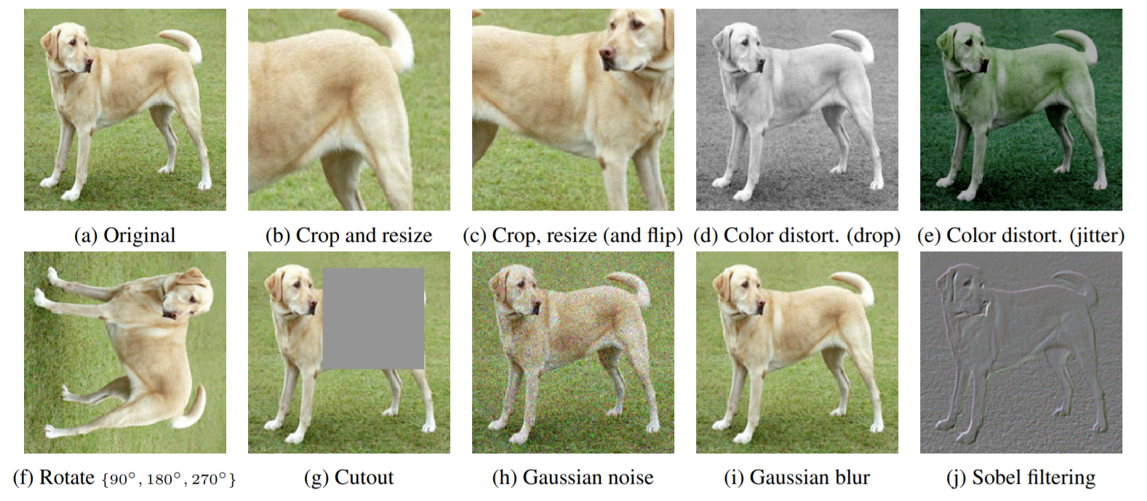
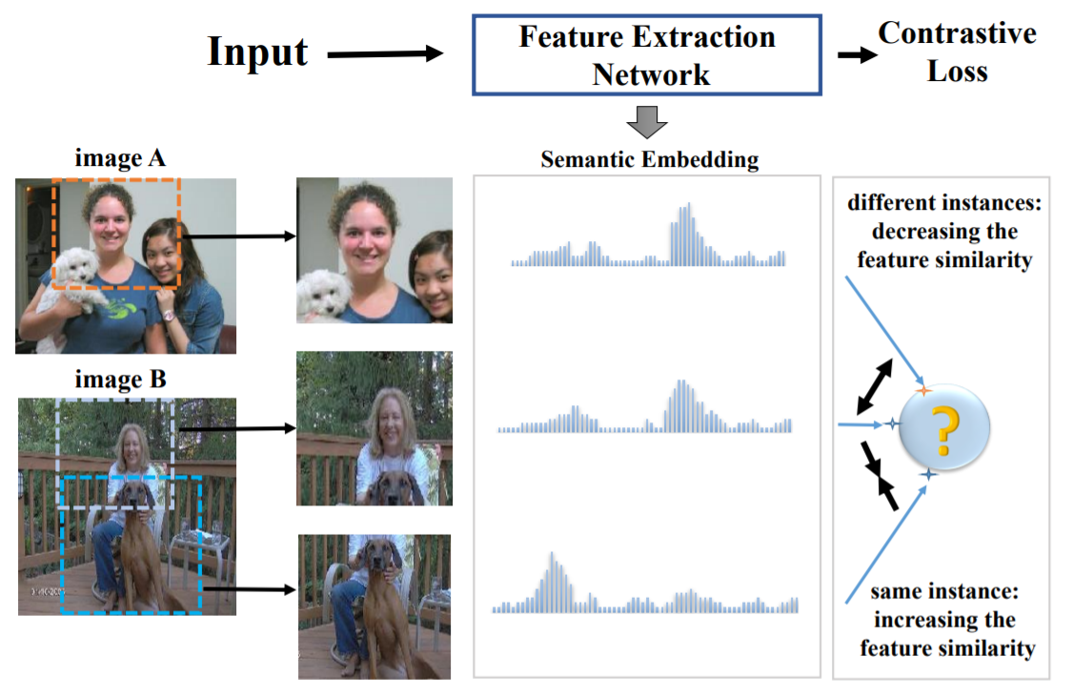
Why?
How?
Future
Overcoming the Weak Priors
Weak priors are insufficient for visual representation learning!
Information is sparse (efficiency is low), yet negative effect exists
Based on the above, we present three work
The unsupervised path: mining and adopting inter-sample similarities
The supervised path: alleviating the conflict brought by semantic labels
Learning-by-compression: a new paradigm of visual representation learning
Strong data augmentation^{[Chen, 2020]} may cause negative impacts to representation learning^{[Huo, 2021]}

Slide 8
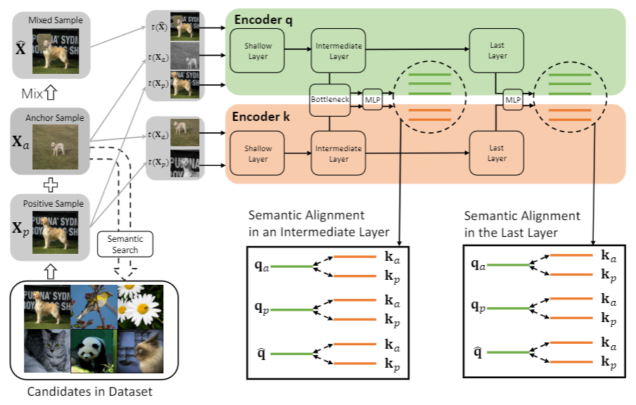
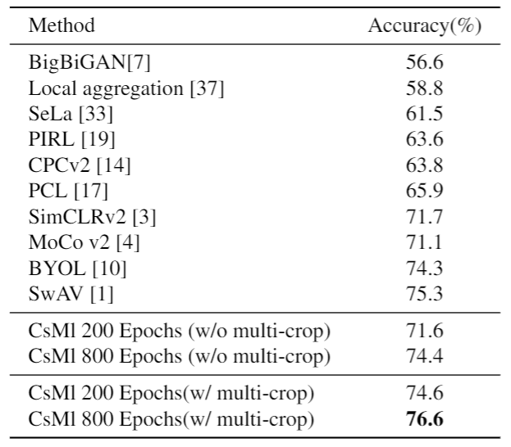
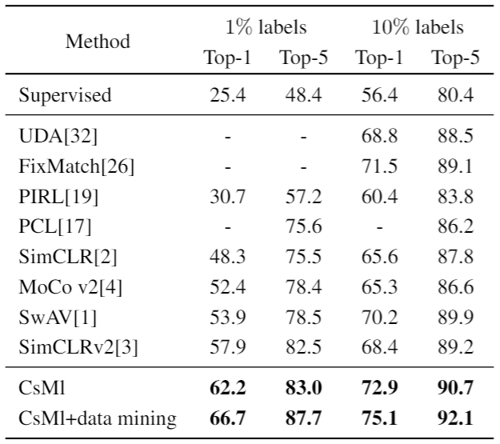
Why?
How?
Future
Solution: The Unsupervised Path
Observation: not all different samples are to be pushed away
This differs from the popular baselines, e.g. SimCLR^{[Chen, 2020]} and MoCo^{[He, 2020]}
Algorithm: building hierarchically mixed samples for semantic alignment
Effectiveness: state-of-the-art in linear test and semi-supervised learning
The proposed HSA framework^{[Xu, 2020]}
Linear test, ImageNet-1K
Semi-supervised test, ImageNet-1K
H. Xu et al., Seed the Views: Hierarchical Semantic Alignment for Contrastive Representation Learning, in arXiv preprint:2012.02733, 2020.

Slide 9
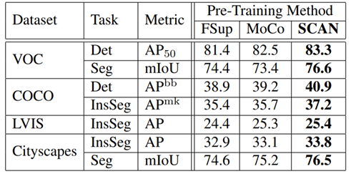
Why?
How?
Future
Solution: The Supervised Path
Observation: not all intra-class samples are to be pulled together
This differs from other methods, e.g. Supervised Contrastive Learning^{[Khosla, 2020]}
Algorithm: pulling the intra-class samples with most similar appearance
Effectiveness: consistent improvement on downstream tasks
The proposed SCAN framework^{[Wei, 2020]}
Downstream performance, various datasets
L. Wei et al., Can Semantic Labels Assist Self-Supervised Visual Representation Learning?, in arXiv preprint:2011.08621, 2020.

Slide 10
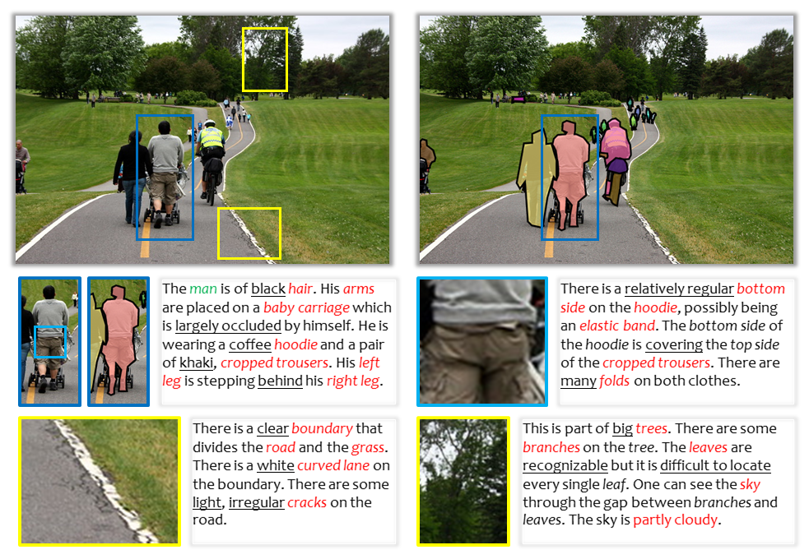
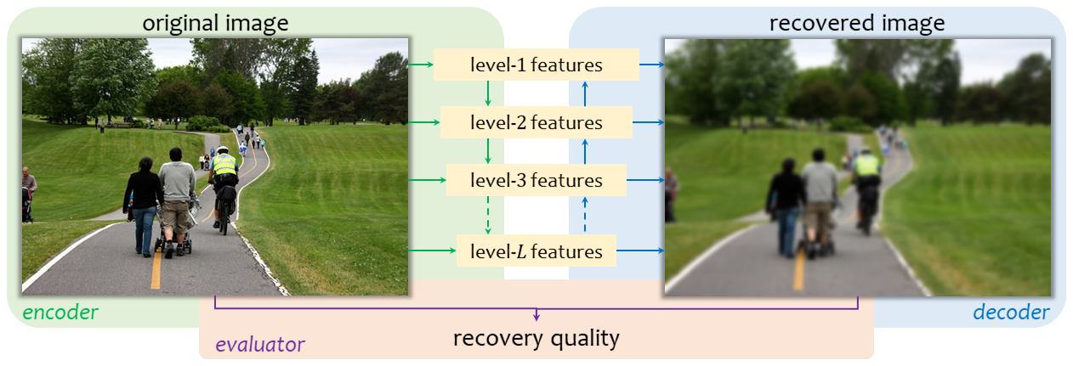
Why?
How?
Future
New: Pre-training as Data Compression
The annotation of currently available datasets are far from complete!
Even provided large amounts of time and budget, it is unlikely that every details can be labeled and then recognized
The learning-by-compression paradigm
Objective: minimizing the size of intermediate features (the description length), meanwhile preserving the quality of the recovered image
The difficulty lies in evaluation: a function that measures the quality of the recovered image
In MS-COCO^{[Lin, 2014]}, only a small portion of recognizable contents have been labeled
The learning-by-compression framework^{[Xie, 2021]} with the need of an evaluation function
L. Xie et al., What Is Considered Complete for Visual Recognition?, in arXiv preprint: 2105.13978, 2021.

Slide 11
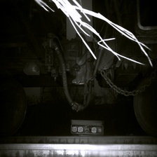
Why?
How?
Future
What Makes CV Landing Efficient?
Basic principles of landing CV algorithms
Note 1: the real-world scenarios can be wild (various domains, long-tailed distribution, etc.)
Note 2: one shall not expect to deliver a single model that works well forever
Solution: the full-life-cycle AI workflow
Pre-trained on ImageNet
Algo Flow
Automatically fine-tuning the extracted model on target data
Model Flow
Extracting models as needed, according to computation setting
Fine-tuned on various scenarios
Data Flow
Iterating the model based on long-tailed and/or novel cases
Diagnosis Flow
Returning reports for users

Slide 12
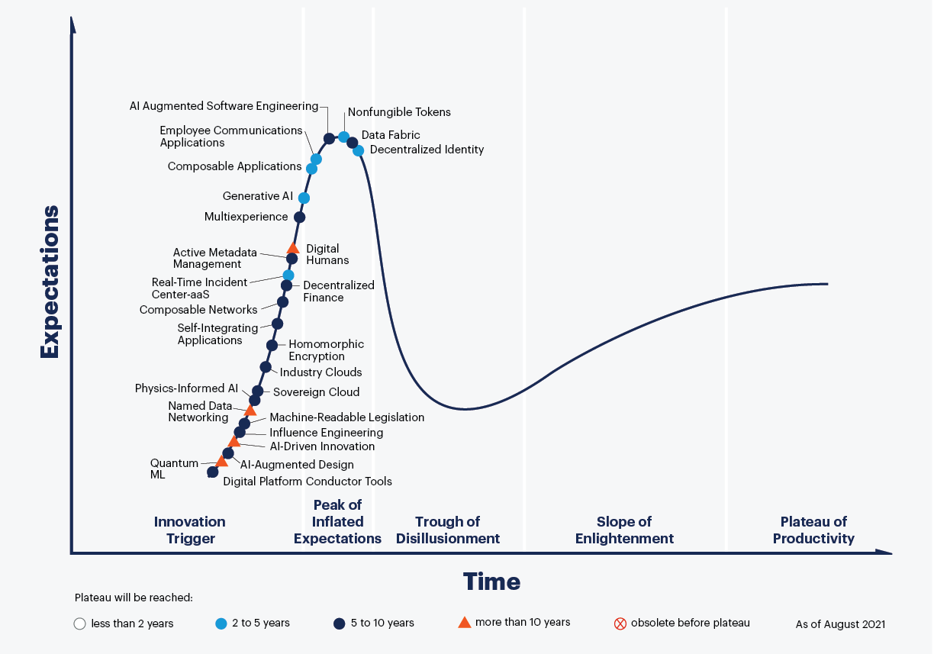
Why?
How?
Future
Looking into the Future
Where are we now? What may happen in the future?
The ability of CV algorithms
?
Is large-model here?
Large pre-trained deep networks, today
Is CV here?
AlexNet and other neural networks, 2012
Large-scale bag-of-visual-words (BOVW) classifiers, 2010
In ILSVRC 2012, XRCE/INRIA built an SVM with 1,000 classes and 1M feature dimensions, leading to 1 billion parameters!
SIFT and other local features, 1999
Time
The Gartner Hype Cycle 2021^{[Gartner'2021]}
Any new technology has to go through the Peak of Inflated Expectations, Trough of Disillusionment, Slope of Enlightenment, and arrive at the Plateau of Productivity
The Growth of CV Algorithms with Time
New technology comes as a major leap: the last leap (deep learning) happened in 2012, with the deep neural networks replacing the dominance of conventional large models!

Slide 13
Why?
How?
Future
Summary and Takeaways
AI has reached the level, and has the need of landing broadly
This is a challenging problem, arguably different from academic benchmarks
A promising direction: AI workflow based on pre-trained models
Pre-trained models are important, but many problems still exist
How to make use of vision data efficiently, e.g. alleviating semantic sparsity?
Is it possible to advance to the next stage through large pre-trained models?
Failure must be tolerated before a new success

Slide 14
References
[Gartner'2021] https://www.gartner.com/smarterwithgartner/3-themes-surface-in-the-2021-hype-cycle-for-emerging-technologies
[ILSVRC'2012] https://image-net.org/challenges/LSVRC/2012/
[Bao, 2021] H. Bao et al., BEiT: BERT Pre-training of Image Transformers, in arXiv preprint:2106.08254, 2021.
[Bu, 2021] X. Bu et al., GAIA: A Transfer Learning System of Object Detection that Fits Your Needs, in CVPR, 2021.
[Chen, 2020] T. Chen et al., A Simple Framework for Contrastive Learning of Visual Representations, in ICML, 2020.
[Deng, 2009] J. Deng et al., ImageNet: A Large-scale Hierarchical Image Database, in CVPR, 2009.
[Gidaris, 2018] S. Gidaris et al., Unsupervised Representation Learning by Predicting Image Rotations, in ICLR, 2018.
[Grill, 2020] J. B. Grill et al., Bootstrap Your Own Latent: A New Approach to Self-supervised Learning, in NeurIPS, 2020.
[He, 2020] K. He et al., Momentum Contrast for Unsupervised Visual Representation Learning, in CVPR, 2020.
[Huo, 2021] X. Huo et al., Heterogeneous Contrastive Learning: Encoding Spatial Information for Compact Visual Representations, in IEEE T-MM, 2021.
[Khosla, 2020] P. Khosla et al., Supervised Contrastive Learning, in NeurIPS, 2020.
[Krizhevsky, 2012] A. Krizhevsky et al., ImageNet Classification with Deep Convolutional Neural Networks, in NeurIPS, 2012.
[Lin, 2014] T. Y. Lin et al., Microsoft COCO: Common Objects in Context, in ECCV, 2014.
[Lowe, 2004] D. G. Lowe, Distinctive Image Features from Scale-invariant Keypoints, in IJCV, 2004.
[Noroozi, 2016] M. Noroozi et al., Unsupervised Learning of Visual Representations by Solving Jigsaw Puzzles, in ECCV, 2016.
[Wei, 2020] L. Wei et al., Can Semantic Labels Assist Self-Supervised Visual Representation Learning?, in arXiv preprint:2011.08621, 2020.
[Xie, 2021] L. Xie et al., What Is Considered Complete for Visual Recognition?, in arXiv preprint: 2105.13978, 2021.
[Xu, 2020] H. Xu et al., Seed the Views: Hierarchical Semantic Alignment for Contrastive Representation Learning, in arXiv preprint:2012.02733, 2020.

Slide 15
Thanks!
If you have any questions or want to open discussions on this talk, please contact me via: 198808xc@gmail.com

