Slide 1
Full-space & Hardware-friendly:
Towards the Next Generation of Neural Architecture Search
Lingxi Xie (谢凌曦)
Huawei Noah’s Ark Lab

Slide 2
Contents
What is Neural Architecture Search? Why is it important?
A generalized pipeline of Neural Architecture Search
Weight-Sharing Neural Architecture Search and the challenges
Our representative work on Neural Architecture Search
P-DARTS: bridging the gap between search and evaluation
PC-DARTS: NAS regularization and normalization
Stabilized-DARTS & GOLD-NAS: larger space, smaller optimization gap
LA-DARTS: introducing hardware constraints into differentiable NAS
Summary and future directions

Slide 3
Contents
What is Neural Architecture Search? Why is it important?
A generalized pipeline of Neural Architecture Search
Weight-Sharing Neural Architecture Search and the challenges
Our representative work on Neural Architecture Search
P-DARTS: bridging the gap between search and evaluation
PC-DARTS: NAS regularization and normalization
Stabilized-DARTS & GOLD-NAS: larger space, smaller optimization gap
LA-DARTS: introducing hardware constraints into differentiable NAS
Summary and future directions

Slide 4
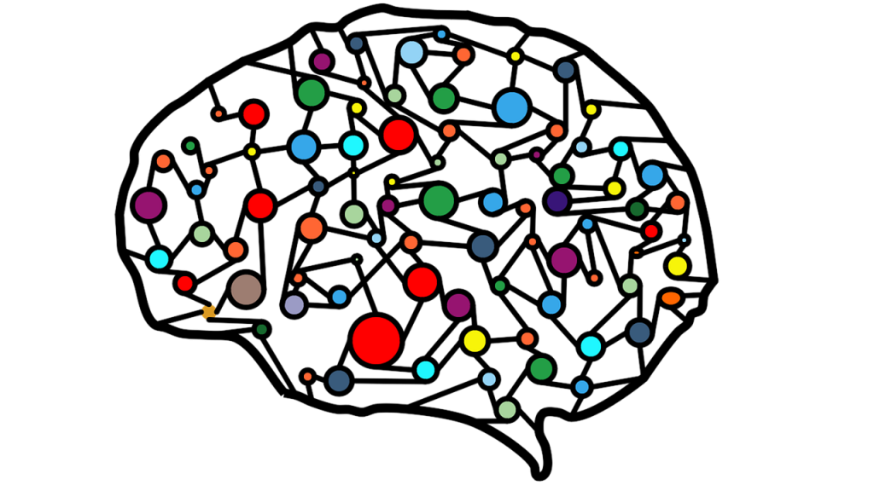
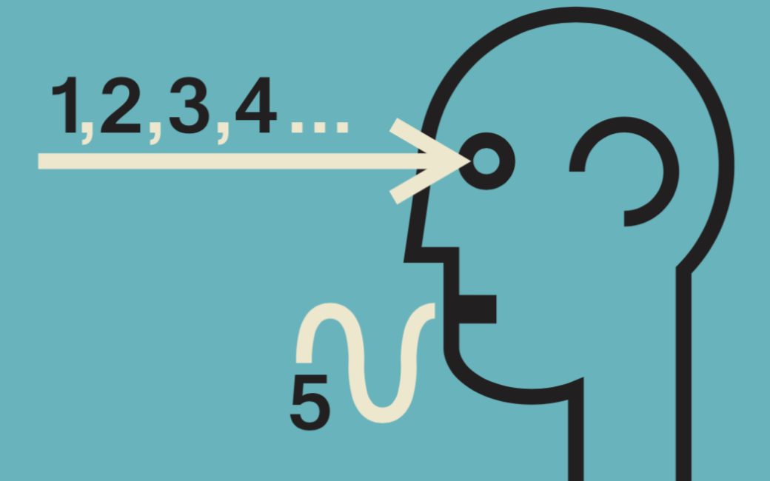
Current Challenges in AI
Three things are certain: data, model and knowledge
Data-efficiency: how to train models with limited or multi-modal data?
Auto-learning: how to design powerful and efficient models for AI applications?
Knowledge-aware: how to define and store knowledge, so that the trained models are secure and reliable?
Data Mining
Deep Learning
Common Sense

Slide 5
Current Challenges in AI
This talk focuses on the second, training powerful models
There is a debate on whether to use manually or automatically designed models
There emerges a new direction named automated machine learning (AutoML), pushing the field to go one step further towards discarding human expertise
In particular, AutoML is an intriguing technique for the industry
Data Mining
Deep Learning
Common Sense

Slide 6
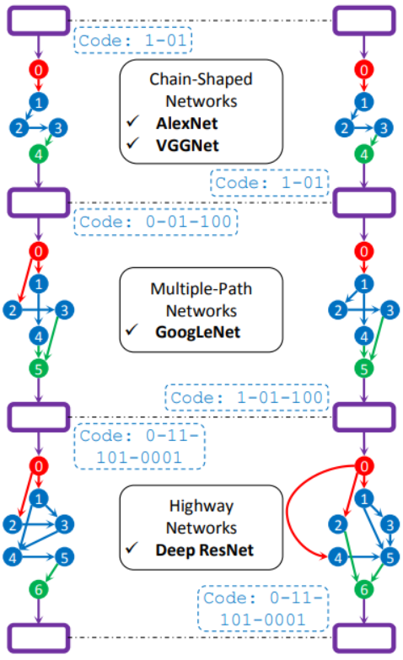
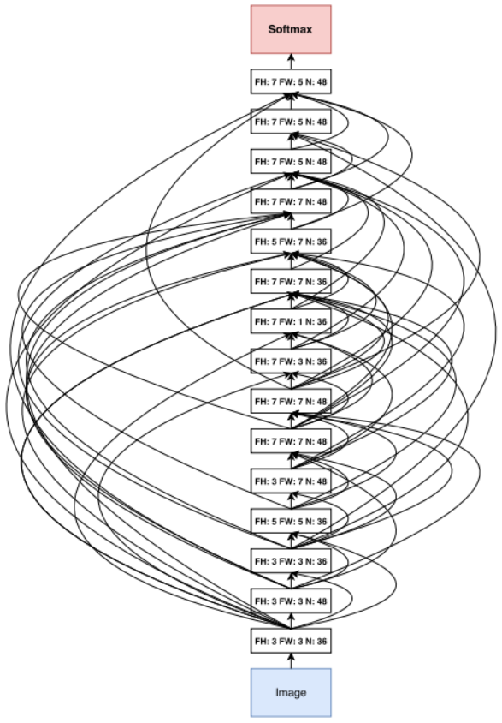
Introduction to Neural Architecture Search (NAS)
A sub-field in AutoML
Instead of manually designing neural networks, exploring the possibility of discovering unexplored architectures with automated algorithms
?
2015
2016
2017
2018
2019
2020

Slide 7
Introduction to Neural Architecture Search (NAS)
In resource-constrained image classification, NAS has achieved much better performance than manually designed approaches
Architecture | Accuracy | Params | Design | Year
SENet | 82.7% | 146M | manual | 2017
NASNet-A | 82.7% | 89M | automated | 2018
AmoebaNet-C | 83.5% | 155M | automated | 2018
Gpipe | 84.3% | 557M | automated | 2019
EfficientNet | 84.4% | 66M | automated | 2019
EffNet+RandAug | 85.0% | 66M | automated | 2019
EffNet+AdvProp | 85.5% | 88M | automated | 2019
EffNet+Ours | 85.8% | 88M | automated | 2020
ImageNet: the basic recognition task in the regular setting (FLOPs not constrained)
Accuracy: top-1
Params: # of parameters
L. Wei et al., Circumventing Outliers of AutoAugment with Knowledge Distillation, ECCV, 2020.

Slide 8
Introduction to Neural Architecture Search (NAS)
In resource-constrained image classification, NAS has achieved much better performance than manually designed approaches
Architecture | Accuracy | FLOPs | Design | Year
MobileNet-v1 | 70.6% | 569M | manual | 2017
ShuffleNet-v2 | 74.9% | 591M | manual | 2018
ProxylessNAS | 75.1% | 465M | automated | 2019
PC-DARTS | 75.8% | 597M | automated | 2019
MobileNet-v3 | 76.6% | 356M | automated | 2019
MixNet | 78.9% | 565M | automated | 2019
OFANet | 80.0% | 595M | automated | 2020
Ours (ongoing) | 80.0% | 590M | automated | 2020
ImageNet: the basic recognition task in the mobile setting (FLOPs not larger than 600M)
Accuracy: top-1
FLOPs: # of mult-add operations
Z. Chen et al., Network Adjustment: Channel Search Guided by FLOPs Utilization Ratio, CVPR, 2020.
L. Wei et al., Circumventing Outliers of AutoAugment with Knowledge Distillation, ECCV, 2020.

Slide 9
Contents
What is Neural Architecture Search? Why is it important?
A generalized pipeline of Neural Architecture Search
Weight-Sharing Neural Architecture Search and the challenges
Our representative work on Neural Architecture Search
P-DARTS: bridging the gap between search and evaluation
PC-DARTS: NAS regularization and normalization
Stabilized-DARTS & GOLD-NAS: larger space, smaller optimization gap
LA-DARTS: introducing hardware constraints into differentiable NAS
Summary and future directions

Slide 10
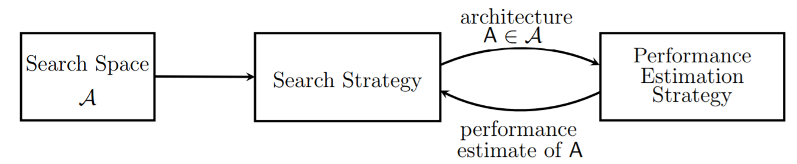
The Pipeline of Neural Architecture Search (NAS)
Almost all NAS approaches are based on “trial and update”
Step 1: define a search space with a large number of candidates
Step 2: sample one or a few architectures from the space
Step 3: evaluate the sampled architectures and update the best one
Step 4: adjust the sampling parameters with the evaluation results
Step 5: repeat Steps 2-4 until end

Slide 11
The Pipeline of Neural Architecture Search (NAS)
Almost all NAS approaches are based on “trial and update”
Three fundamental elements in this pipeline
Search space: which kind of architectures can be found?
Search strategy: how to sample architectures from the space?
Evaluation method: how to evaluate a sampled architecture?
Search Space
Search Strategy
Evaluation Method

Slide 12
The Pipeline: Search Space
Search space: which kind of architectures can be found?
Option 1: open or closed?
Option 2: cell-based or not?
Option 3: a large operation set?
Search Space
Search Strategy
Evaluation Method

Slide 13
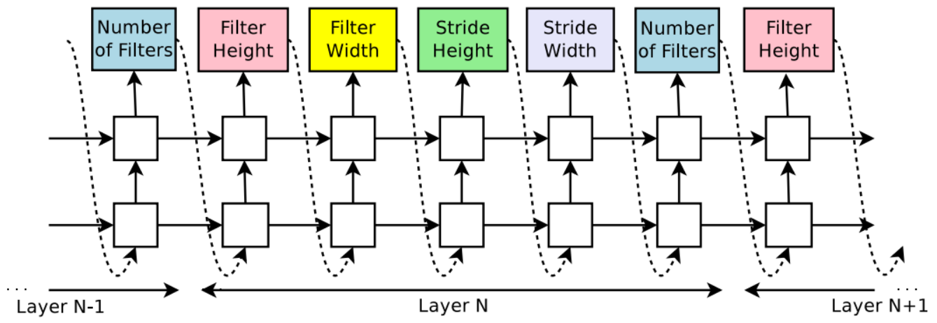
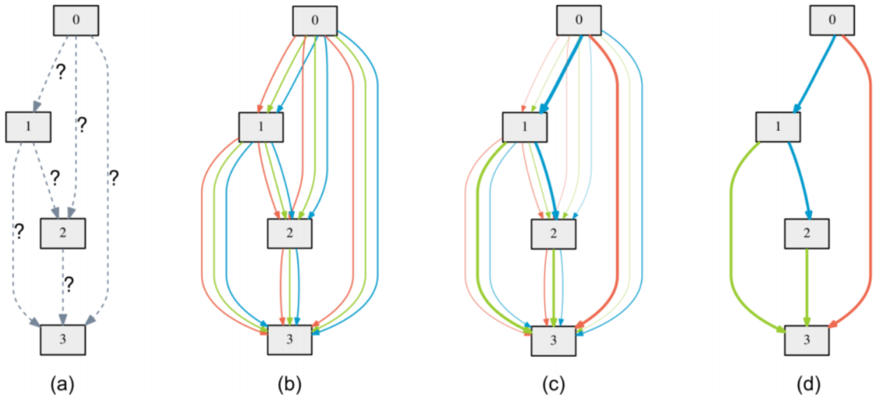
The Pipeline: Search Strategy
Search strategy: how to sample architectures from the space?
Option: individual or weight-sharing?
Search Space
Search Strategy
Evaluation Method

Slide 14
The Pipeline: Search Strategy
Evaluation method: how to evaluate a sampled architecture?
Highly associated to search strategy: individual or weight-sharing?
Search Space
Search Strategy
Evaluation Method

Slide 15
Contents
What is Neural Architecture Search? Why is it important?
A generalized pipeline of Neural Architecture Search
Weight-Sharing Neural Architecture Search and the challenges
Our representative work on Neural Architecture Search
P-DARTS: bridging the gap between search and evaluation
PC-DARTS: NAS regularization and normalization
Stabilized-DARTS & GOLD-NAS: larger space, smaller optimization gap
LA-DARTS: introducing hardware constraints into differentiable NAS
Summary and future directions

Slide 16
The Key Lies in Search Efficiency
A naïve search method: every time, choosing an uncovered architecture and evaluating its performance
Problem: unbearably slow (e.g., thousands of GPU-days for a single search)
Solution: sharing computation between sampled architectures
This reduces the cost of a single search to less than one GPU-day
But, a new problem: weight-sharing introduces (large?) approximation

Slide 17
Hence, There Are Two Mainstreams of NAS
Individual NAS approaches: individual search and evaluation
Pros: the search pipeline is relatively flexible; it is easier to perform multi-target optimization; search and evaluation are decoupled and thus more stable
Cons: the search process is time-consuming
Weight-sharing NAS approaches: joint search and evaluation
Pros: the search process is computationally efficient
Cons: the approximation introduces instability to the search process
Our research mainly focuses on weight-sharing NAS

Slide 18
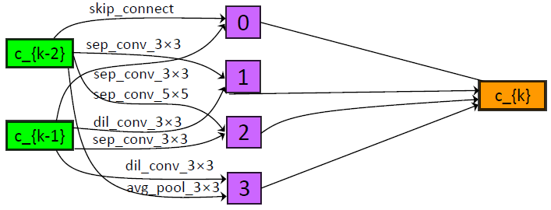
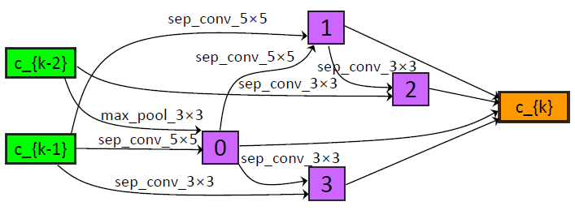
In Particular, Differentiable NAS (DARTS, 2019)
A cell-based search space
Repeatable cells, the number of cells is adjustable
input
output
Normal
Cell
Reduction
Cell
Normal
Cell
Reduction
Cell
Normal
Cell
$$×N$$
$$×N$$
$$×N$$

Slide 19
In Particular, Differentiable NAS (DARTS, 2019)
A cell-based search space
Repeatable cells, the number of cells is adjustable
Within each cell, there is a directed acyclic graph (DAG)
All operators can appear in each edge, with a weighted sum
Architecture search turns into a problem of continuous optimization
The dominant operators are preserved and the architecture is determined
Normal
Cell
H. Liu et al., DARTS: Differentiable Architecture Search, ICLR, 2019.

Slide 20
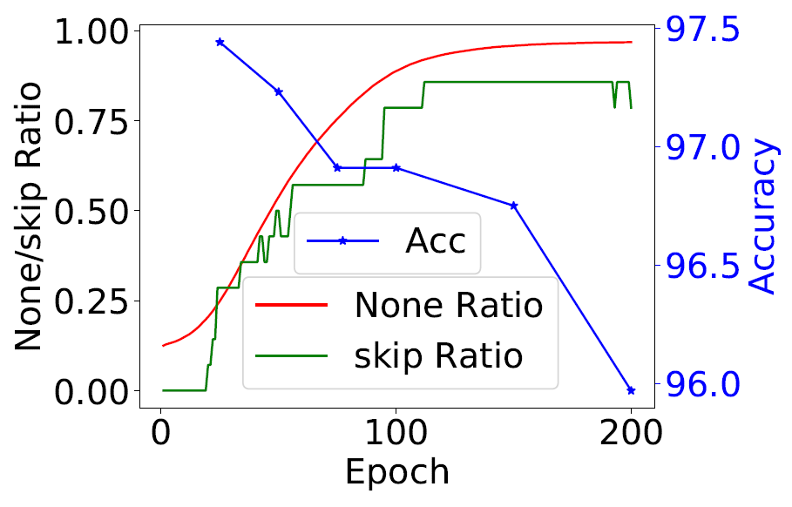
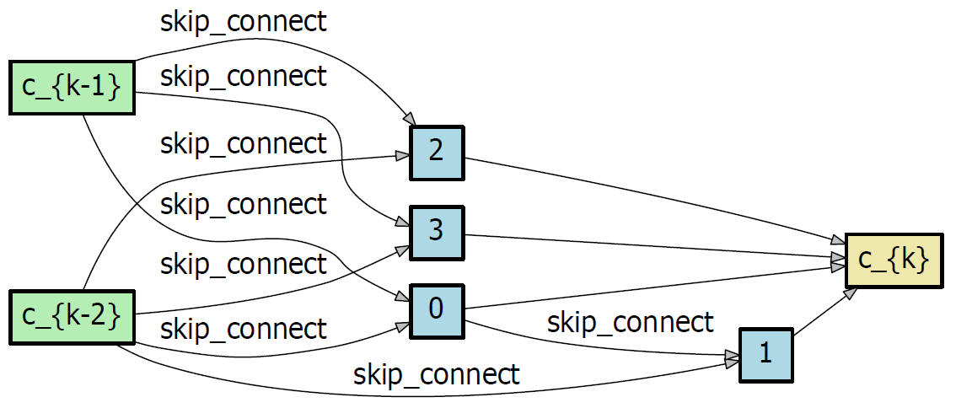
The Essence of DARTS, and Its Drawbacks
Training a super-network to approximate sub-networks
Assumption: a well-optimized super-network can produce good sub-networks
But, the assumption does not necessarily hold: there may exist a large “optimization gap” between the super-network and sub-networks
An extreme case: search collapse, in which all edges in the super-network are dominated by skip-connect, a weak operator, yet the validation accuracy of the super-network is still very high
Current solution: early termination, which makes the search result quite uncertain
H. Liang et al., DARTS+: Improved Differentiable Architecture Search with Early Stopping, arXiv: 1909.06035, 2019.
K. Bi et al., Stabilizing DARTS with Amended Gradient Estimation on Architectural Parameters, arXiv: 1910.11831, 2019.

Slide 21
Contents
What is Neural Architecture Search? Why is it important?
A generalized pipeline of Neural Architecture Search
Weight-Sharing Neural Architecture Search and the challenges
Our representative work on Neural Architecture Search
P-DARTS: bridging the gap between search and evaluation
PC-DARTS: NAS regularization and normalization
Stabilized-DARTS & GOLD-NAS: larger space, smaller optimization gap
LA-DARTS: introducing hardware constraints into differentiable NAS
Summary and future directions

Slide 22
P-DARTS: Overview
We focus on a specific aspect of the “optimization gap”
Observation: the search process is performed on a shallow architecture, but the evaluation process is performed on a deep architecture
The “depth gap”: the best configuration in a shallow architecture does not necessarily work well in a deep architecture
Our solution: progressively increasing the search depth
Two useful techniques: search space approximation and search space regularization
Nice results on standard image classification benchmarks
Large improvement beyond DARTS, on both CIFAR10/CIFAR100 and ImageNet
Search cost as small as 0.3 GPU-days (7 hours on a single GPU)
X. Chen et al., Progressive Differentiable Architecture Search: Bridging the Depth Gap between Search and Evaluation, ICCV, 2019.

Slide 23
P-DARTS: Bridging the Depth Gap
The original solution: training on shallow, evaluation on deep
Our solution: closing up the depth gap progressively, during search
Details: why not directly searching on a deep architecture (20 cells)?
A deep super-network is computationally inefficient
Directly searching on a very deep architecture
20 cells
20 cells
20 cells
14 cells
8 cells
8 cells
search
evaluation
search
evaluation
DARTS: CIFAR10 test error 2.83%
P-DARTS: CIFAR10 test error 2.55%

Slide 24
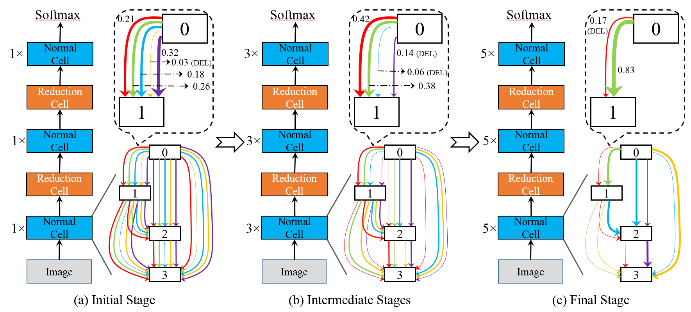
P-DARTS: The Overall Pipeline
Search space approximation to reduce search costs
We prune a part of weak edges each time we increase the super-network depth

Slide 25
P-DARTS: The Optimization Tricks
Searching on deep networks finds many skip-connect operators
Essence: the unfairness among different operators
On the one hand, skip-connect often leads to fastest gradient descent
On the other hand, skip-connect does not have parameters and so performs bad
Our solution: search space regularization
Adding a dropout after each skip-connect during the search process
Preserving a fixed number of skip-connect operators after the entire search
Results
Accuracy on CIFAR10 | # skip-connect preserved
Search space regularization | 2 | 3 | 4
w/o dropout on skip-connect | 97.07% | 96.72% | 96.49%
w/ dropout on skip-connect | 97.31% | 97.16% | 97.03%

Slide 26
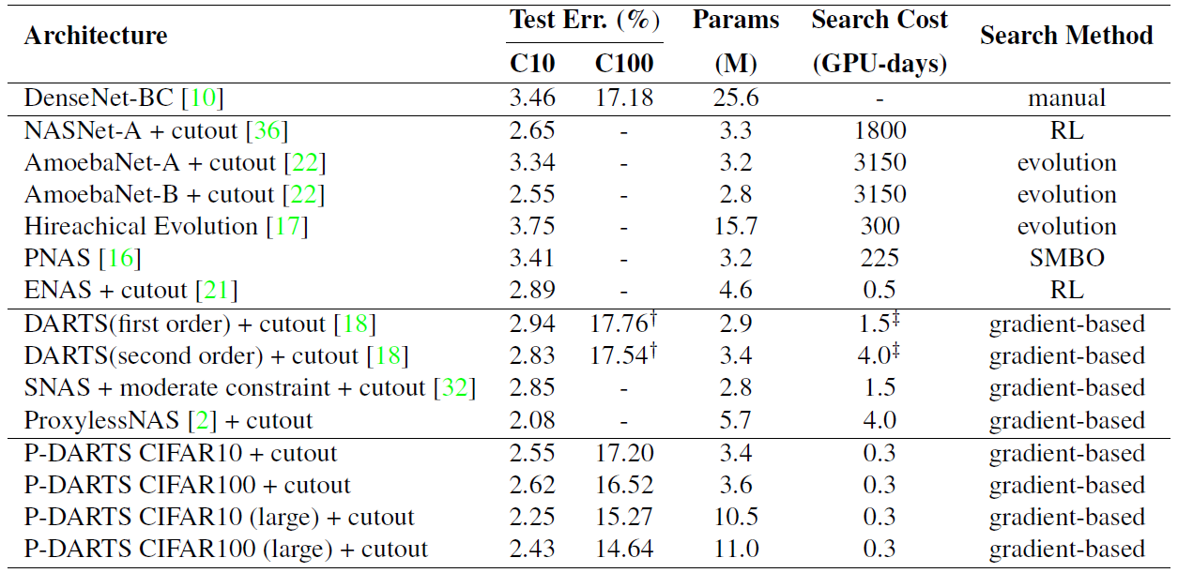
P-DARTS: Evaluation Performance on CIFAR10/100
Better performance and search efficiency, compared to DARTS
2.55% vs. 2.94% error rate (CIFAR10), 0.3 vs. 4.0 GPU-days of search time

Slide 27
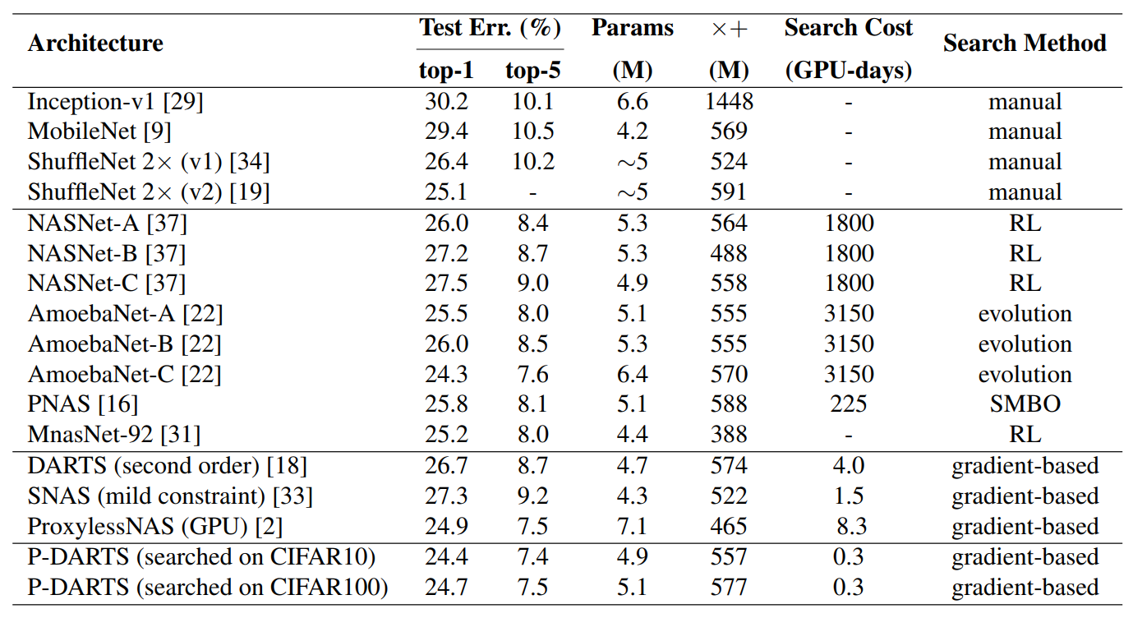
P-DARTS: Evaluation Performance on ImageNet
Better performance and search efficiency, compared to DARTS
24.4% vs. 26.7% error rate, 0.3 vs. 4.0 GPU-days of search time

Slide 28
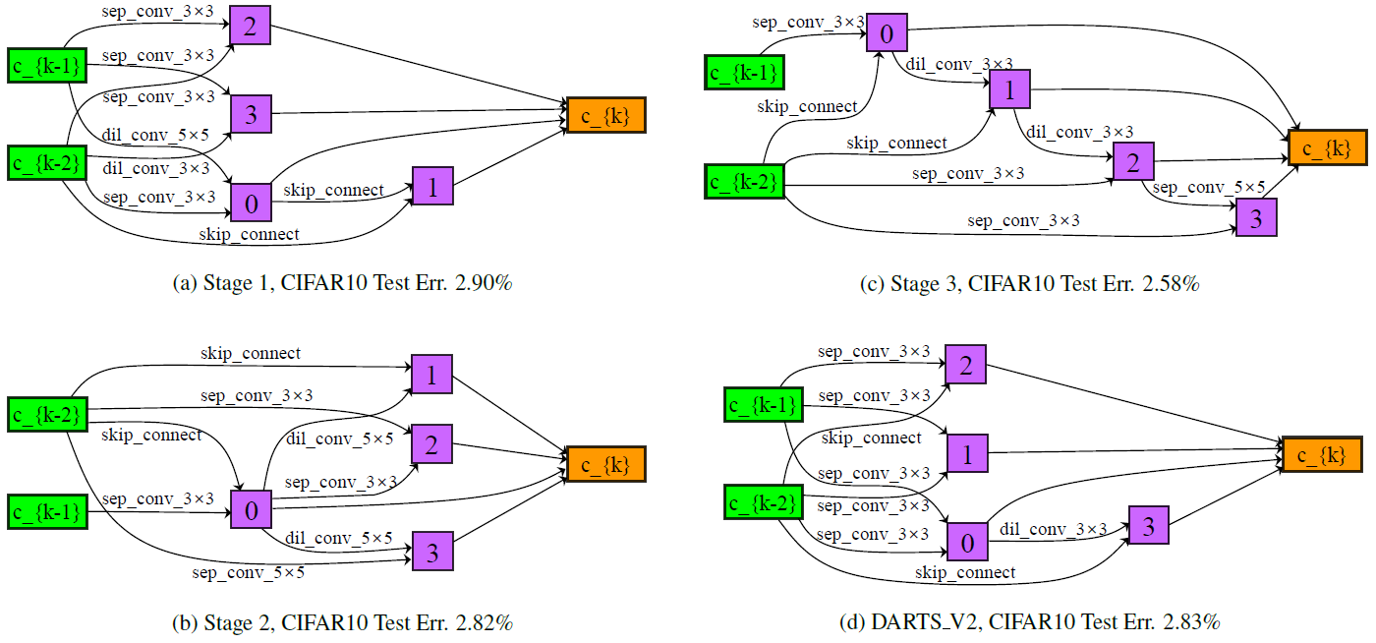
P-DARTS: Searched Architecture in Cells
Much deeper architecture, compared to DARTS
The existence of the depth gap is verified!

Slide 29
Contents
What is Neural Architecture Search? Why is it important?
A generalized pipeline of Neural Architecture Search
Weight-Sharing Neural Architecture Search and the challenges
Our representative work on Neural Architecture Search
P-DARTS: bridging the gap between search and evaluation
PC-DARTS: NAS regularization and normalization
Stabilized-DARTS & GOLD-NAS: larger space, smaller optimization gap
LA-DARTS: introducing hardware constraints into differentiable NAS
Summary and future directions

Slide 30
PC-DARTS: Overview
We focus on another aspect of the “optimization gap”
Observation: the super-network can easily fit the training data, but the pruned sub-networks may not inherit the ability of the super-network
The “over-fitting issue”: the best super-network does not necessarily produce the best sub-network after pruning
Our solution: randomly sampling a part of super-network channels
A side benefit: accelerating the search process
Nice results on standard image classification benchmarks
Large improvement beyond DARTS, on both CIFAR10 and ImageNet
Search cost as small as 0.06 GPU-days (1.5 hours on a single GPU)
Y. Xu et al., PC-DARTS: Partial Channel Connections for Memory-Efficient Differentiable Architecture Search, ICLR, 2020.

Slide 31
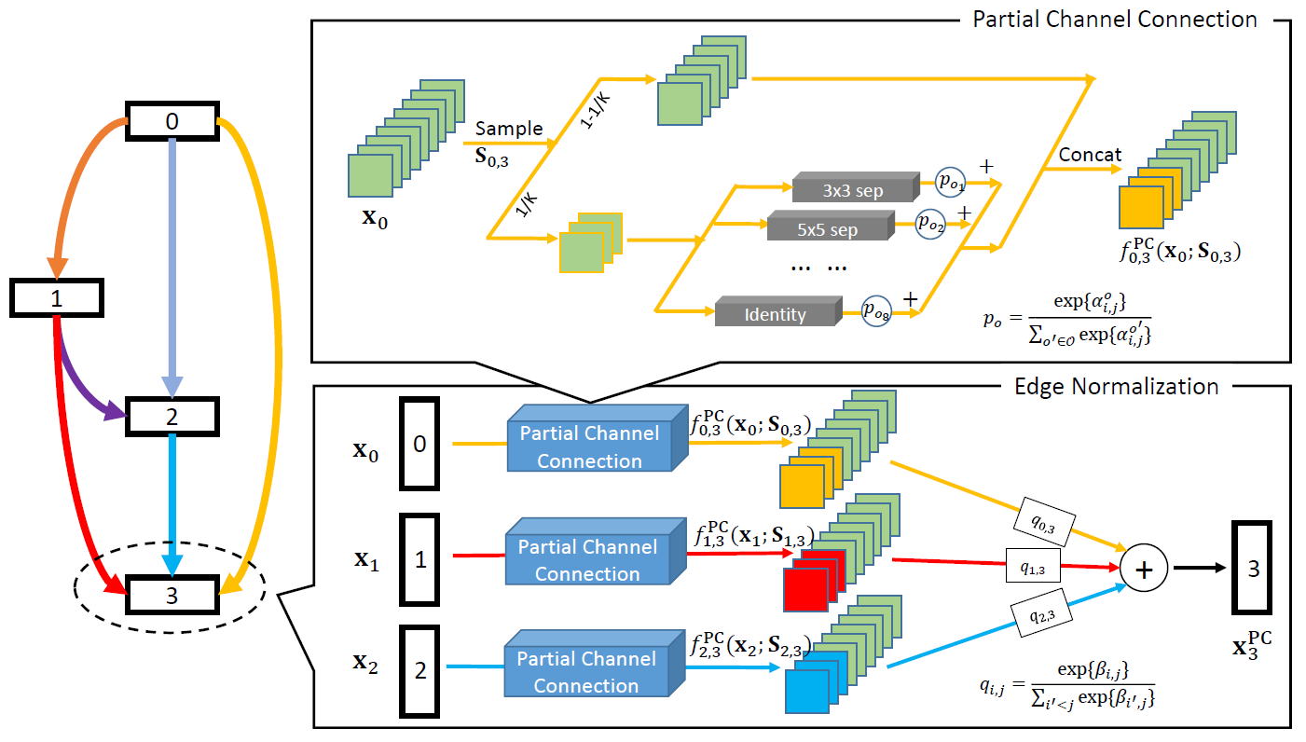
PC-DARTS: The Overall Pipeline
Partial channel connection for regularization
We propose edge normalization which stabilizes the search process

Slide 32
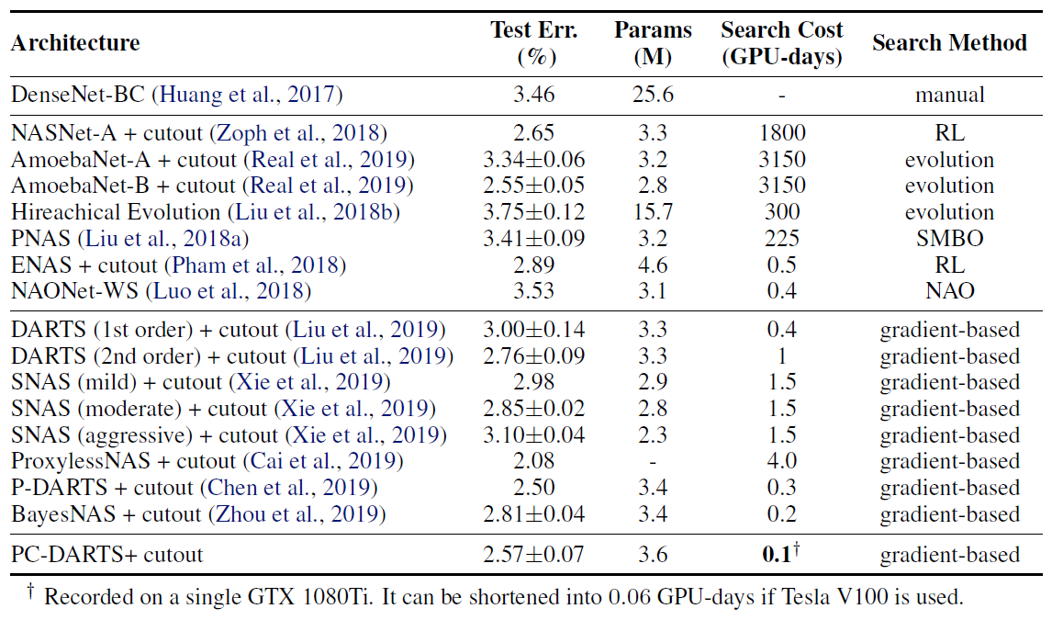
PC-DARTS: Evaluation Performance on CIFAR10
Better accuracy compared to DARTS (error: 2.57% vs. 2.76%)
Extremely fast search speed (0.06 GPU-days)

Slide 33
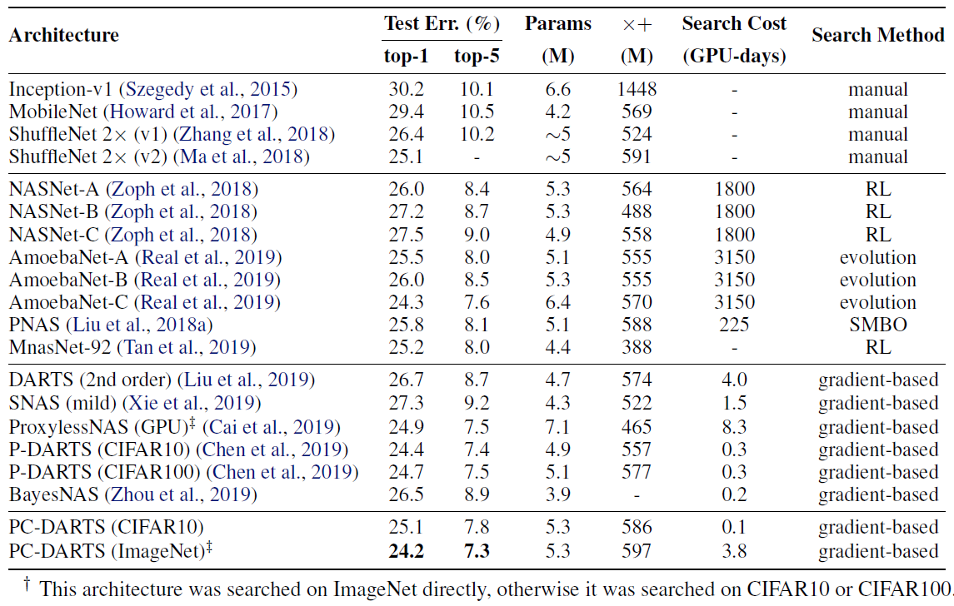
PC-DARTS: Evaluation Performance on ImageNet
State-of-the-art accuracy in the DARTS search space
Directly search on ImageNet, requiring only 3.8 GPU-days

Slide 34
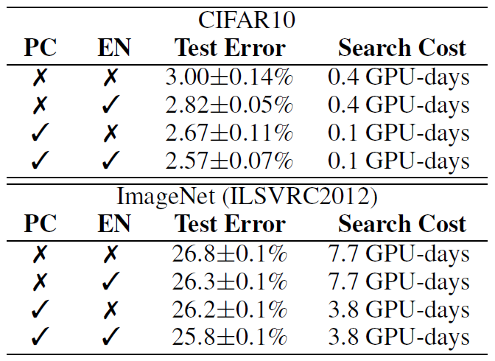
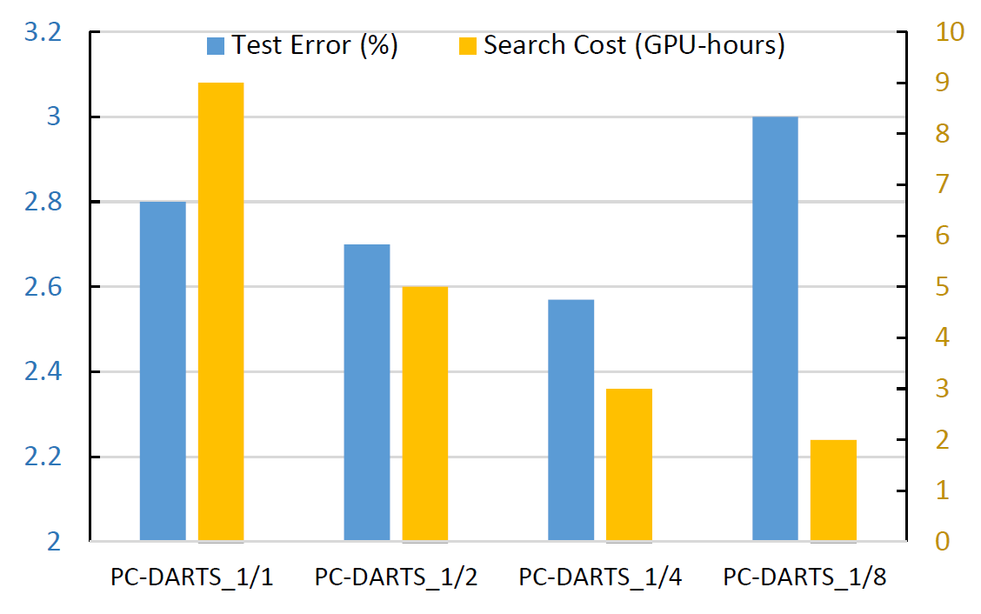
PC-DARTS: Ablation Studies
Edge normalization improves search stability
It also works well in other DARTS-based approaches (e.g., the original DARTS)
There is a tradeoff between search efficiency and accuracy
Most often, a large dataset requires richer information to be sampled

Slide 35
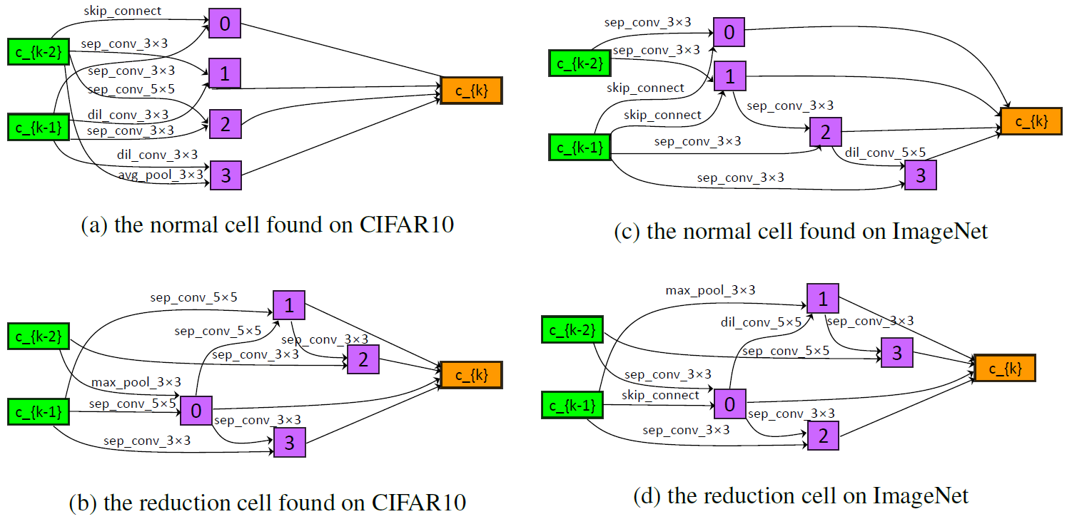
PC-DARTS: Searched Architecture in Cells
Different cells searched from CIFAR10 and ImageNet
ImageNet-searched cells are much deeper

Slide 36
Contents
What is Neural Architecture Search? Why is it important?
A generalized pipeline of Neural Architecture Search
Weight-Sharing Neural Architecture Search and the challenges
Our representative work on Neural Architecture Search
P-DARTS: bridging the gap between search and evaluation
PC-DARTS: NAS regularization and normalization
Stabilized-DARTS & GOLD-NAS: larger space, smaller optimization gap
LA-DARTS: introducing hardware constraints into differentiable NAS
Summary and future directions

Slide 37
Stabilized-DARTS: Overview
We deal with the “optimization gap” in mathematics
An important key lies in the approximation error of gradient computation
To shrink the gap, we apply a better estimation of the architectural gradients
Our approach achieves stabilized search performance
It works on a very large search space, on which previous work mostly failed
K. Bi et al., Stabilizing DARTS with Amended Gradient Estimation on Architectural Parameters, arXiv: 1910.11831, 2019.

Slide 38
Stabilized-DARTS: Search Instability
We deal with a critical issue that causes instability of DARTS
DARTS, when trained for sufficiently long, converges to dramatically bad results, e.g. all preserved operators are skip-connect
We find out that the main reason and propose a practical solution to alleviate the instability
It requires similar computational overhead as the second-order version of DARTS
It produces stable results when the search arrives at convergence
It enables very large search space to be explored
H. Liang et al., DARTS+: Improved Differentiable Architecture Search with Early Stopping, arXiv: 1909.06035, 2019.
K. Bi et al., Stabilizing DARTS with Amended Gradient Estimation on Architectural Parameters, arXiv: 1910.11831, 2019.

Slide 39
The Reason for Search Instability?
Bi-level optimization is the major reason
DARTS requires updating the network weights, $ω$, and the architectural parameters, $α$, alternately, so it needs to compute $∇_{α}ℒ_{val}\left(ω^{⋆}\left(α\right),α\right)|_{α=α_{t}}=$ $∇_{α}ℒ_{val}\left(ω,α\right)|_{ω=ω^{⋆}\left(α_{t}\right),α=α_{t}}+∇_{α}ω^{⋆}\left(α\right)|_{α=α_{t}}∙∇_{ω}ℒ_{val}\left(ω,α\right)|_{ω=ω^{⋆}\left(α_{t}\right),α=α_{t}}$
$∇_{α}ω^{⋆}\left(α\right)|_{α=α_{t}}$ is very difficult to compute, so it makes a dramatic approximation that cannot even guarantee the right direction of optimization
Solution: a better approximation
With a slight modification, we make sure that the direction is correct (although the approximation error is still expected to be large)
This allows us to extend the search space (all cells in DARTS can be different)
H. Liang et al., DARTS+: Improved Differentiable Architecture Search with Early Stopping, arXiv: 1909.06035, 2019.
K. Bi et al., Stabilizing DARTS with Amended Gradient Estimation on Architectural Parameters, arXiv: 1910.11831, 2019.

Slide 40
GOLD-NAS: Overview
Why don’t we rethink the existing differentiable search method?
A lot of hand-designed rules apply: hard constraints, limiting the search flexibility, prone to optimization gap
Bi-level optimization: instable, difficult to generalize to a large search space
Our solution: a large space with a new search framework
An enlarged search space: most constraints are released
One-level optimization: no approximation burden, more stable
Gradual pruning: a better way to reduce the discretization error
Result: fast, stable, and flexible search
One search procedure, a set of Pareto-optimal architectures
Good performance on CIFAR10 and ImageNet
K. Bi et al., GOLD-NAS: Gradual, One-Level, Differentiable, arXiv: 2007.03331, 2020.

Slide 41
GOLD-NAS: Search Space Design
Discarding most rules that DARTS has used
All cells of the same type can be individually designed
Each node can be connected to an arbitrary number of precursors
Each edge can preserve multiple operators (softmax replaced by sigmoid)
The search space becomes much larger
The flexible configuration leads to higher computational efficiency

Slide 42
GOLD-NAS: One-Level Optimization
Why not using bi-level optimization?
Bi-level optimization suffers gradient approximation errors, which will become much larger in the enlarged space and make the search procedure unstable
But, DARTS has argued that one-level optimization does not work
The reason that one-level optimization fails
Similar to over-fitting: $ω$ and $α$ are jointly optimized, but the size of $ω$ is much larger than that of $α$, which means that optimizing $ω$ is often more effective
But, it is the value of $α$ that impacts the result of architecture search
So, a simple and effective solution is to add regularization (any kind: Dropout, AutoAugment, $ℓ_{2}$-norm, etc.) to the one-level optimization process
In the original DARTS space, it works well ($2.80±0.06\%$ error on CIFAR10)
K. Bi et al., Stabilizing DARTS with Amended Gradient Estimation on Architectural Parameters, arXiv: 1910.11831, 2019.

Slide 43
GOLD-NAS: Gradual Pruning
The challenge of the new space: all operators tend to be preserved
If we (1) do not consider the computational cost and (2) do not incur over-fitting, the best choice is to preserve all operators on all edges
Pruning by threshold can cause significant “discretization errors”
Solution: gradual pruning with an increasing hardware constraint
At the very beginning (warm-up), the hardware constraint is set to be zero and the search algorithm focuses on improving the super-network accuracy
Gradually increasing the hardware constraint (e.g. FLOPS), so that the operators that have smaller contribution are pushed towards lower weights
When the weight of an edge becomes sufficiently smaller, it is pruned so that the discretization error is ignorable

Slide 44
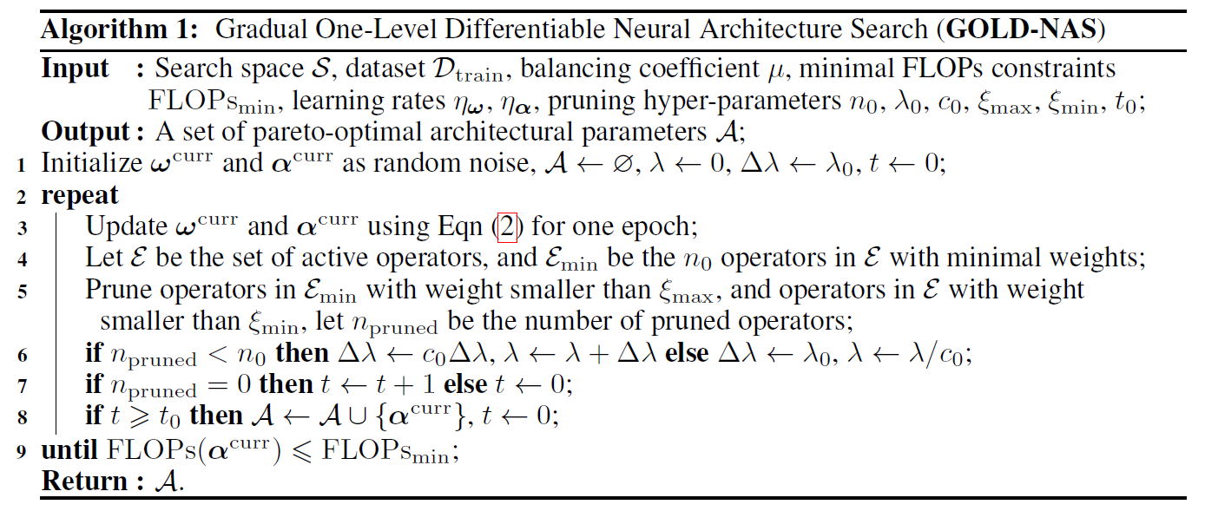
GOLD-NAS: Gradual Pruning
The key is to control the coefficient of hardware constraint
It zigzags from zero to a relatively large value
One search procedure, a set of Pareto-optimal architectures

Slide 45
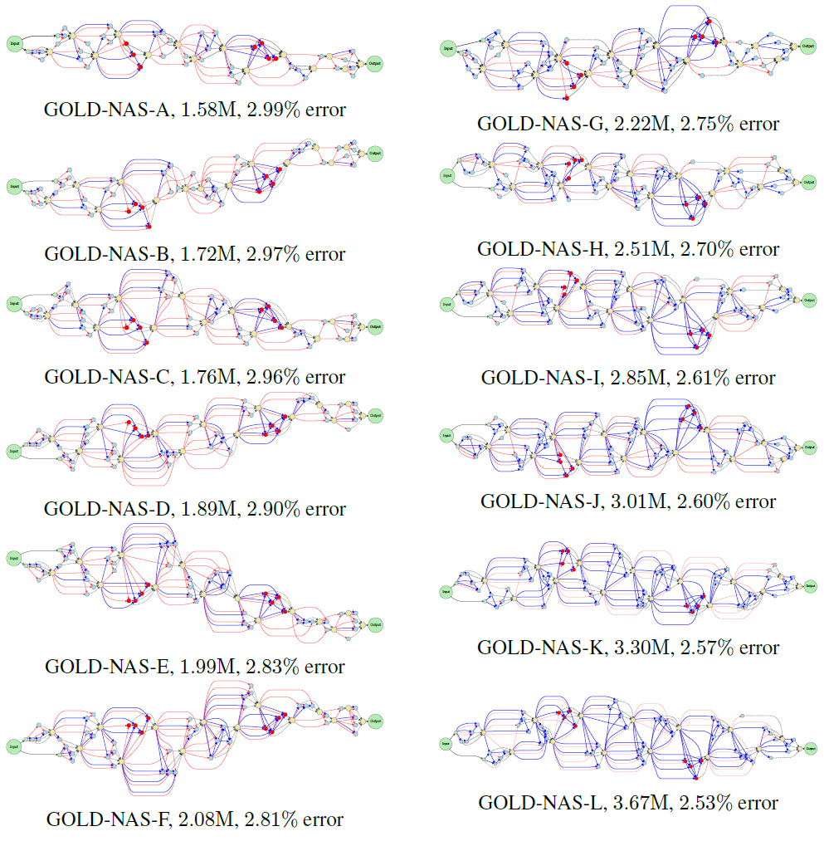
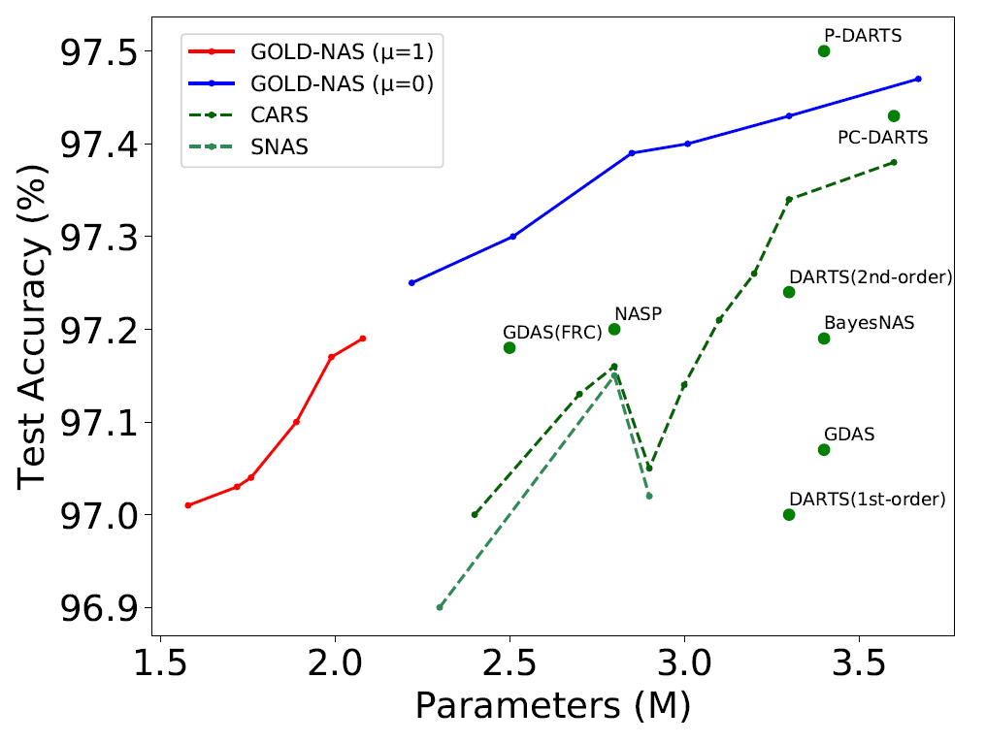
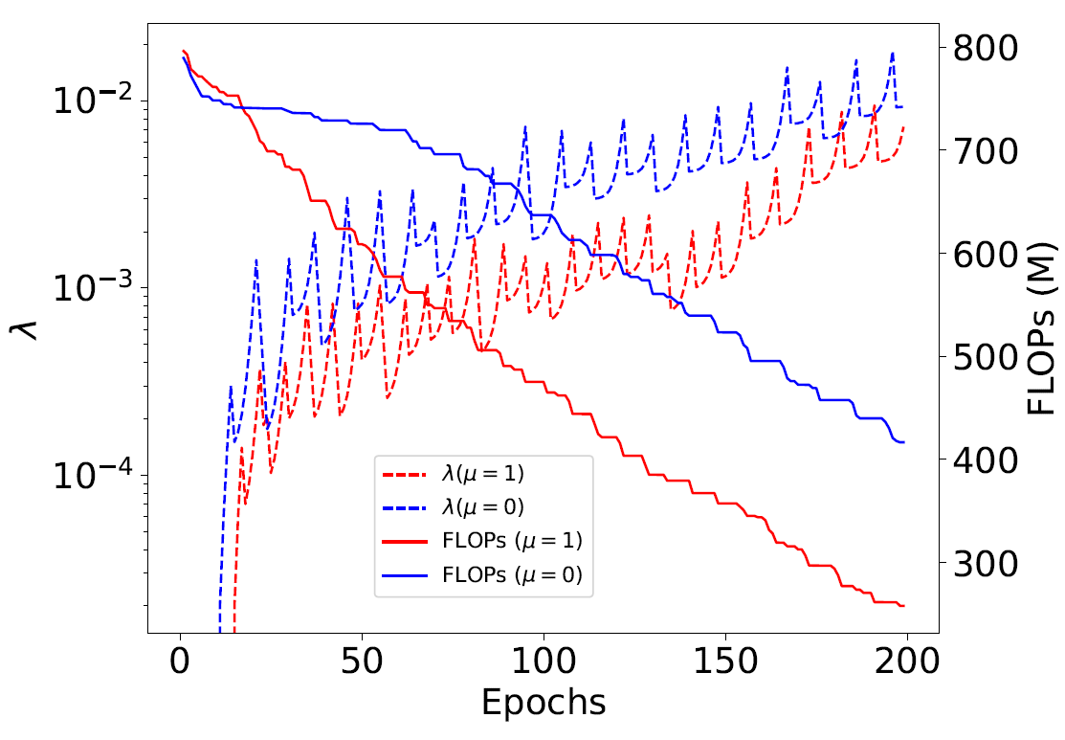
GOLD-NAS: Searched Architectures on CIFAR10
The Pareto front
Architectures: from small to large, accuracy- computation tradeoff
Surpassing the existing work on CIFAR10
Note that how the coefficient zigzags during the search

Slide 46
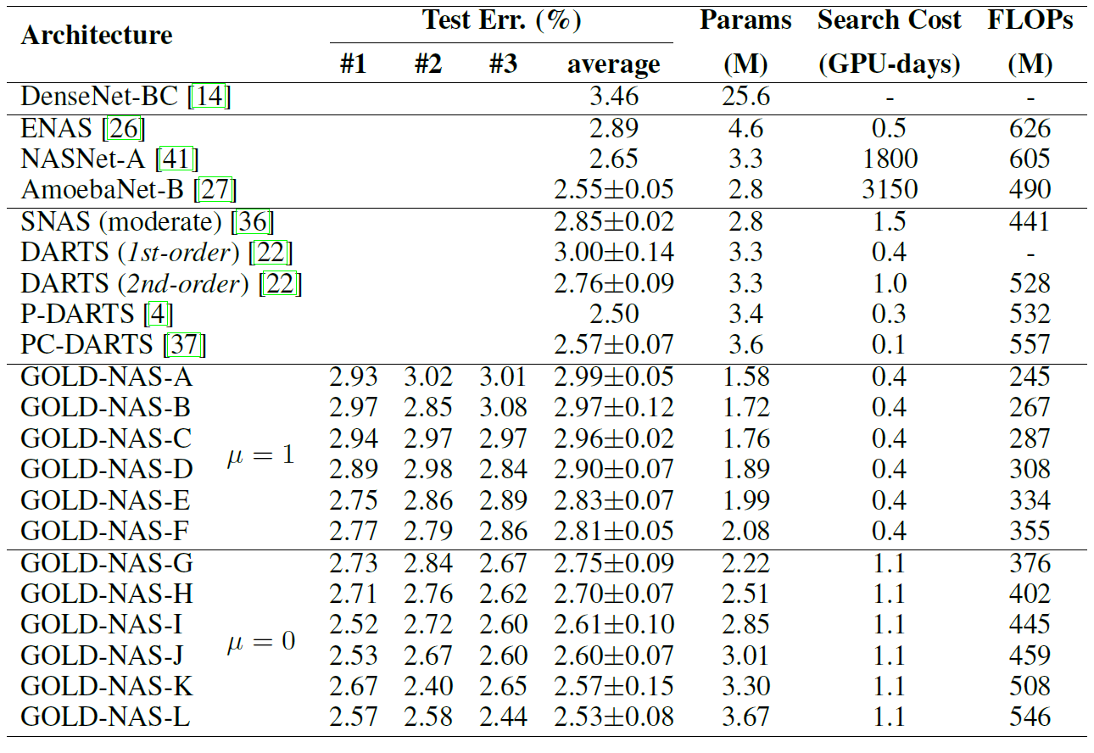
GOLD-NAS: Evaluation Performance on CIFAR10
Better accuracy-computation tradeoff compared to DARTS
0.4/1.1 GPU-days to obtain a set of Pareto-optimal architectures

Slide 47
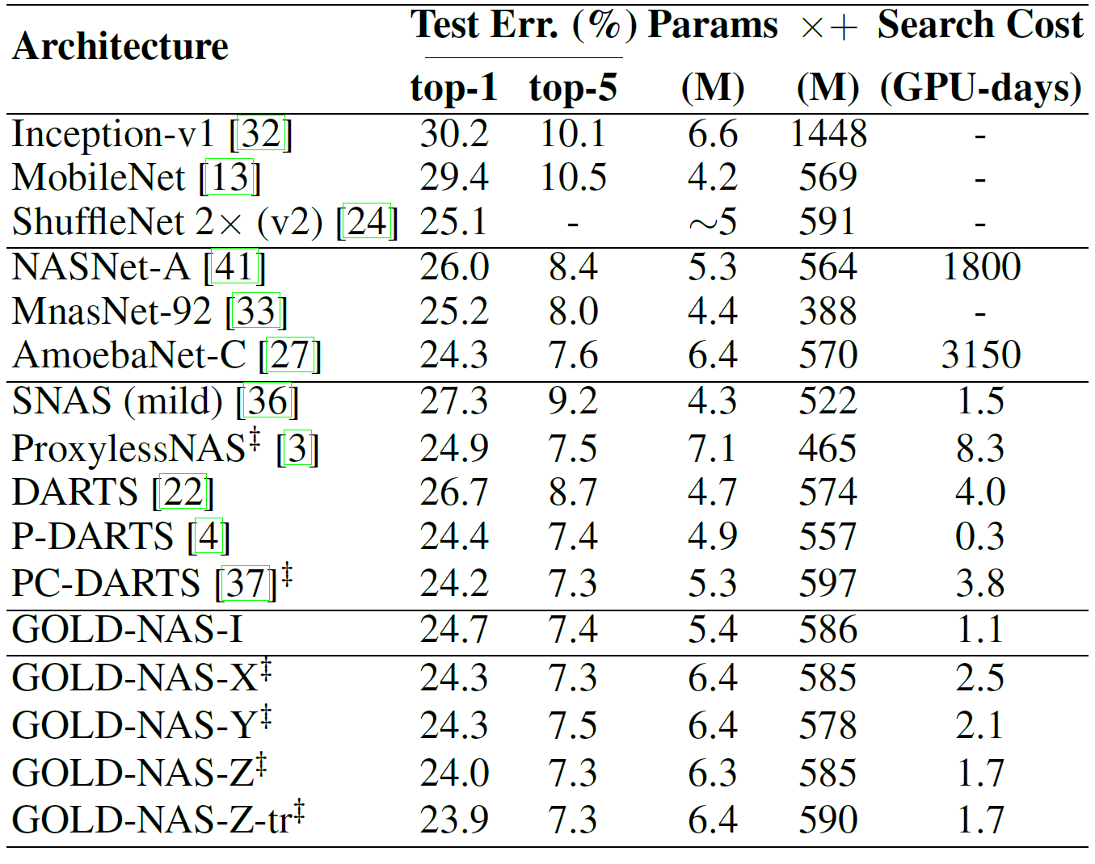
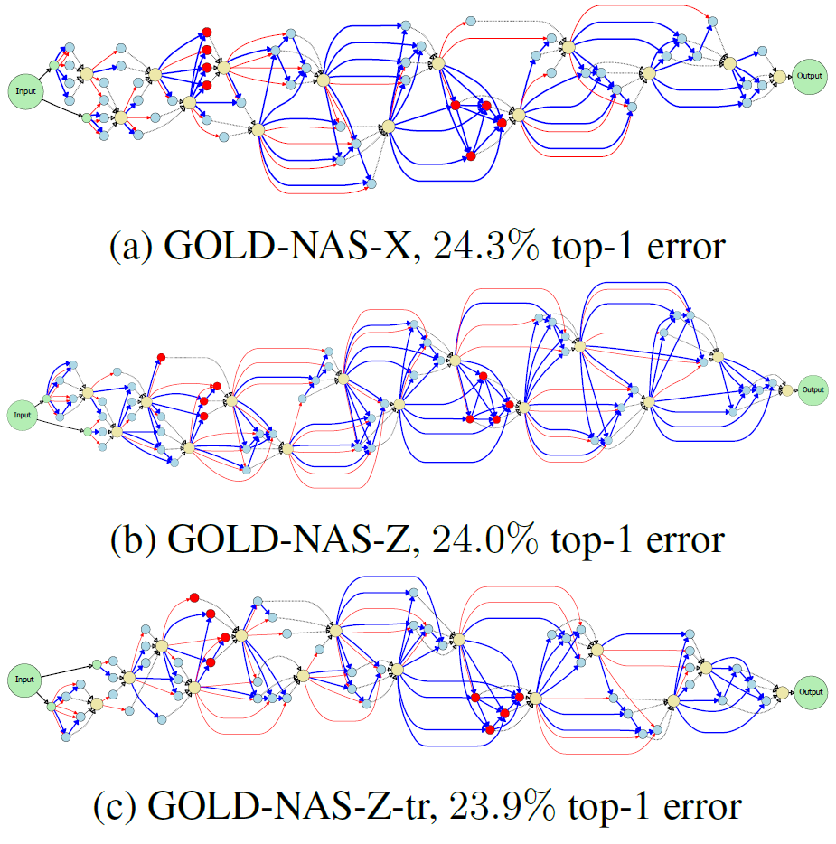
GOLD-NAS: Evaluation Performance on ImageNet
State-of-the-art accuracy of the differentiable search method
Directly search on ImageNet, requiring only ~2 GPU-days

Slide 48
Contents
What is Neural Architecture Search? Why is it important?
A generalized pipeline of Neural Architecture Search
Weight-Sharing Neural Architecture Search and the challenges
Our representative work on Neural Architecture Search
P-DARTS: bridging the gap between search and evaluation
PC-DARTS: NAS regularization and normalization
Stabilized-DARTS & GOLD-NAS: larger space, smaller optimization gap
LA-DARTS: introducing hardware constraints into differentiable NAS
Summary and future directions

Slide 49
LA-DARTS: Overview
Differentiable NAS methods are unable to consider network latency
Latency is not differentiable with respect to the architectural parameters
So are other kind of hardware constraints, e.g. power consumption
Solution: a differentiable (trainable) latency prediction module
Trained with collecting latency data on specific hardware (very cheap)
Inserted to differentiable search frameworks as an extra loss term
No hardware-related knowledge is required (easily transplanted)
Result: latency-friendly architectures (same accuracy, ~20% latency drop)
Different architectures on GPU (NVIDIA Tesla-P100) and CPU (Intel E5-1620)
Different architectures compared to FLOPs-aware search
Y. Xu et al., Latency-Aware Differentiable Neural Architecture Search, arXiv: 2001.06392, 2020.

Slide 50
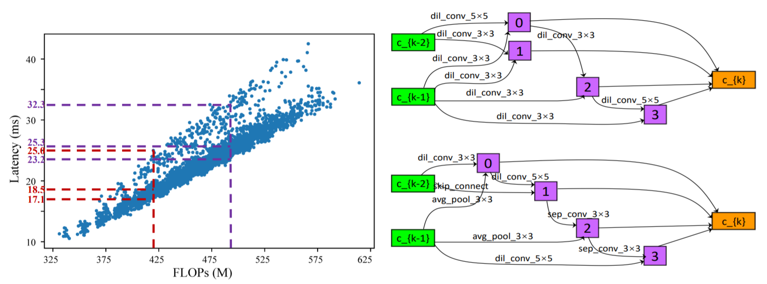
LA-DARTS: The Importance and Difficulty
Importance: real-world applications
But, latency is difficult to measure in a differentiable search pipeline
Architectures with the same FLOPs can have different latency
Architectures with the same operators can have different latency

Slide 51
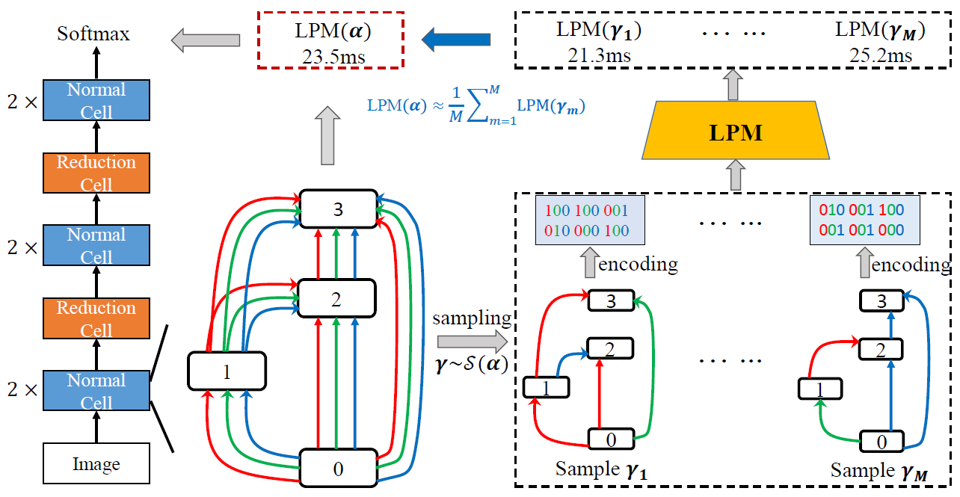
LA-DARTS: The Latency Prediction Module
We collect latency data to train the latency prediction module
Each architecture is encoded as a fixed-length binary code as the input

Slide 52
LA-DARTS: Accuracy of Latency Prediction
Data collection
100,000 architectures sampled and evaluated with random input images
9 hours on a NVIDIA Tesla-P100 GPU (batch size is 32)
LPM: a three-layer fully-connected network
Prediction accuracy is sufficiently high (even when small noise is added to the latency prediction result, the search procedure still works well)
GPU accuracy is slightly higher than CPU accuracy

Slide 53
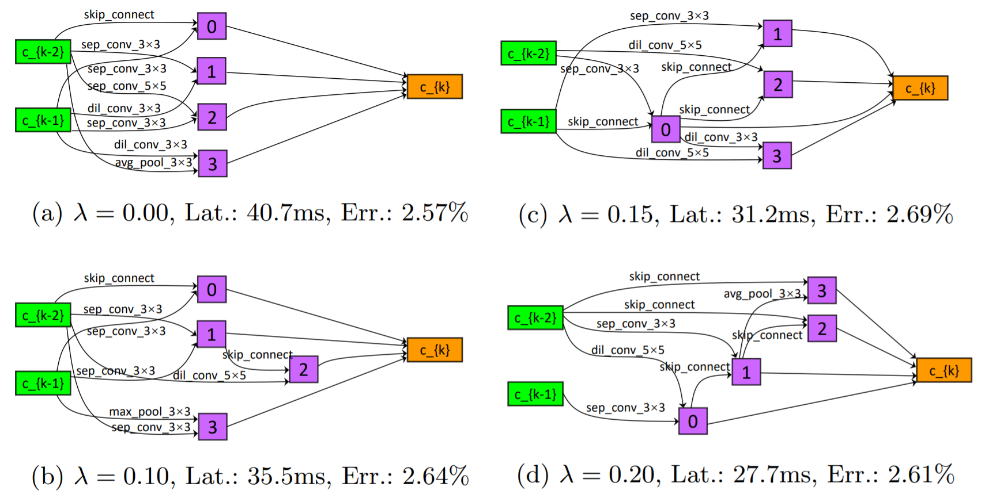
LA-DARTS: Search with Different Latency Weights
A tradeoff between accuracy and latency
On CIFAR10: 30% latency drop with little accuracy drop

Slide 54
LA-DARTS: Search on Different Hardware
Architectures searched on GPU and CPU are different
The accuracy-latency tradeoff is more significant on CPU

Slide 55
Contents
What is Neural Architecture Search? Why is it important?
A generalized pipeline of Neural Architecture Search
Weight-Sharing Neural Architecture Search and the challenges
Our representative work on Neural Architecture Search
P-DARTS: bridging the gap between search and evaluation
PC-DARTS: NAS regularization and normalization
Stabilized-DARTS & GOLD-NAS: larger space, smaller optimization gap
LA-DARTS: introducing hardware constraints into differentiable NAS
Summary and future directions

Slide 56
Summary
AutoML is an emerging topic and part of the future of AI
NAS is a subarea of AutoML, the cutting edge methodology of deep learning
Two main choices of NAS: individual vs. weight-sharing optimization
Heuristic search is conservative, works on small spaces and behaves stable
Differentiable search is promising, but has a lot of serious issues to solve yet
Towards stable differentiable search: shrinking the optimization gap
P-DARTS, PC-DARTS: on search strategy
Stabilized-DARTS: on improving search stability from mathematics
GOLD-NAS: on larger search space and a new search framework
LA-DARTS: introducing non-differentiable hardware constraints

Slide 57
Future Trends as Open Problems
Q1: which search strategy is better, individual or weight-sharing?
Individual: computational overhead seems unaffordable to most users
Weight-sharing: stability is below satisfaction, but progresses have been made
Q2: what should the basic search unit be, a layer or a basic operator?
Smaller basic units imply a larger search space, which requires search stability
Smaller basic units may bring in challenges to hardware design
Q3: how to apply the searched architectures to real-world scenarios?
Hardware: differentiable search methods are not yet friendly to, say, latency
Individual vision tasks: sharing the same backbone or not?

Slide 58
Thanks!
Questions, please?

