Slide 1
Neural Architecture Search: The Next Half Generation of Machine Learning
Speaker: Lingxi Xie (谢凌曦)
Noah’s Ark Lab, Huawei Inc. (华为诺亚方舟实验室)
Slides available at my homepage (TALKS)

Slide 2
Outline
Neural Architecture Search: what and why?
A generalized framework of Neural Architecture Search
Evolution-based approaches
Reinforcement-learning-based approaches
Towards one-shot architecture search
Applications to a wide range of vision tasks
Our new progress on Neural Architecture Search
Open problems and future directions

Slide 3
Outline
Neural Architecture Search: what and why?
A generalized framework of Neural Architecture Search
Evolution-based approaches
Reinforcement-learning-based approaches
Towards one-shot architecture search
Applications to a wide range of vision tasks
Our new progress on Neural Architecture Search
Open problems and future directions

Slide 4
Take-Home Messages
Automated Machine Learning (AutoML) is the future
Deep learning makes feature learning automatic
AutoML makes deep learning automatic
NAS is an important subtopic of AutoML
The future is approaching faster than we used to think!
2017: NAS appears
2018: NAS becomes approachable
2019 and 2020: NAS will be mature and a standard technique

Slide 5
Some Opinions of Myself
There are two major challenges in the field of computer vision, or even AI
Knowledge representation: how to build a mathematical model to cover real data?
Model optimization: how to train a complex model with a limited amount of data?
State-of-the-art solutions?
Knowledge representation: hierarchical features and interaction – as pointed out by David Marr in 1970’s
Model optimization: training deep neural networks – one step further, AutoML

Slide 6
Fundamental Ideology of AutoML
One step further in discarding human expertise and trusting training data
Background: the big data era
Knowing this principle helps to discriminate which work is good for AutoML
Very promising for the industry, in particular companies like Huawei
Engineers often do not have so much expertise
But you very much need to develop different models in a short period of time

Slide 7
Introduction: Neural Architecture Search
Neural Architecture Search (NAS)
Instead of manually designing neural network architecture (e.g., AlexNet, VGGNet, GoogLeNet, ResNet, DenseNet, etc.), exploring the possibility of discovering unexplored architecture with automatic algorithms
Why is NAS important?
A step from manual model design to automatic model design (analogy: deep learning vs. conventional approaches)
Able to develop data-specific models
[Krizhevsky, 2012] A. Krizhevsky et al., ImageNet Classification with Deep Convolutional Neural Networks, NIPS, 2012.
[Simonyan, 2015] K. Simonyan et al., Very Deep Convolutional Networks for Large-scale Image Recognition, ICLR, 2015.
[Szegedy, 2015] C. Szegedy et al., Going Deeper with Convolutions, CVPR, 2015.
[He, 2016] K. He et al., Deep Residual Learning for Image Recognition, CVPR, 2016.
[Huang, 2017] G. Huang et al., Densely Connected Convolutional Networks, CVPR, 2017.

Slide 8
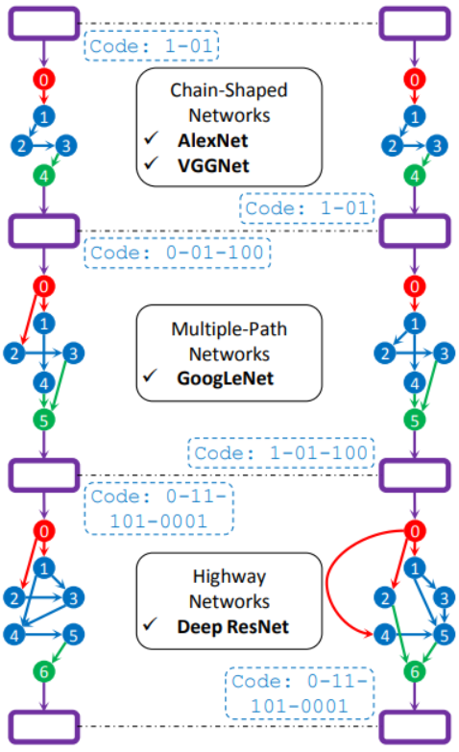
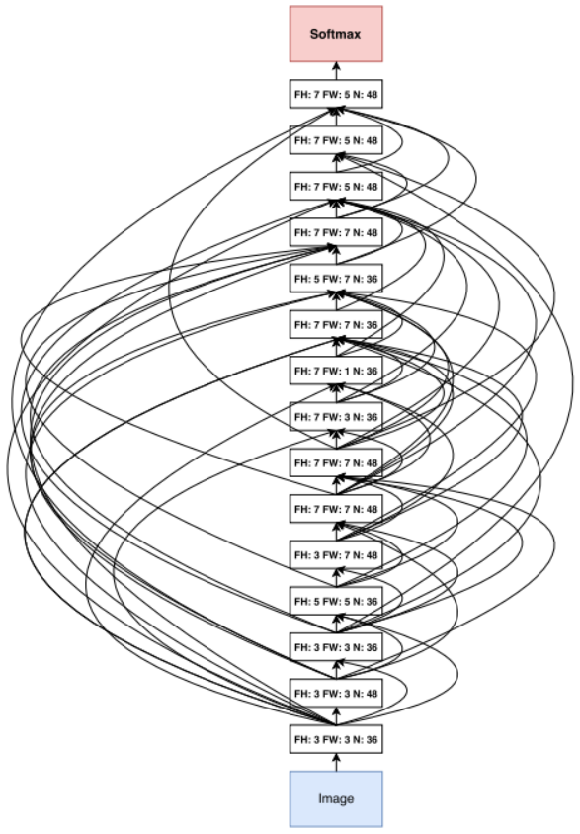
Introduction: Examples and Comparison
Model comparison: ResNet, GeNet, NASNet and ENASNet
[He, 2016] K. He et al., Deep Residual Learning for Image Recognition, CVPR, 2016.
[Xie, 2017] L. Xie et al., Genetic CNN, ICCV, 2017.
[Zoph, 2018] B. Zoph et al., Learning Transferable Architectures for Scalable Image Recognition, CVPR, 2018.
[Pham, 2018] H. Pham et al., Efficient Neural Architecture Search via Parameter Sharing, ICML, 2018.

Slide 9
Outline
Neural Architecture Search: what and why?
A generalized framework of Neural Architecture Search
Evolution-based approaches
Reinforcement-learning-based approaches
Towards one-shot architecture search
Applications to a wide range of vision tasks
Our new progress on Neural Architecture Search
Open problems and future directions

Slide 10
Framework: Trial and Update
Almost all NAS algorithms are based on the “trial and update” framework
Starting with a set of initial architectures (e.g., manually defined) as individuals
Assuming that better architectures can be obtained by slight modification
Applying different operations on the existing architectures
Preserving the high-quality individuals and updating the individual pool
Iterating till the end
Three fundamental requirements
The building blocks: defining the search space (dimensionality, complexity, etc.)
The representation: defining the transition between individuals
The evaluation method: determining if a generated individual is of high quality

Slide 11
Framework: Building Blocks
Building blocks are like basic genes for these individuals
Some examples here
Genetic CNN: only $3×3$ convolution is allowed to be searched (followed by default BN and ReLU operations), $3×3$ pooling is fixed
NASNet: $13$ operations shown below
PNASNet: $8$ operations, removing those never-used ones from NASNet
ENASNet: $6$ operations
DARTS: $8$ operations
[Xie, 2017] L. Xie et al., Genetic CNN, ICCV, 2017.
[Zoph, 2018] B. Zoph et al., Learning Transferable Architectures for Scalable Image Recognition, CVPR, 2018.
[Liu, 2018] C. Liu et al., Progressive Neural Architecture Search, ECCV, 2018.
[Pham, 2018] H. Pham et al., Efficient Neural Architecture Search via Parameter Sharing, ICML, 2018.
[Liu, 2019] H. Liu et al., DARTS: Differentiable Architecture Search, ICLR, 2019.

Slide 12
Framework: Search
Finding new individuals that have potentials to work better
Heuristic search in the large space
Two mainly applied methods: the genetic algorithm and reinforcement learning
Both are heuristic algorithms applied to the scenarios of a large search space and limited ability to explore every single element in the space
A fundamental assumption: both of these heuristic algorithms can preserve good genes and based on which discover possible improvements
Also, it is possible to integrate architecture search to network optimization
These algorithms are often much faster
[Real, 2017] E. Real et al., Large-Scale Evolution of Image Classifiers, ICML, 2017.
[Xie, 2017] L. Xie et al., Genetic CNN, ICCV, 2017.
[Zoph, 2018] B. Zoph et al., Learning Transferable Architectures for Scalable Image Recognition, CVPR, 2018.
[Liu, 2018] C. Liu et al., Progressive Neural Architecture Search, ECCV, 2018.
[Pham, 2018] H. Pham et al., Efficient Neural Architecture Search via Parameter Sharing, ICML, 2018.
[Liu, 2019] H. Liu et al., DARTS: Differentiable Architecture Search, ICLR, 2019.

Slide 13
Framework: Evaluation
Evaluation aims at determining which individuals are good and to be preserved
Conventionally, this was often done by training a network from scratch
This is extremely time-consuming, so researchers often train NAS on a small dataset like CIFAR and then transfer the found architecture to larger datasets like ImageNet
Even in this way, the training process is really slow: Genetic-CNN requires $17$ GPU-days for a single training process, and NAS-RL requires more than $20,000$ GPU-days
Efficient methods were proposed later
Ideas include parameter sharing (without the need of re-training everything for each new individual) and using a differentiable architecture (joint optimization)
Now, an efficient search process on CIFAR can be reduced to a few GPU-hours, though training the searched architecture on ImageNet is still time-consuming
[Xie, 2017] L. Xie et al., Genetic CNN, ICCV, 2017.
[Zoph, 2017] B. Zoph et al., Neural Architecture Search with Reinforcement Learning, ICLR, 2017.
[Pham, 2018] H. Pham et al., Efficient Neural Architecture Search via Parameter Sharing, ICML, 2018.
[Liu, 2019] H. Liu et al., DARTS: Differentiable Architecture Search, ICLR, 2019.

Slide 14
Outline
Neural Architecture Search: what and why?
A generalized framework of Neural Architecture Search
Evolution-based approaches
Reinforcement-learning-based approaches
Towards one-shot architecture search
Applications to a wide range of vision tasks
Our new progress on Neural Architecture Search
Open problems and future directions

Slide 15
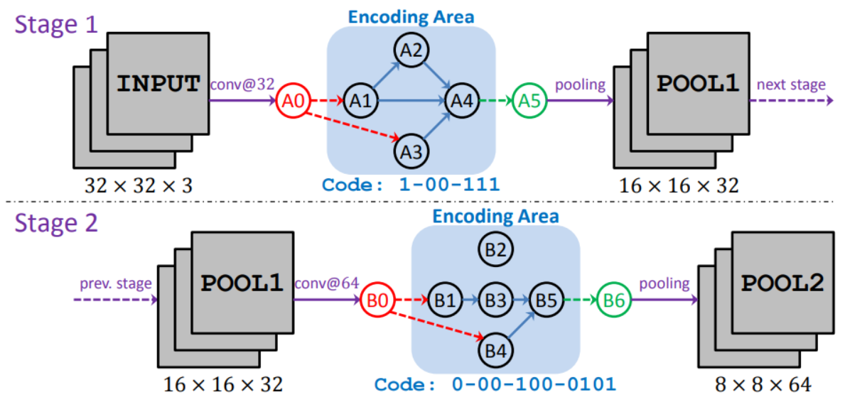
Genetic CNN
Only considering the connection between basic building blocks
Encoding each network into a fixed-length binary string
Standard operators: mutation, crossover, and selection
Limited by computation
Relatively low accuracy
[Xie, 2017] L. Xie et al., Genetic CNN, ICCV, 2017.

Slide 16
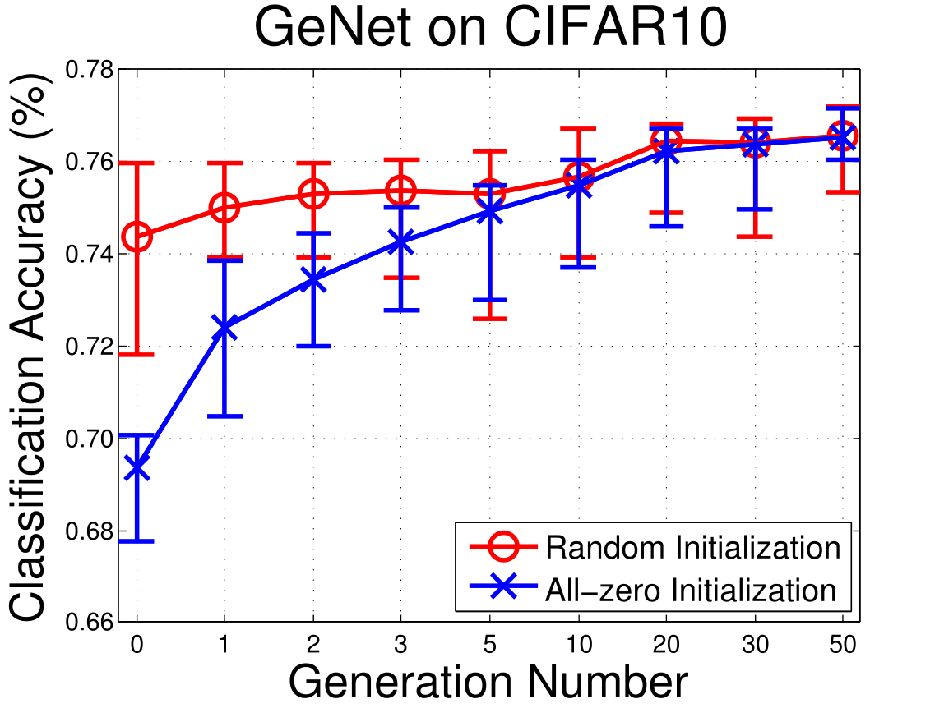
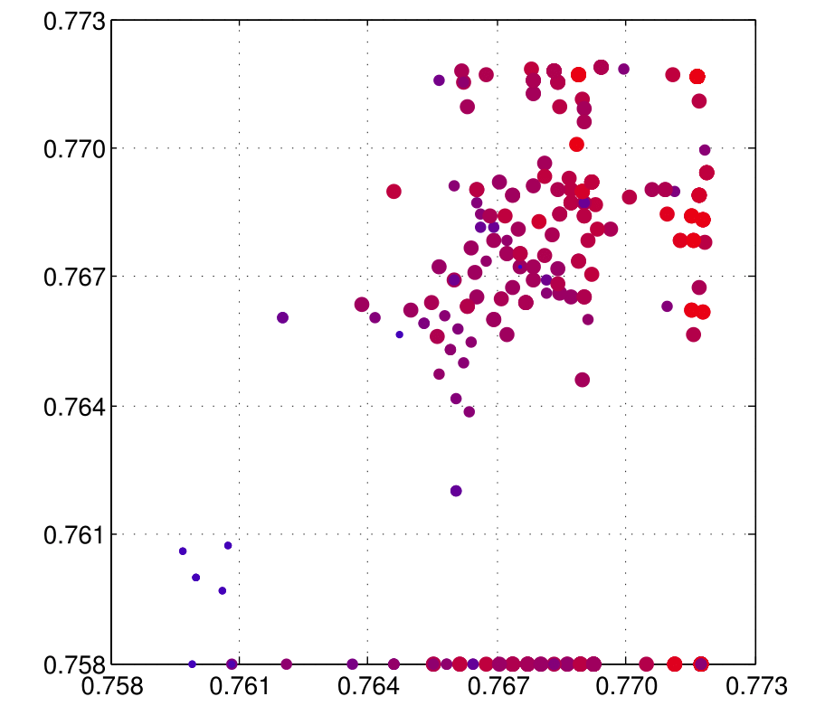
Genetic CNN
Figure: the impact of initialization is ignorable after a sufficient number of rounds
CIFAR10 experiments
$3$ stages, $\left\{K_{1},K_{2},K_{3}\right\}=\left\{3,4,5\right\}$, $L=19$
$N=20$ (individuals), $L=50$ (rounds)
Gen # | Max $\%$ | Min $\%$ | Avg $\%$ | Med $\%$ | St-D $\%$
$$0$$ | $$75.96$$ | $$71.81$$ | $$74.39$$ | $$74.53$$ | $$0.91$$
$$1$$ | $$75.96$$ | $$73.93$$ | $$75.01$$ | $$75.17$$ | $$0.57$$
$$2$$ | $$75.96$$ | $$73.95$$ | $$75.32$$ | $$75.48$$ | $$0.57$$
$$5$$ | $$76.24$$ | $$72.60$$ | $$75.32$$ | $$75.65$$ | $$0.89$$
$$10$$ | $$76.72$$ | $$73.92$$ | $$75.68$$ | $$75.80$$ | $$0.88$$
$$20$$ | $$76.83$$ | $$74.91$$ | $$76.45$$ | $$76.79$$ | $$0.61$$
$$50$$ | $$77.06$$ | $$75.84$$ | $$76.58$$ | $$76.81$$ | $$0.55$$
Figure: (a) parent(s) with higher recognition accuracy are more likely to generate child(ren) with higher quality
[Xie, 2017] L. Xie et al., Genetic CNN, ICCV, 2017.

Slide 17
Genetic CNN
Code: 1-01
0
Chain-Shaped
Networks
AlexNet
VGGNet
0
1
1
Generalizing the best learned structures to other tasks
The small datasets with deeper networks
2
3
2
3
4
4
Code: 1-01
Network | SVHN | CF10 | CF100
GeNet #1, after Gen. #$0$ | $$2.25$$ | $$8.18$$ | $$31.46$$
GeNet #1, after Gen. #$5$ | $$2.15$$ | $$7.67$$ | $$30.17$$
GeNet #1, after Gen. #$20$ | $$2.05$$ | $$7.36$$ | $$29.63$$
GeNet #1, after Gen. #$50$ | $$1.99$$ | $$7.19$$ | $$29.03$$
GeNet #2, after Gen. #$50$ | $$1.97$$ | $$7.10$$ | $$29.05$$
Code: 0-01-100
0
0
1
Multiple-Path
Networks
GoogLeNet
1
2
3
2
3
4
4
5
5
Code: 1-01-100
Code: 0-11-101-0001
0
0
Network | ILSVRC2012, 1/5 |  | Depth
$19$-layer VGGNet | $$28.7$$ | $$9.9$$ | $$19$$
GeNet #1, after Gen. #$50$ | $$28.12$$ | $$9.95$$ | $$22$$
GeNet #2, after Gen. #$50$ | $$27.87$$ | $$9.74$$ | $$22$$
1
Highway
Networks
Deep ResNet
1
2
3
2
3
4
5
4
5
6
Code: 0-11-101-0001
6

Slide 18
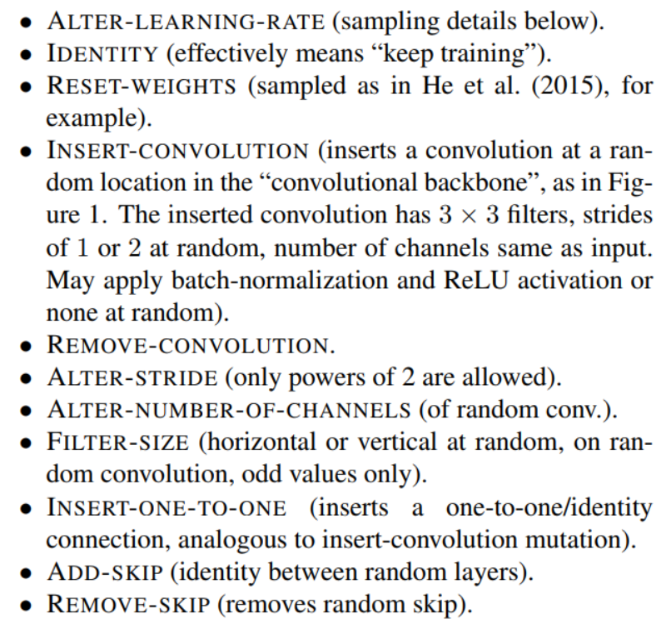
Large-Scale Evolution of Image Classifiers
Modifying the individuals with a pre-defined set of operations, shown in the right part
Larger networks work better
Much larger computational overhead is used: $250$ computers for hundreds of hours
Take-home message: NAS requires careful design and large computational costs
[Real, 2017] E. Real et al., Large-Scale Evolution of Image Classifiers, ICML, 2017.

Slide 19
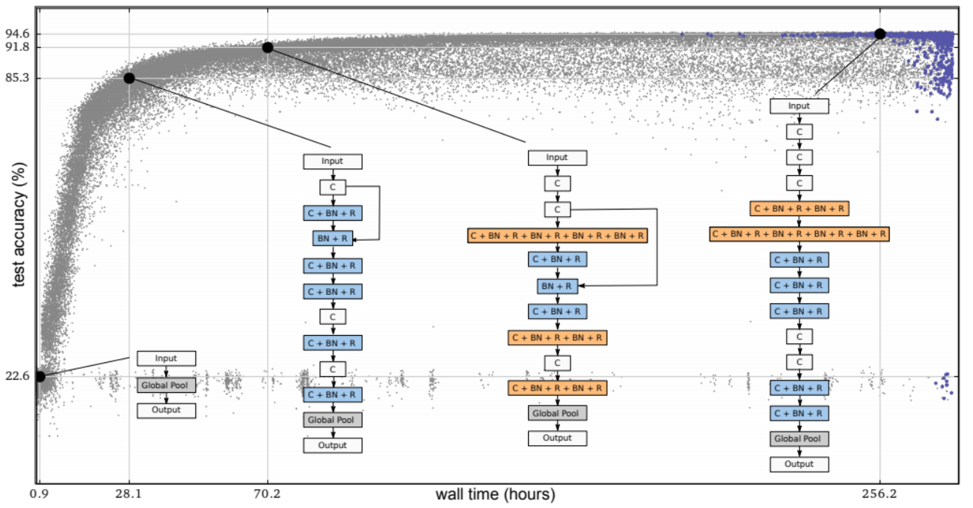
Large-Scale Evolution of Image Classifiers
The search progress
[Real, 2017] E. Real et al., Large-Scale Evolution of Image Classifiers, ICML, 2017.

Slide 20
Representative Work on NAS
Neural Architecture Search: what and why?
A generalized framework of Neural Architecture Search
Evolution-based approaches
Reinforcement-learning-based approaches
Towards one-shot architecture search
Applications to a wide range of vision tasks
Our new progress on Neural Architecture Search
Open problems and future directions

Slide 21
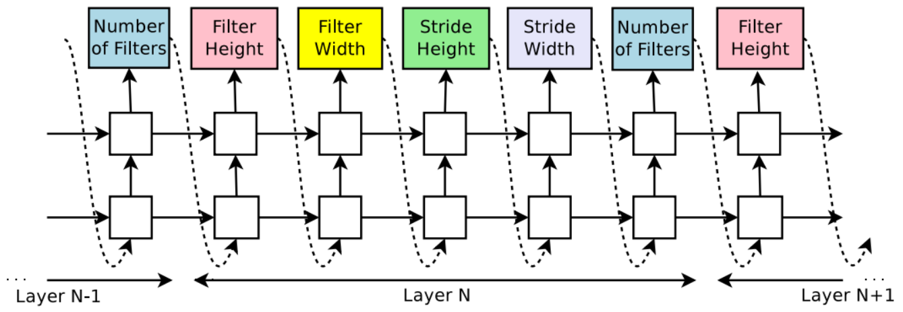
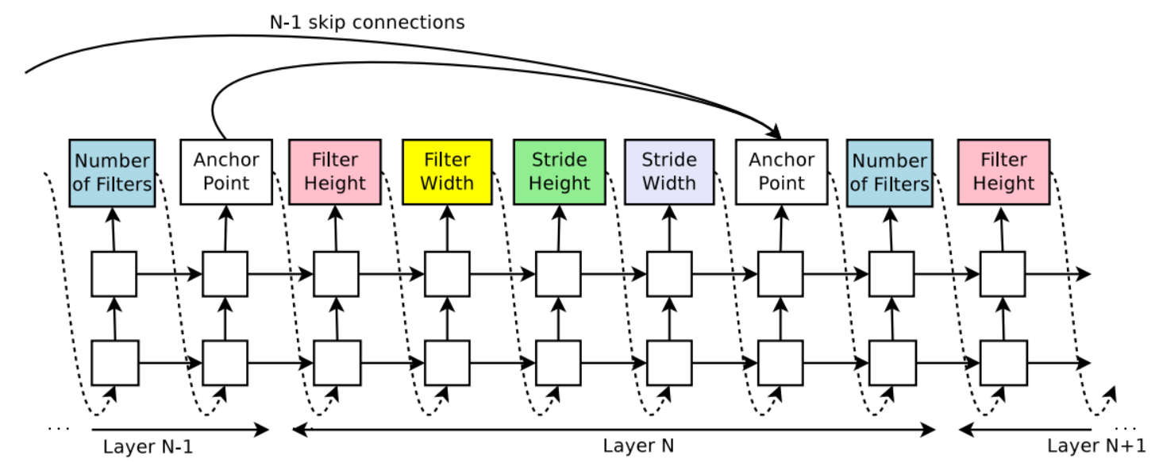
NAS with Reinforcement Learning
Using reinforcement learning (RL) to search over the large space
The entire structure is generated by an RL algorithm or an agent
The validation accuracy serves as feedback to train the agent’s policy
Computational overhead is high
$800$ GPUs for $28$ days (CIFAR)
No ImageNet experiments
Superior accuracy to manually- designed network architectures
[Zoph, 2017] B. Zoph et al., Neural Architecture Search with Reinforcement Learning, ICLR, 2017.

Slide 22
NAS Network
Instead of the previous work that searched everything, this work only searched for a limited number of basic building blocks
The remaining part is mostly the same
Computational overhead is still high
$500$ GPUs for $4$ days (CIFAR)
Good ImageNet performance
[Zoph, 2018] B. Zoph et al., Learning Transferable Architectures for Scalable Image Recognition, CVPR, 2018.

Slide 23
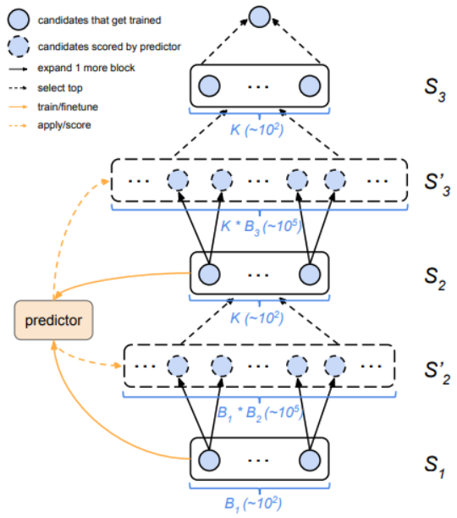
Progressive NAS
Instead of searching over the entire network (containing a few blocks), this work added one block each time (progressive search)
The best combinations are recorded for the next-stage search
The efficiency of search is higher
The remaining part is mostly the same
Computational overhead is still high
$100$ GPUs for $1.5$ days (CIFAR)
Better ImageNet performance
[Liu, 2018] C. Liu et al., Progressive Neural Architecture Search, ECCV, 2018.

Slide 24
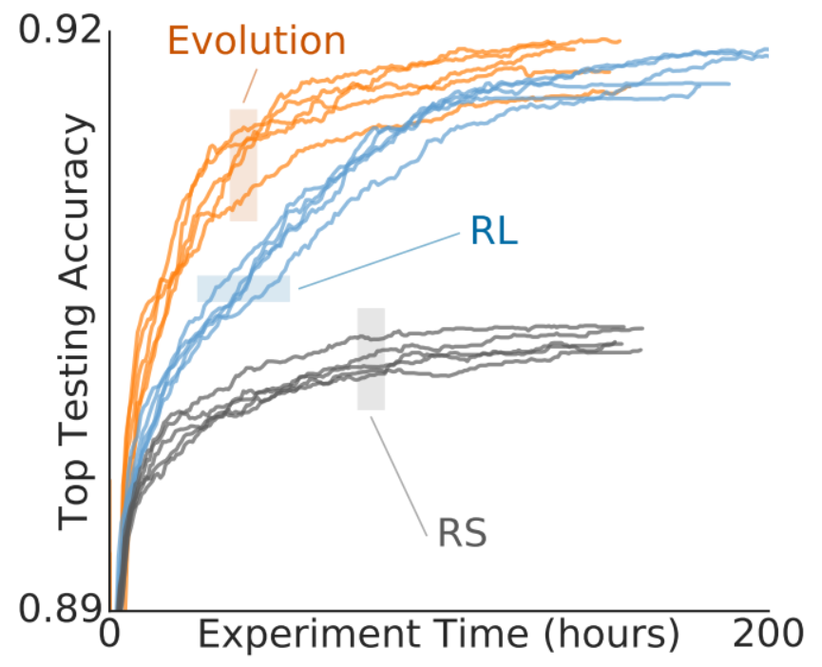
Regularized Evolution
Regularized evolution: assigning “aged” individuals with a higher probability to be eliminated
Evolution works equally well or better than RL algorithms
Take-home message: evolutional algorithms play an important role especially when the computational budget is limited; also, the conventional evolutional algorithms need to be modified so as to fit the NAS task
[Real, 2019] E. Real et al., Regularized Evolution for Image Classifier Architecture Search, AAAI, 2019.

Slide 25
Representative Work on NAS
Neural Architecture Search: what and why?
A generalized framework of Neural Architecture Search
Evolution-based approaches
Reinforcement-learning-based approaches
Towards one-shot architecture search
Applications to a wide range of vision tasks
Our new progress on Neural Architecture Search
Open problems and future directions

Slide 26
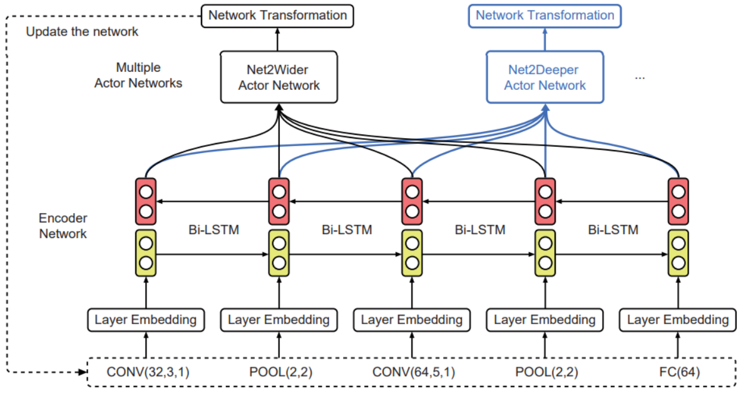
Efficient NAS by Network Transformation
Instead of training a new individual from scratch, this work reused the weights of a prior network (expected to be similar to the current network), so that the current training is more efficient
Net2Net is used for initialization
Operations: wider and deeper
Much more efficient
$5$ GPUs for $2$ days (CIFAR)
No ImageNet experiments
[Chen, 2015] T. Chen et al., Net2Net: Accelerating Learning via Knowledge Transfer, ICLR, 2015.
[Cai, 2018] H. Cai et al., Efficient Architecture Search by Network Transformation, AAAI, 2018.

Slide 27
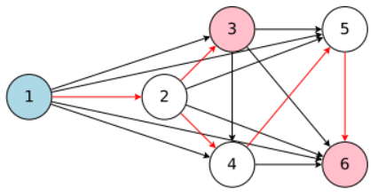
Efficient NAS via Parameter Sharing
Instead of modifying network initialization, this work goes one step forward by sharing parameters among all generated networks
Each training stage is much shorter
Much more efficient
$1$ GPU for $0.45$ days (CIFAR)
No ImageNet experiments
[Pham, 2018] H. Pham et al., Efficient Neural Architecture Search via Parameter Sharing, ICML, 2018.

Slide 28
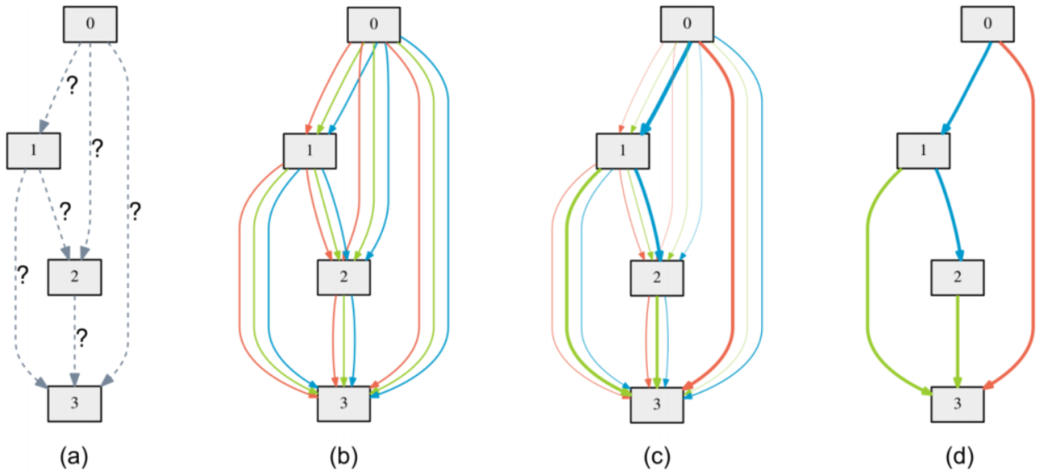
Differentiable Architecture Search
With a fixed number of intermediate blocks, the operator applied to each state is unknown in the beginning
During the training process, the operator is formulated as a mixture model
The learning goal is the mixture coefficients (differentiable)
In the end of training, the most likely operator is kept, and the entire network is trained again
Much more efficient
$1$ GPU for $4$ days (CIFAR)
Reasonable ImageNet results (in the mobile setting)
[Liu, 2019] H. Liu et al., DARTS: Differentiable Architecture Search, ICLR, 2019.

Slide 29
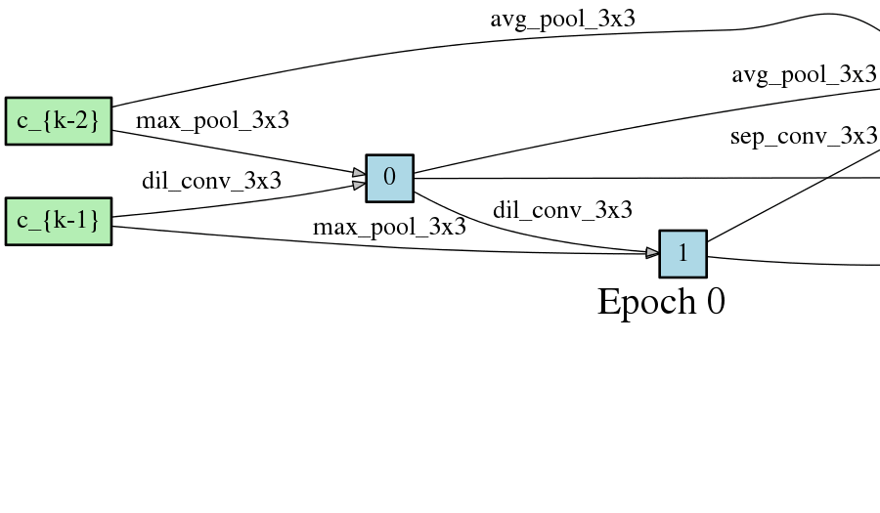
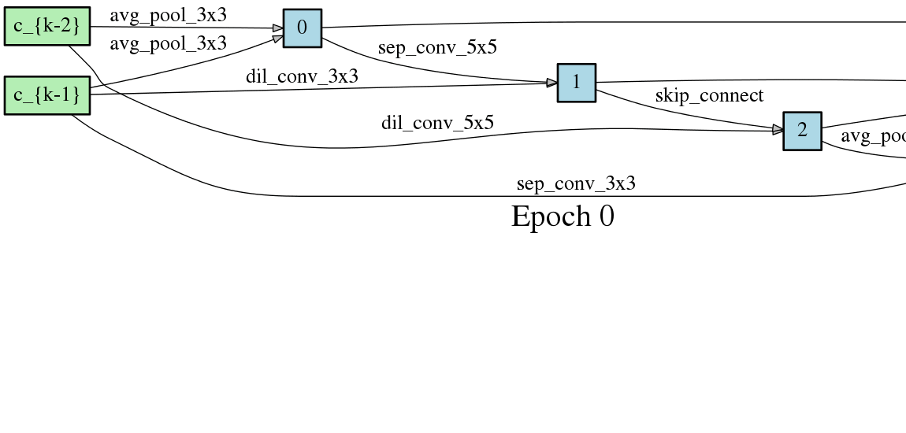
Differentiable Architecture Search
The best cell changes over time
[Liu, 2019] H. Liu et al., DARTS: Differentiable Architecture Search, ICLR, 2019.

Slide 30
Proxyless NAS
The first NAS work that is directly optimized on ImageNet (ILSVRC2012)
Learning weight parameters and binarized architectures simultaneously
Close to Differentiable NAS
Efficient
$1$ GPU for $8$ days
Reason- able perfor- mance (mobile)
[Cai, 2019] H. Cai et al., ProxylessNAS: Direct Neural Architecture Search on Target Task and Hardware, ICLR, 2019.

Slide 31
Probabilistic NAS
A new way to train a super-network
Sampling sub-networks from a distribution
Also able to perform proxyless architecture search
Efficiency brought by flexible control of search time on each sub-network
$1$ GPU for $0.2$ days
Accuracy is a little bit weak on ImageNet
[Noy, 2019] F.P. Casale et al., Probabilistic Neural Architecture Search, arXiv preprint: 1902.05116, 2019.

Slide 32
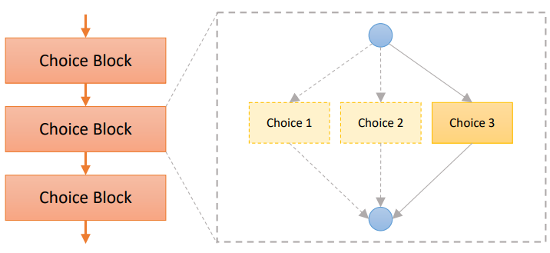
Single-Path One-Shot NAS
Main idea: balancing the sampling probability of each path in one-shot search
With the benefit of decoupling operations on each edge
Bridging the gap between search and evaluation
Modified search space
Blocks based on ShuffleNet-v2
Evolution-based search algorithm
Channel number search
Latency and FLOPs constraints
Improved accuracy on single-shot NAS
[Guo, 2019] Z. Guo et al., Single Path One-Shot Neural Architecture Search with Uniform Sampling, arXiv preprint: 1904.00420, 2019.

Slide 33
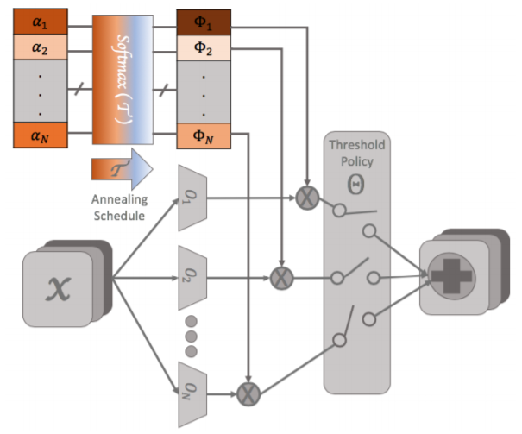
Architecture Search, Anneal and Prune
Another effort to deal with the decoupling issue of DARTS
Decreasing the temperature term in computing the probability added to each edge
Pruning edges with low weights
Gradually turning the architecture to one-path
Efficiency brought by pruning
$1$ GPU for $0.2$ days
Accuracy is still a little bit weak on ImageNet
[Noy, 2019] A. Noy et al., ASAP: Architecture Search, Anneal and Prune, arXiv preprint: 1904.04123, 2019.

Slide 34
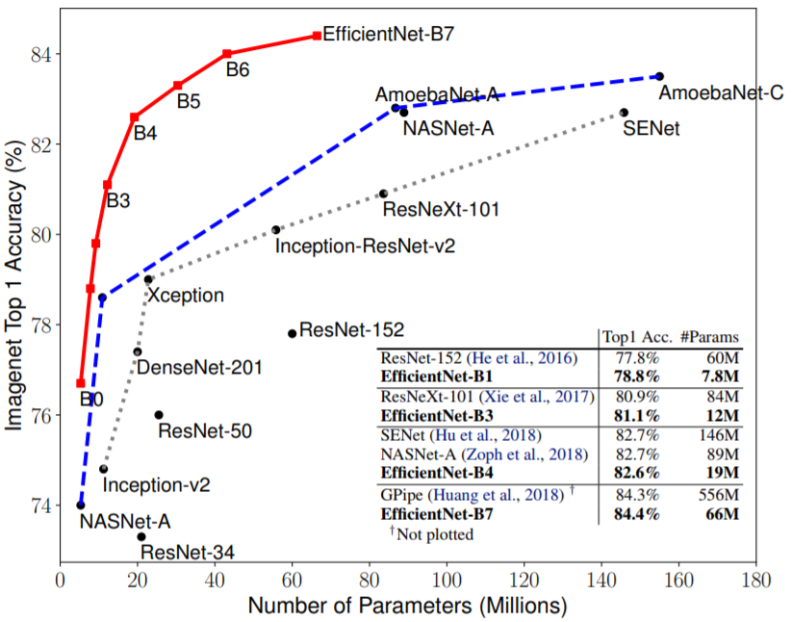
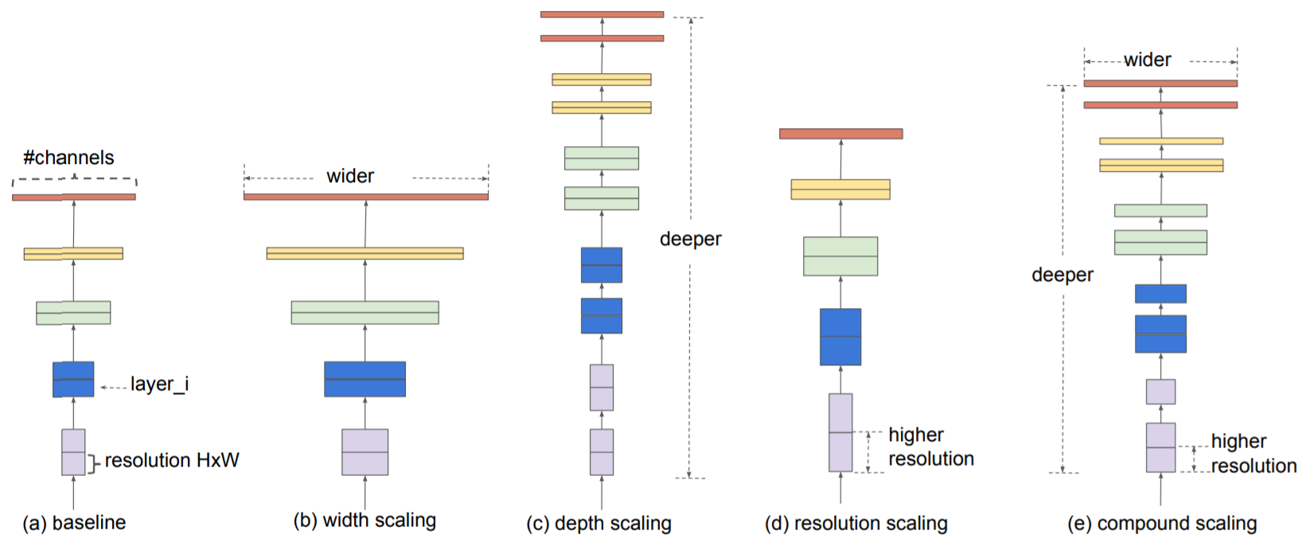
EfficientNet: Conservative but SOTA
A conservative NAS strategy
Based on MobileNet modules, only allowing rescaling to be searched
State-of-the-art ($84.1\%$) on ImageNet
Discussion: another side of NAS
[Tan, 2019] M. Tan et al., EfficientNet: Rethinking Model Scaling for Convolutional Neural Networks, ICML, 2019.

Slide 35
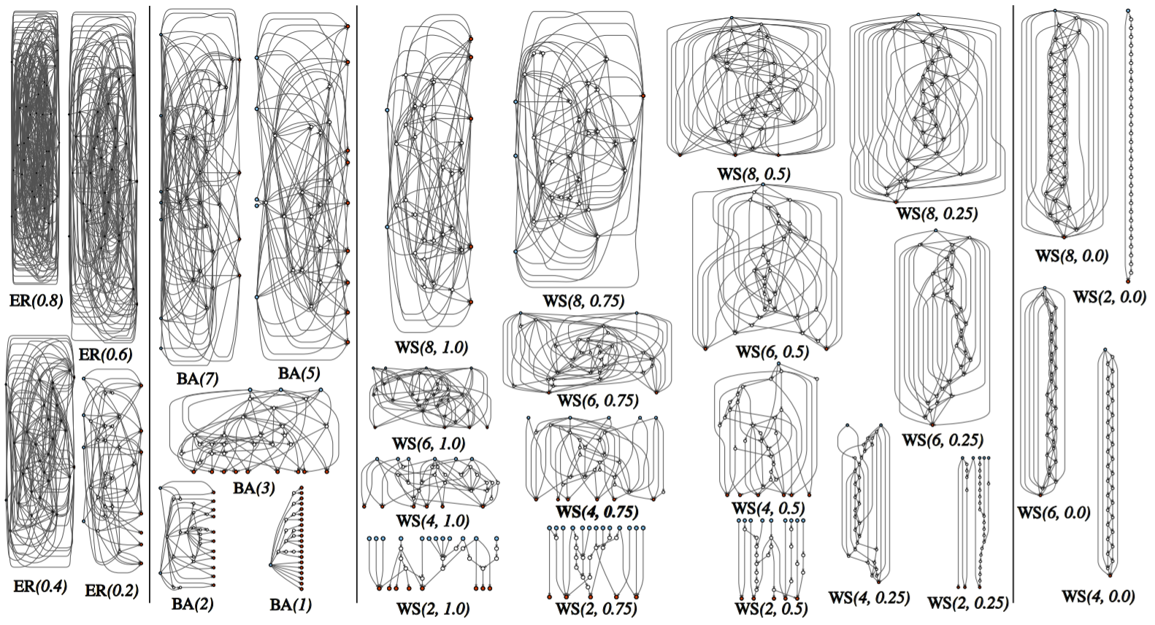
Randomly Wired Neural Networks
A more diverse set of connectivity patterns
Connecting NAS and randomly wired neural networks
An important insight: when the search space is large enough, randomly wired networks are almost as effective as carefully searched architectures
This does not reflect that NAS is useless, but reveals that the current NAS methods are not effective enough
[Xie, 2019] S. Xie et al., Exploring Randomly Wired Neural Networks for Image Recognition, arXiv preprint: 1904.01569, 2019.

Slide 36
Representative Work on NAS
Neural Architecture Search: what and why?
A generalized framework of Neural Architecture Search
Evolution-based approaches
Reinforcement-learning-based approaches
Towards one-shot architecture search
Applications to a wide range of vision tasks
Our new progress on Neural Architecture Search
Open problems and future directions

Slide 37
Auto-Deeplab
A hierarchical architecture search space
With both network-level and cell-level structures being investigated
Differentiable search method (in order to accelerate)
Similar performance to Deeplab-v3 (without pre-training)
[Liu, 2019] C. Liu et al., Auto-DeepLab: Hierarchical Neural Architecture Search for Semantic Image Segmentation, CVPR, 2019.

Slide 38
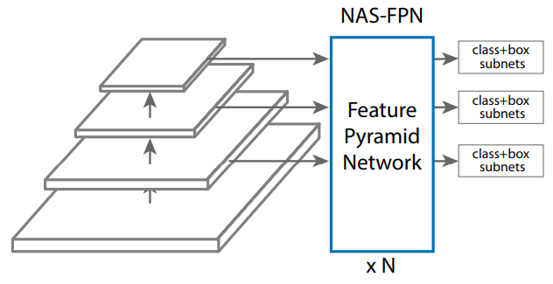
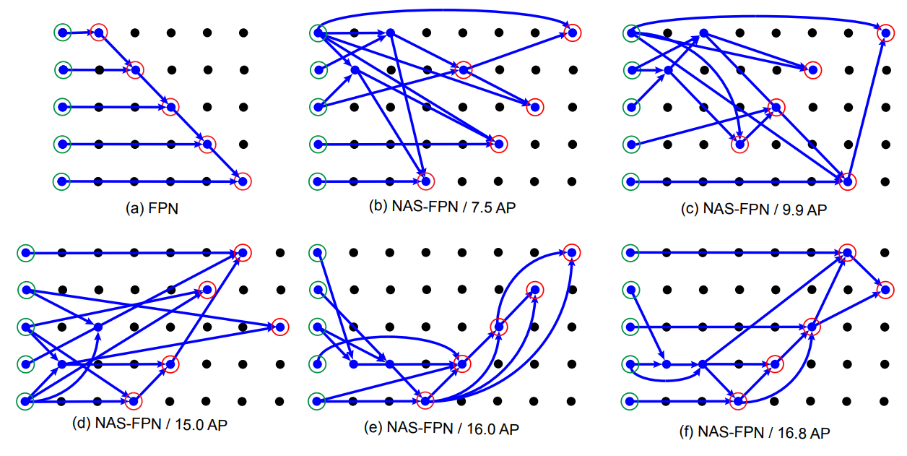
NAS-FPN
Searching for the feature pyramid network
Reinforcement-learning-based search
Good performance on MS-COCO
Improving mobile detection accuracy by $2\%$ AP compared to SSDLite on MobileNetV2
Achieving $48.3\%$ AP, surpassing state-of-the-arts
[Ghaisi, 2019] G. Ghaisi et al., NAS-FPN: Learning Scalable Feature Pyramid Architecturefor Object Detection, CVPR, 2019.

Slide 39
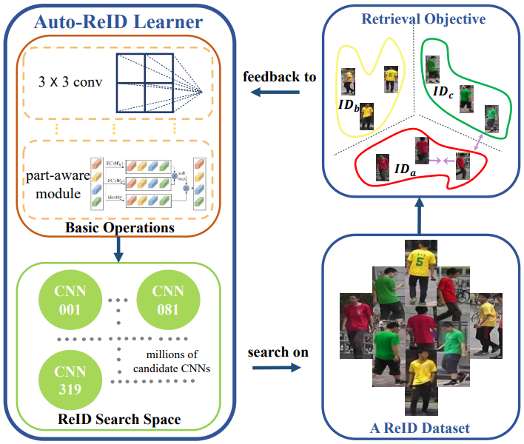
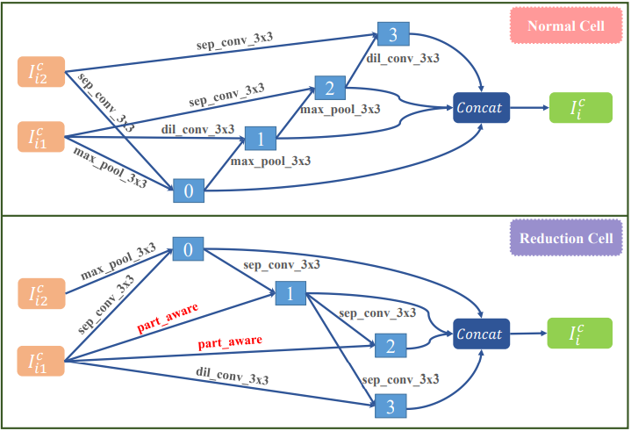
Auto-ReID
A search space with part-aware module
Using both ranking and classification loss
Differentiable search
State-0f-the-art performance on ReID
[Quan, 2019] R. Quan et al., Auto-ReID: Searching for a Part-aware ConvNet for Person Re-Identification, arXiv preprint: 1903.09776, 2019.

Slide 40
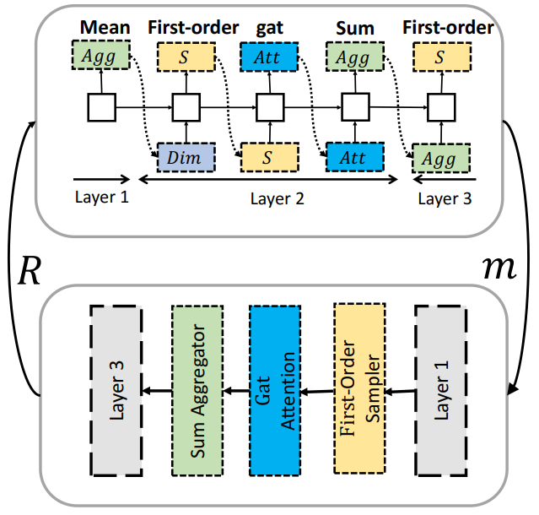
GraphNAS
A search space containing components of GNN layers
RL-based search algorithm
A modified parameter sharing scheme
Surpassing manually designed GNN architectures
[Gao, 2019] Y. Gao et al., GraphNAS: Graph Neural Architecture Search with Reinforcement Learning, arXiv preprint: 1904.09981, 2019.

Slide 41
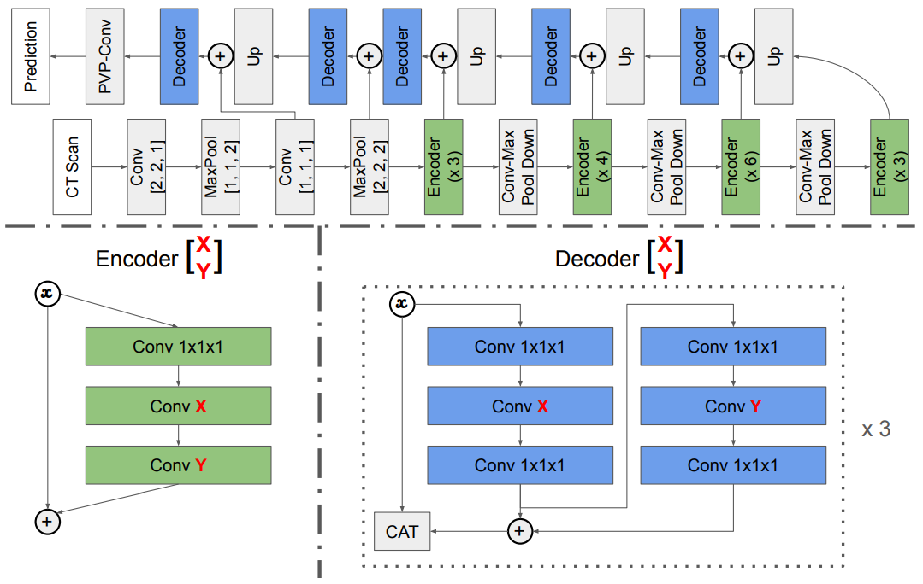
V-NAS
Medical image segmentation
Volumetric convolution required
Searching volumetric convolution
2D conv, 3D conv and P3D conv
Differentiable search algorithm
Outperforming state-of-the-arts
[Zhu, 2019] Z. Zhu et al., V-NAS: Neural Architecture Search for Volumetric Medical Image Segmentation, arXiv preprint: 1906.02817, 2019.

Slide 42
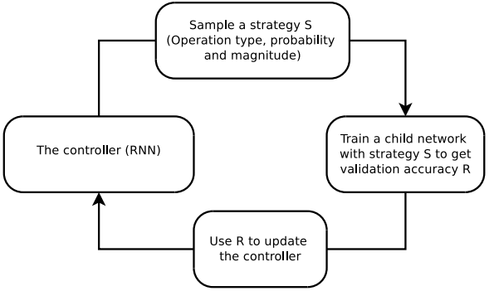
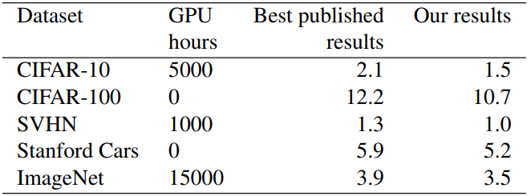
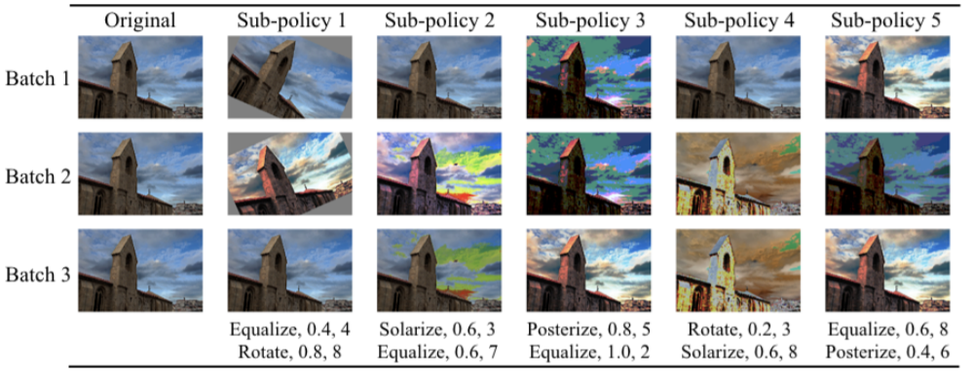
Automatic Data-Augmentation
Learning hyper-parameters
Search Space: Shear-X/Y, Translate-X/Y, Rotate, AutoContrast, Invert, etc.
Reinforcement-learning-based search
Impressive performance on a few standard image classification benchmarks
Transferring to other tasks, e.g., NAS-FPN
[Cubuk, 2019] E. Cubuk et al., AutoAugment: Learning Augmentation Strategies from Data, CVPR, 2019.

Slide 43
More Work for Your Reference
https://github.com/markdtw/awesome-architecture-search

Slide 44
Outline
Neural Architecture Search: what and why?
A generalized framework of Neural Architecture Search
Evolution-based approaches
Reinforcement-learning-based approaches
Towards one-shot architecture search
Applications to a wide range of vision tasks
Our new progress on Neural Architecture Search
Open problems and future directions

Slide 45
We focus on Differentiable Search
Why?
I think this is in the right way of developing NAS algorithms
An example: DARTS vs. EfficientNet
However...
Differentiable search (in particular, DARTS) has a lot of problems
In what follows, we discuss our solution to some of them
[Liu, 2019] H. Liu et al., DARTS: Differentiable Architecture Search, ICLR, 2019.

Slide 46
P-DARTS: Overview
We start with the drawbacks of DARTS
There is a depth gap between search and evaluation
The search process is not stable: multiple runs, different results
The search process is not likely to transfer: only able to work on CIFAR10
We proposed a new approach named Progressive DARTS
A multi-stage search progress which gradually increases the search depth
Two useful techniques: search space approximation and search space regularization
We obtained nice results
SOTA accuracy by the searched networks on CIFAR10/CIFAR100 and ImageNet
Search cost as small as $0.3$ GPU-days (one single GPU, $7$ hours)
[Liu, 2019] H. Liu et al., DARTS: Differentiable Architecture Search, ICLR, 2019.
[Chen, 2019] X. Chen et al., Progressive Differentiable Architecture Search: Bridging the Depth Gap between Search and Evaluation, ICCV, 2019.

Slide 47
P-DARTS: Motivation
The depth gap and why it is important
$$20$$
cells
$$20$$
cells
$$20$$
cells
$$14$$
cells
$$8$$
cells
$8$ cells
search
evaluation
search
evaluation
DARTS: CIFAR10 test error $2.83\%$
P-DARTS: CIFAR10 test error $2.55\%$

Slide 48
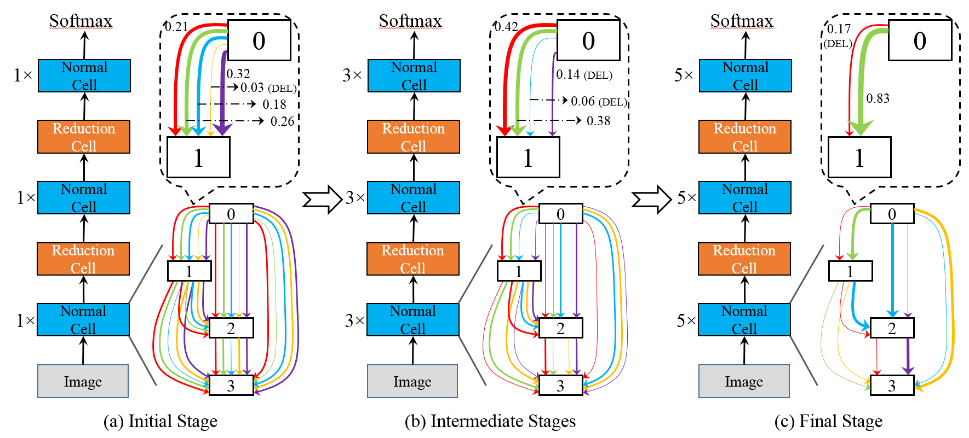
P-DARTS: Search Space Approximation
The progressive way of increasing search depth

Slide 49
P-DARTS: Search Space Regularization
Problem: the strange behavior of skip-connect
Searching on a deep network leads to many skip-connect operations (poor results)
Reasons?
On the one hand, skip-connect often leads to fastest gradient descent
On the other hand, skip-connect does not have parameters and so leads to bad results
Solution: regularization
Adding a Dropout after each skip-connect, dedaying the rate during search
Preserving a fixed number of skip-connect after the entire search
Results
Dropout on skip-c | Testing Error, $2$ SC | Testing Error, $3$ SC | Testing Error, $4$ SC
with Dropout | $$2.93\%$$ | $$3.28\%$$ | $$3.51\%$$
without Dropout | $$2.69\%$$ | $$2.84\%$$ | $$2.97\%$$

Slide 50
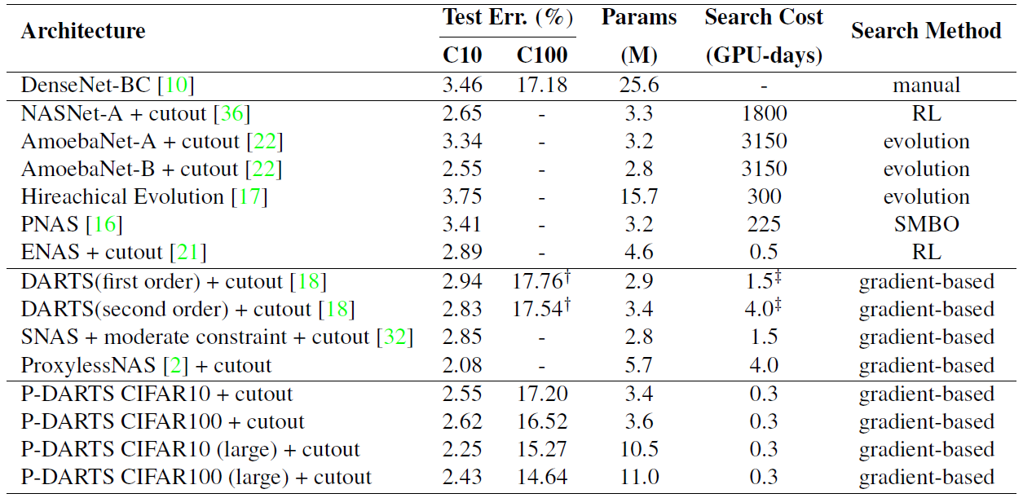
P-DARTS: Performance on CIFAR10/100
CIFAR10 and CIFAR100 (a useful enhancement: Cutout)
[DeVries, 2017] T. DeVries et al., Improved Regularization of Convolutional Neural Networks with Cutout, arXiv 1708.04552, 2017.

Slide 51
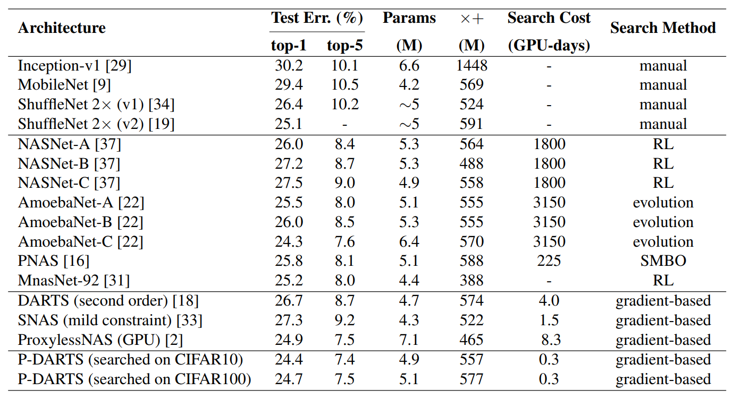
P-DARTS: Performance on ImageNet
ImageNet (ILSVRC2012) under the Mobile Setting

Slide 52
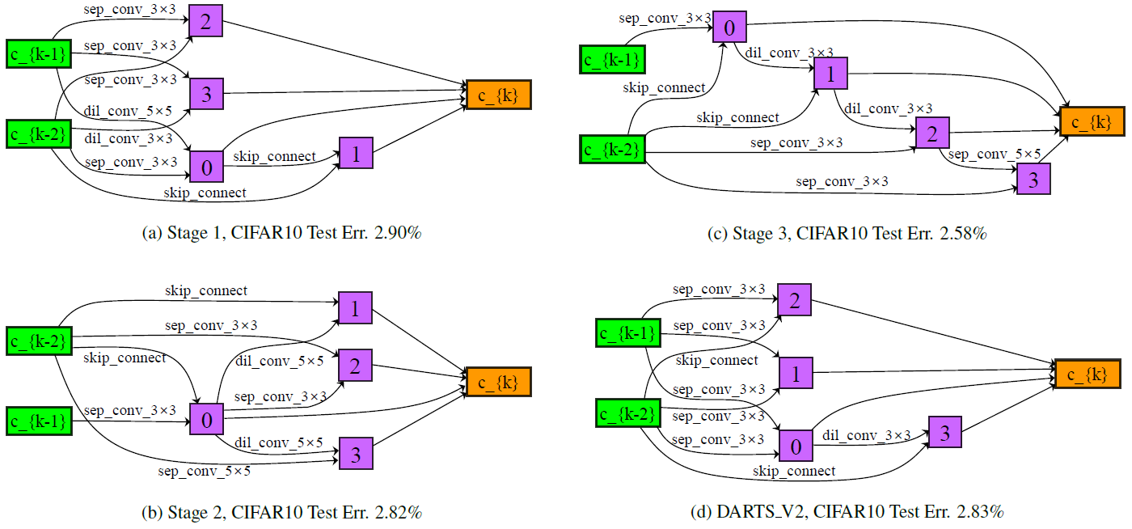
P-DARTS: Searched Cells
Searched architectures (verification of depth gap!)

Slide 53
P-DARTS: Summary
The depth gap needs to be solved
Different properties of networks with different depths
Depth is still the key issue in deep learning
Our approach
State-of-the-art results on both CIFAR10/100 and ImageNet
Search cost as small as $0.3$ GPU-days
Future directions
Directly searching on ImageNet
There are many unsolved issues on NAS!

Slide 54
PC-DARTS: A More Powerful Approach
We still build our approach upon DARTS
We proposed a new approach named Partially-Connected DARTS
An alternative approach to deal with the over-fitting issue of DARTS
Using partial channel connection as regularization
This method is even more stable, which can be directly searched on ImageNet
We obtained nice results
SOTA accuracy by the searched networks on ImageNet
Search cost as small as $0.06$ GPU-days (one single GPU, $1.5$ hours) on CIFAR10/100, or $4$ GPU-days ($8$ GPUs, $11.5$ hours) on ImageNet
[Liu, 2019] H. Liu et al., DARTS: Differentiable Architecture Search, ICLR, 2019.
[Xu, 2019] Y. Xu et al., PC-DARTS: Partial Channel Connections for Memory-Efficient Differentiable Architecture Search, submitted, 2019.

Slide 55
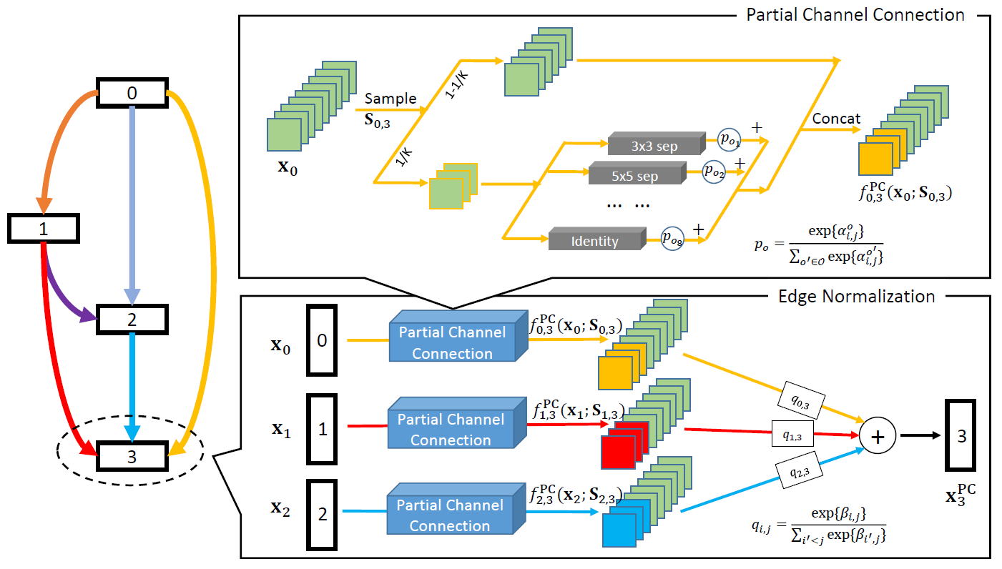
PC-DARTS: Illustration
Partial channel connection and edge normalization

Slide 56
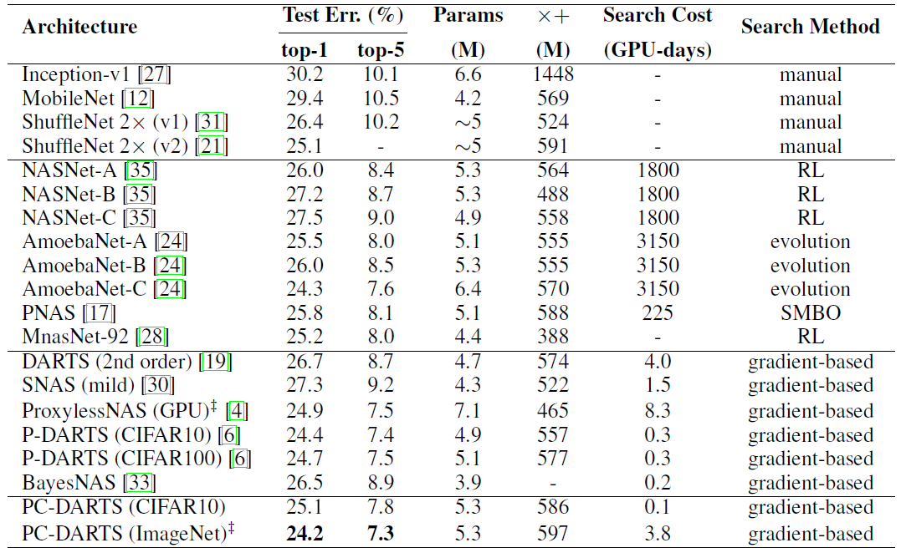
PC-DARTS: Performance on ImageNet
ImageNet (ILSVRC2012) under the Mobile Setting

Slide 57
PC-DARTS: Summary
Regularization is still a big issue
Partial channel connection in order to prevent over-fitting
Edge normalization in order to make partial channel connection work more stable
Our approach
State-of-the-art results on ImageNet
Search cost as small as $0.06$ GPU-days
Future directions
Searching on a larger number of classes
There are many unsolved issues on NAS!

Slide 58
Outline
Neural Architecture Search: what and why?
A generalized framework of Neural Architecture Search
Evolution-based approaches
Reinforcement-learning-based approaches
Towards one-shot architecture search
Applications to a wide range of vision tasks
Our new progress on Neural Architecture Search
Open problems and future directions

Slide 59
Conclusions
NAS is a promising and important trend for machine learning in the future
NAS vs. fixed architectures as deep learning vs. conventional handcrafted features
Two important factors of NAS to be determined
Basic building blocks: fixed or learnable
The way of exploring the search space: genetic algorithm, reinforcement learning, or joint optimization
The importance of computational power is reduced, but still significant

Slide 60
Related Applications
The searched architectures were verified effective for transfer learning tasks
NASNet outperformed ResNet101 in object detection by $4\%$
Take-home message: stronger architectures are often transferrable
The ability of NAS in other vision tasks
Preliminary success in semantic segmentation, object detection, etc.
[Zoph, 2018] B. Zoph et al., Learning Transferable Architectures for Scalable Image Recognition, CVPR, 2018.
[Chen, 2018] L. Chen et al., Searching for Efficient Multi-Scale Architectures for Dense Image Prediction, NIPS, 2018.
[Liu, 2019] C. Liu et al., Auto-DeepLab: Hierarchical Neural Architecture Search for Semantic Image Segmentation, CVPR, 2019.
[Ghiasi, 2019] G. Ghiasi et al., NAS-FPN: Learning Scalable Feature Pyramid Architecture for Object Detection, CVPR, 2019.

Slide 61
Future Directions
Currently, the search space is constrained by the limited types of building blocks
It is not guaranteed that the current building blocks are optimal
It remains to explore the possibility of searching into the building blocks
Currently, the searched architectures are not friendly to hardware
Which leads to dramatically slow speed in network training
Currently, the searched architectures are task-specific
This may not be a problem, but an ideal vision system should be generalized
Currently, the searching process is not yet stable
We desire a framework as generalized as regular deep networks

Slide 62
Thanks
Questions, please?

