Slide 1
ICMR 2015 Image Classification and Retrieval are ONE (Online NN Estimation)
Speaker: Lingxi Xie
Authors: Lingxi Xie¹, Richang Hong²,
Bo Zhang¹, Qi Tian³
¹Department of Computer Science and Technology, Tsinghua University
²School of Computer and Information, Hefei University of Technology
³Department of Computer Science, University of Texas at San Antonio

Slide 2
Outline
Introduction
Image Classification and Retrieval
Conventional BoVW Model
Goal and Motivation
The ONE Algorithm
Experimental Results
Conclusions

Slide 3
Outline
Introduction
Image Classification and Retrieval
Conventional BoVW Model
Goal and Motivation
The ONE Algorithm
Experimental Results
Conclusions

Slide 4
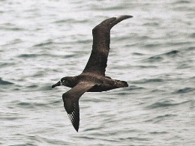
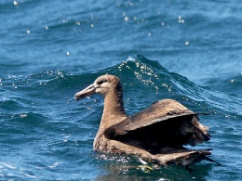
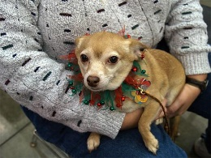
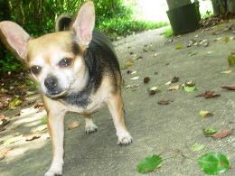
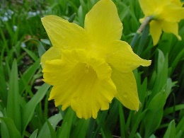
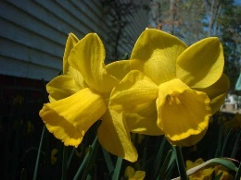
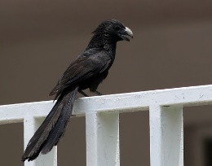
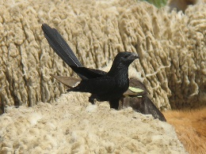
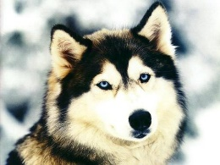
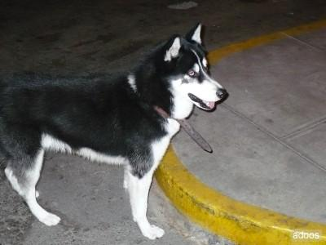
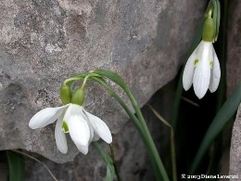
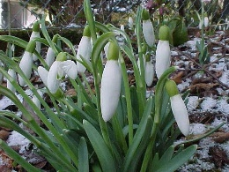
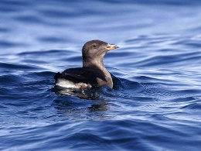
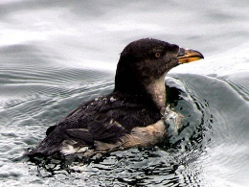
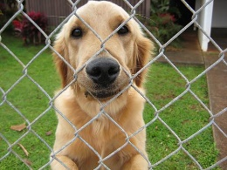
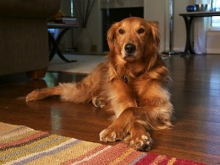
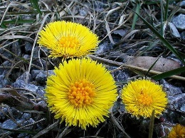
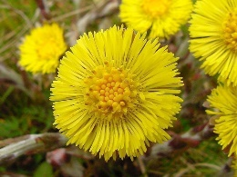
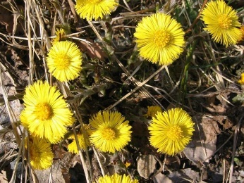
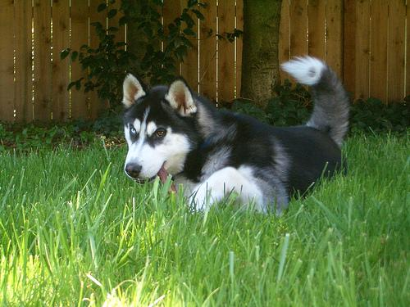
Introduction: Image Classification
BIRD
DOG
DOG
FLOWER
FLOWER
Image
Dataset
Black-foot. Albatross
Chihuahua
daffodil
Groove-billed Ani
Siberian Husky
snowdrop
Bird-200
Dog-120
Flwr-102
Rhinoceros Auklet
Golden Retriever
Colts’ foot
Test
FLOWER
DOG
?
?
Colts’ foot
Siberian Husky

Slide 5
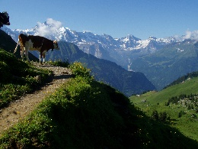
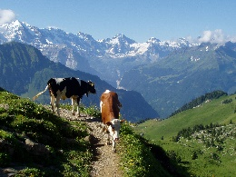
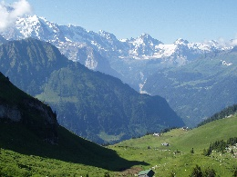
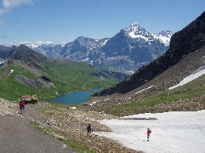
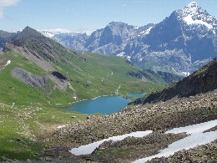
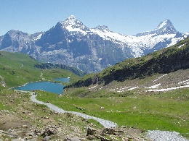
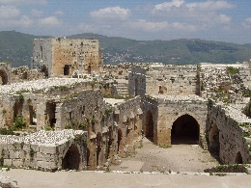
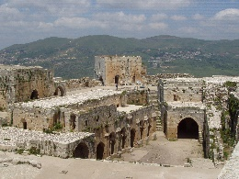
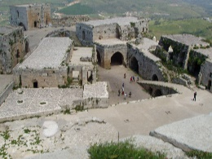
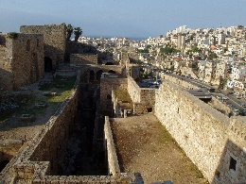
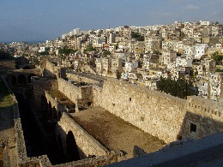
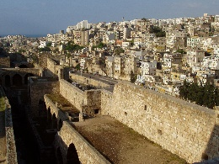
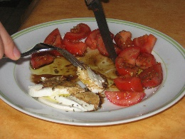
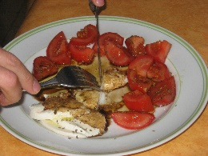
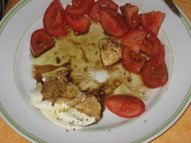
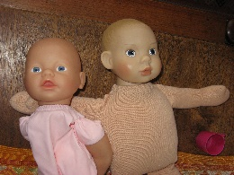
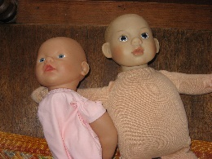
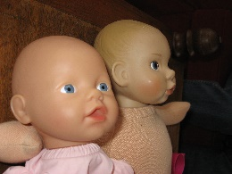
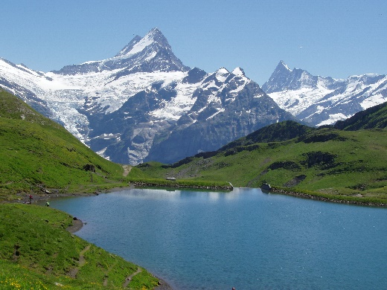
Introduction: Image Retrieval
Image
Dataset
Holiday
QUERY
TP
TP
TP
TP
Test
TP
True-
Positive
FP
TP
FP
TP
FP
False-Positive

Slide 6
BoVW for Classification & Retrieval
COMMON PART
classification
raw images
visual features
global features
A
Img. 1
Img. 2
Img. 3
B
Img. 2
Img. 4
Img. 5
image descriptors
visual vocabulary
inverted file
retrieval

Slide 7
Outline
Introduction
Image Classification and Retrieval
Conventional BoVW Model
Goal and Motivation
The ONE Algorithm
Experimental Results
Conclusions

Slide 8
The Goal
Designing a UNIFIED model:
image classification
for
image retrieval
Answering two questions:
What is the difference between them?
Can we benefit from the unified model?

Slide 9
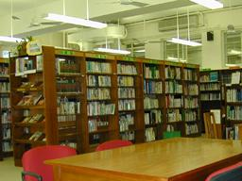
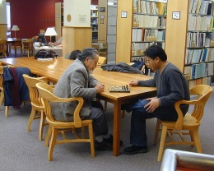
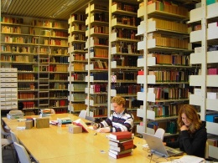
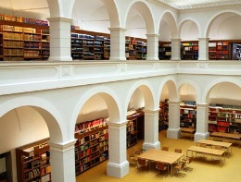
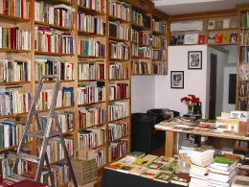
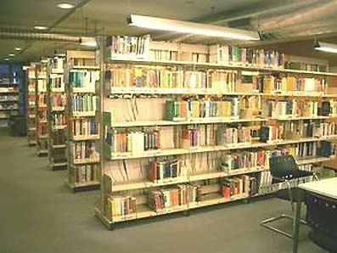
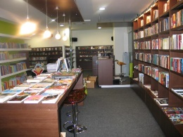
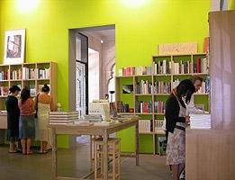
Classification vs. Retrieval
QUERY
sitting people
tidy shelves
chessboard
tidy shelves
sitting people
laptops
library
(library)
arches
open spaces
square table
bookstore
library attr.
bookstore attr.
neutral attr.
6
dense books
tidy shelves
square tables
2
Q
3
7
1
5
With
Retrieval
ladder
pictures
square tables
With
Classification
×
√
4
dense books
tidy shelves
square tables
cashier
various styles
square tables
standing people
sparse books
square tables

Slide 10
Any Inspirations?
Fact 1: classification tasks benefit from extra information (image labels)!
Fact 2: image-to-class distance is more stable than image-to-image distance.
Classification with NN search?
×
Retrieval with class labels?
√
Solution: defining the class for retrieval: extracting multiple objects for each image!

Slide 11
Outline
Introduction
Image Classification and Retrieval
Conventional BoVW Model
Goal and Motivation
The ONE Algorithm
Experimental Results
Conclusions

Slide 12
ONE: Online NN Estimation
Measuring image-to-class distance!
For classification, we have spontaneous categories.
For retrieval, each image forms a category!
Terminology
Category: $\left\{1,2,⋯,C\right\}$, for retrieval, $C=N$.
Image: $I$, each with a category label.
Object proposal set: $𝒫$, $\left|𝒫\right|=K$.
Feature: $f$, each object corresponds to a feature.
Feature set: $ℱ_{c}$, all features in category $c$.

Slide 13
ONE: Online NN Estimation
How to compute image-to-class distance?
image-to-class
distance
$$dist\left(I_{0},c\right)≜dist\left(I_{0},ℱ_{c}\right)$$
$=\frac{1}{K_{0}}\sum_{k=1}^{K_{0}}{dist\left(f_{0,k},ℱ_{c}\right)}$
$=\frac{1}{K_{0}}\sum_{k=1}^{K_{0}}{\min_{f∈ℱ_{c}}{{\left\|f_{0,k}−f\right\|}_{2}^{2}}}$
Naive-Bayes Nearest Neighbor (NBNN)
Boiman et.al, In Defense of Nearest-Neighbor based Image Classification, CVPR’08

Slide 14
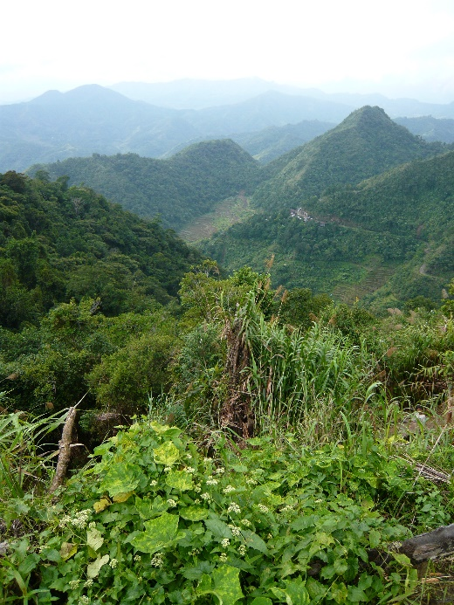
ONE: Online NN Estimation
“Class” $1$
1
1
1
1
1
Feature Space

Slide 15
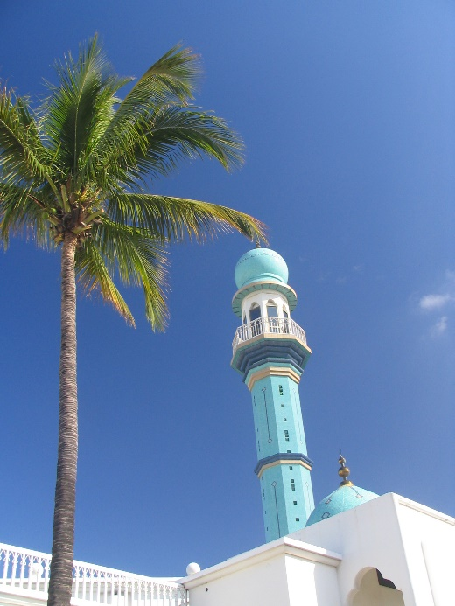
ONE: Online NN Estimation
“Class” $2$
1
2
2
1
2
2
1
2
1
1
Feature Space

Slide 16
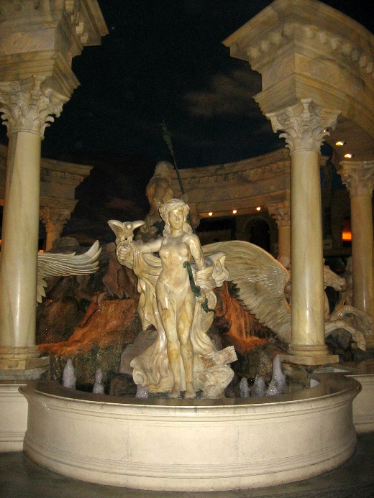
ONE: Online NN Estimation
“Class” $3$
3
1
2
2
3
3
1
2
2
3
1
2
3
1
1
Feature Space

Slide 17
ONE: Online NN Estimation
Test Case
3
1
2
2
3
3
1
2
2
3
1
2
3
1
1
Feature Space

Slide 18
ONE: Online NN Estimation
3
1
2
2
3
3
1
2
2
3
1
2
3
1
1
Feature Space

Slide 19
ONE: Online NN Estimation
Classification?
Retrieval?
Class
$$1$$
3
Rank $3$
1
2
2
3
3
1
Class
$$2$$
2
2
Rank $1$
3
1
2
3
1
Class
$$3$$
1
Rank $2$
Feature Space

Slide 20
What is the Benefit?
QUERY
Search by “natural scene”
TP
TP
mountain
Search by “mountain”
TP
terrace
Search by “terrace”
TP
TP
TP
natural scene
Fused Results
TP
TP
TP
TP
TP

Slide 21
Definition of Object Proposals
Manual Definition
vs.
Automatic Detection
In experiments: both produce satisfying performance!
For simplicity: we use manual definition in evaluation.

Slide 22
Time & Memory Costs
Dataset scale
$N$ candidate images ($\sim {10}^{6}$)
$K$ object proposals for each image ($\sim {10}^{2}$)
$D$-dimensional features for each object ($4096$)
FOR ONE SINGLE QUERY
Time Complexity
$$O\left(K×NK×D\right)=O\left(NK^{2}D\right)$$
# querying features
# indexed features
TOO
EXPENSIVE!
Memory Complexity
$$O\left(N×K×D\right)=O\left(NKD\right)$$

Slide 23
Approximation
Approximate NN search!
PCA reduction: from $D$ to $D′$ ($512$) dimensions
Product Quantization (PQ) approximation: $M$ ($32$) segments, each with $T$ ($4096$) codewords.
FOR ONE SINGLE QUERY
Time Complexity
$$O\left(K×NK×M+K×D′×T\right)$$
PQ cost in summation
codebook
costs
MUCH BETTER!
Memory Complexity
$$O\left(NK×M×\log_{2}{T}+D′×T\right)$$

Slide 24
Parallelization
Why parallelization?
PQ needs a huge amount of regular computations
In comparison, conventional BoVW models with either SVM or inverted index is difficult to parallelize
GPU: the most powerful devices for parallelization
After using GPU
30-50x speed up based on PQ
Only ~1s for each query among 1M images

Slide 25
Outline
Introduction
Image Classification and Retrieval
Conventional BoVW Model
Goal and Motivation
The ONE Algorithm
Experimental Results
Conclusions

Slide 26
Experiments: Image Classification
Fine-Grained Object Recognition
The Pet-37 dataset (7390 images)
The Flower-102 dataset (8189 images)
The Bird-200 dataset (11788 images)
Scene Recognition
The LandUse-21 dataset (2100 images)
The Indoor-67 dataset (15620 images)
The SUN-397 dataset (108954 images)

Slide 27
Results: Fine-Grained Recognition
Pet-37
Flower-102
Bird-200
Wang, IJCV14
59.29%
75.26%
N/A
Murray, CVPR14
56.8%
84.6%
33.3%
Donahue, ICML14
N/A
N/A
58.75%
Razavian, CVPR14
N/A
86.8%
61.8%
Ours (ONE)
88.05%
85.49%
59.66%
SVM with deep feat.
89.50%
86.24%
61.54%
ONE+SVM
90.03%
86.82%
62.02%

Slide 28
Results: Scene Recognition
LandUse-21
Indoor-67
SUN-397
Kobayashi, CVPR14
92.8%
63.4%
46.1%
Xie, CVPR14
N/A
63.48%
46.91%
Donahue, ICML14
N/A
N/A
40.94%
Razavian, CVPR14
N/A
69.0%
N/A
Ours (ONE)
94.52%
68.46%
53.00%
SVM with deep feat.
93.98%
69.61%
54.47%
ONE+SVM
94.71%
70.13%
54.87%

Slide 29
Experiments: Image Retrieval
Near-Duplicate Image Retrieval
The Holiday dataset (1491 images)
500 image groups, 2-12 images per group
Evaluation: the mAP score
The UKBench dataset (10200 images)
2550 object groups, 4 objects per group
Evaluation: the N-S score
The Holiday+1M dataset
Holiday mixed with 1 million distractor images

Slide 30
Results: Image Retrieval
Holiday
UKBench
Holiday+1M
Zhang, ICCV13
0.809
3.60
0.633
Zheng, CVPR14
0.858
3.85
N/A
Zheng, arXiv14
0.881
3.873
0.724
Razavian, CVPR14
0.843
N/A
N/A
Ours (ONE)
0.887
3.873
N/A
BoVW with SIFT
0.518
3.134
N/A
ONE+BoVW
0.899
3.887
0.758

Slide 31
Outline
Introduction
Image Classification and Retrieval
Conventional BoVW Model
Goal and Motivation
The ONE Algorithm
Experimental Results
Conclusions

Slide 32
What have we Learned?
Image classification and retrieval: difference?
Classification benefits from extra labels.
Measuring image-to-class distance is more stable!
Image classification and retrieval: connections?
Both are dealing with image similarity!
From retrieval to category: “pseudo” labels.
ONE (Online Nearest-neighbor Estimation)
A unified model for classification and retrieval.

Slide 33
Why ONE Works Well?
Measuring image-to-class distance.
Theory: NBNN [Boiman, CVPR’08].
Generalizing to image retrieval: “pseudo” labels.
How to perform excellent classification/retrieval?
Good detection (object proposals definition).
Good description (deep conv-net features).
Make it fast: approximation and acceleration.
GPU might be the trend of big-data computation.

Slide 34
Thank you!
Questions please?

