Slide 1
ICCV 2015 RIDE: Reversal Invariant Descriptor Enhancement
Speaker: Lingxi Xie
Authors: Lingxi Xie, Jingdong Wang,
Weiyao Lin, Bo Zhang, Qi Tian
State Key Laboratory of Intelligent Technology and Systems
Department of Computer Science and Technology
Tsinghua University
http://www.tsinghua.edu.cn

Slide 2
Outline
Introduction
The Bag-of-Feature Model
The RIDE Algorithm
Motivation
Towards Reversal Invariance
Experimental Results
Conclusions

Slide 3
Outline
Introduction
The Bag-of-Feature Model
The RIDE Algorithm
Motivation
Towards Reversal Invariance
Experimental Results
Conclusions

Slide 4
Image Classification

Slide 5
Outline
Introduction
The Bag-of-Feature Model
The RIDE Algorithm
Motivation
Towards Reversal Invariance
Experimental Results
Conclusions

Slide 6
Image-level Vector
Spatial Pooling:
Sum Pooling/Max Pooling,
Spatial Pyramid Matching [Lazebnik, CVPR06]
Geometric Phrase Pooling [Xie, ACMMM12]
Compact Feature Codes
Hard/Soft/Sparse Coding methods:
Vector Quantization
LLC Encoding [Wang, CVPR10]
Fisher Vector Encoding [Perronnin, ECCV10]
Visual Vocabulary
Clustering Methods:
K-Means
Hierarchical K-Means [Nister, CVPR06]
Approximate K-Means [Philbin, CVPR07]
Image Descriptors
Gradient-based Local Descriptors:
SIFT [Lowe, IJCV04]
HOG [Dalal, CVPR05]
LCS [Perronnin, ECCV10]
Raw Image

Slide 7
Image-level Vector
Spatial Pooling:
Sum Pooling/Max Pooling,
Spatial Pyramid Matching [Lazebnik, CVPR06]
Geometric Phrase Pooling [Xie, ACMMM12]
Compact Feature Codes
Hard/Soft/Sparse Coding methods:
Vector Quantization
LLC Encoding [Wang, CVPR10]
Fisher Vector Encoding [Perronnin, ECCV10]
Visual Vocabulary
Clustering Methods:
K-Means
Hierarchical K-Means [Nister, CVPR06]
Approximate K-Means [Philbin, CVPR07]
Image Descriptors
Gradient-based Local Descriptors:
SIFT [Lowe, IJCV04]
HOG [Dalal, CVPR05]
LCS [Perronnin, ECCV10]
Raw Image

Slide 8
Outline
Introduction
The Bag-of-Feature Model
The RIDE Algorithm
Motivation
Towards Reversal Invariance
Experimental Results
Conclusions

Slide 9
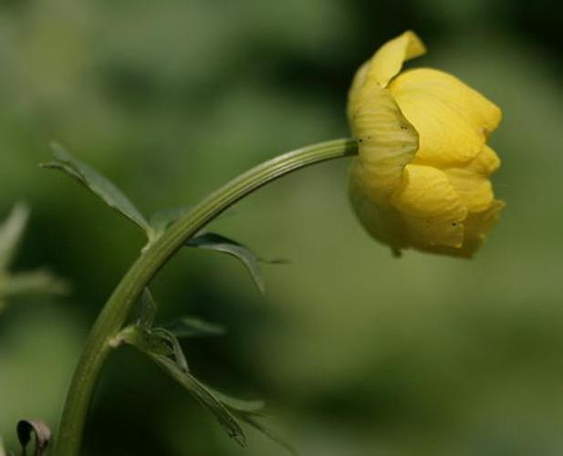
Image Matching: Reversal Copy
What We Want
What SIFT Does

Slide 10
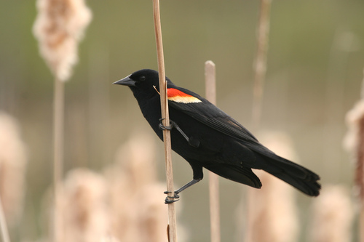
Image Matching: Reversal Objects
What We Want
What SIFT Does

Slide 11
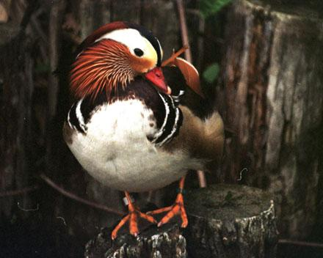
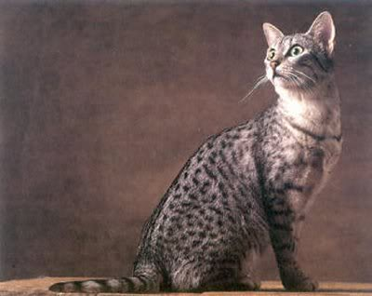
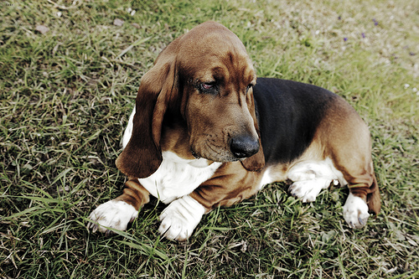
Image Retrieval: Settings
Aircraft-100 Dataset
100 Aircraft Models, 100 Samples in each Model
ALL Images are Manually Oriented to Right
Why Aircrafts?
The Orientation of an Aircraft is Easy to Judge!
Orientation?

Slide 12
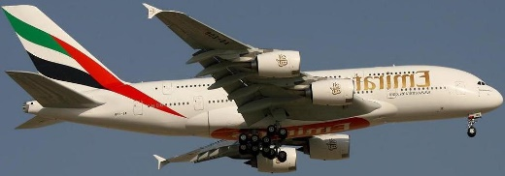
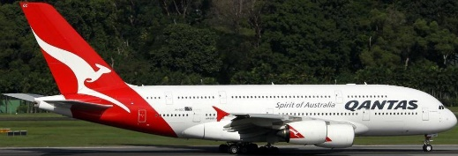
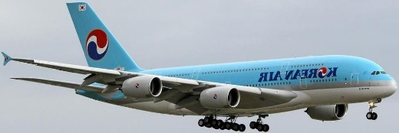
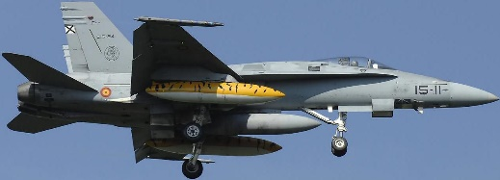
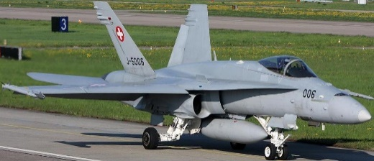
Image Retrieval: Sample Images

Slide 13
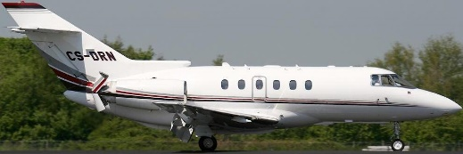
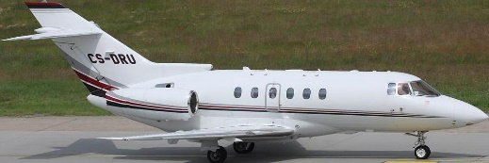
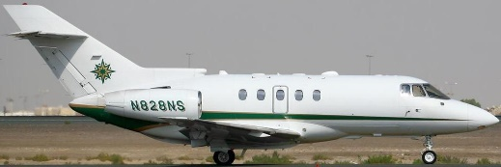
Image Retrieval: Original Image
QUERY
RESULT
#1: BAE-125
$$d=0.00$$
#2: BAE-125
$$d=0.22$$
Model:
BAE-125
Mean AP: 0.4143
Mean Dist.: 0.83
Mean TP Dist.: 0.34
Self-Ranking: #1
First FP: #18
#3: BAE-125
$$d=0.23$$
#4: BAE-125
$$d=0.23$$
#5: BAE-125
$$d=0.24$$
#6: BAE-125
$$d=0.25$$

Slide 14
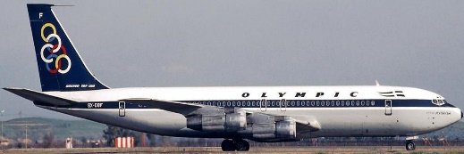
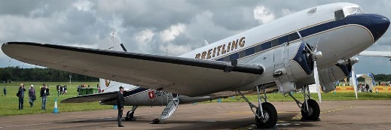
Image Retrieval: Reversed Image
QUERY
RESULT
#1: 707-320
$$d=0.81$$
#2: DC-3
$$d=0.83$$
Model:
BAE-125
Mean AP: 0.0025
Mean Dist.: 1.09
Mean TP Dist.: 1.06
Self-Ranking: #514
First TP: #388
#3: Cessna-560
$$d=0.84$$
#4: MD-80
$$d=0.84$$
#5: 737-400
$$d=0.84$$
#6: 747-100
$$d=0.85$$

Slide 15
Image Retrieval: Comparison
QUERY
QUERY
Model:
BAE-125
Model:
BAE-125
Mean AP: 0.4143
Mean Dist.: 0.83
Mean TP Dist.: 0.34
Self-Ranking: #1
First FP: #18
Mean AP: 0.0025
Mean Dist.: 1.09
Mean TP Dist.: 1.06
Self-Ranking: #514
First TP: #388

Slide 16
What is Observed?
After an Image is Reversed ...
Handcrafted Descriptors cannot be Matched
Feature Representations are Completely Different
Classifying a Dataset with Reversed Objects
Reversed Objects are Different Prototypes
Less # of Training Samples for each Prototype
Inferior Recognition Accuracy

Slide 17
Outline
Introduction
The Bag-of-Feature Model
The RIDE Algorithm
Motivation
Towards Reversal Invariance
Experimental Results
Conclusions

Slide 18
What Happened after Reversal?
Original SIFT
Reversed SIFT
0
0
1
1
2
2
3’
3
3
2’
1’
3’
0’
2’
1’
0’
4
4
5
5
6
6
7’
7
7
6’
5’
7’
4’
6’
5’
4’
8
8
9
9
10
10
11’
11
11
10’
9’
11’
8’
10’
9’
8’
12
12
13
13
14
14
15’
15
15
14’
13’
15’
12’
14’
13’
12’
3
3
2
2
1’
1
1
2’
1’
3’
2’
3’
Original
Index
Reversed
Index
4
4
0’
0
0
0’
4’
4’
$$14×8+5=117$$
$$13×8+7=111$$
5
5
6
6
7’
7
7
6’
7’
5’
6’
5’

Slide 19
Reversal Invariance: Formulation
Descriptors
Original Descriptor: $d$
Reversed Descriptor: $d^{R}$
What is Reversal Invariance?
A Function: $r\left(d\right)$
Which Holds: $r\left(d\right)=r\left(d^{R}\right)$ for ANY $d$

Slide 20
How to Find $r\left(d\right)$?
A Specific Definition
Define: $r\left(d\right)≜s\left(d,d^{R}\right)$
In Which, $s\left(d,d^{R}\right)$ must be Symmetric
So, $r\left(d\right)≜s\left(d,d^{R}\right)=s\left(d^{R},d \right)=r\left(d^{R}\right)$
NOTE: ${\left(d^{R}\right)}^{R}=d$
Reversing an Image Twice is NO Change!

Slide 21
How to Find $s\left(d,d^{R}\right)$?
Another Specific Definition
Define: $s\left(d,d^{R}\right)$ is either $d$ or $d^{R}$
Maximally Preserving the Description Power of SIFT
There can be Many Other Solutions
An Orientation Function $q\left(d\right)$
The Extent that $d$ is Oriented to Right
Compare $q\left(d\right)$ with $q\left(d^{R}\right)$
The One with Larger Value is Selected
If Equal, Select the One with Larger Alphabetical Order

Slide 22
How to Find $q\left(d\right)$?
Descriptor
Bin
3
2
1
0
1
2
3
$$x$$
4
0
4
5
6
7
$$y$$
5
6
7
8
9
10
11
$$G_{3,1}^{Y}=−a_{3,1}×\frac{\sqrt{2}}{2}$$
12
13
14
15
$$G_{3,1}^{X}=a_{3,1}×\frac{\sqrt{2}}{2}$$
$$G^{X}=\sum_{i=0}^{15}{\sum_{j=0}^{7}{G_{i,j}^{X}}}$$
$$G^{Y}=\sum_{i=0}^{15}{\sum_{j=0}^{7}{G_{i,j}^{Y}}}$$
$$q\left(d\right)=G^{X}\left(d\right)$$

Slide 23
Summary
Why Reversal Invariance?
Reversal Generates Different Prototypes
How to Obtain Reversal Invariance?
Compute Orientation, Get the Maximum
Extra Computational Costs
Cheap: Little Time, No Memory
RIDE can be Applied to Other Descriptors!

Slide 24
Outline
Introduction
The Bag-of-Feature Model
The RIDE Algorithm
Motivation
Towards Reversal Invariance
Experimental Results
Conclusions

Slide 25
Datasets
Fine-Grained Object Recognition
Oxford Pet-37 (37 Cats & Dogs, 7390 Images)
Aircraft-100 (100 Aircraft Models, 10000 Images)
Stanford Dog-120 (120 Dogs, 20780 Images)
Caltech-UCSD Bird-200 (200 Birds, 11788 Images)
Scene Classification
LandUse-21 (21 Land Uses, 2100 Images)
MIT Indoor-67 (67 Indoor Scenes, 15620 Images)
SUN-397 (397 In/Out-door Scenes, 108754 Images)

Slide 26
Settings
The BoVW Model
Images are Resized, 300 Pixels on Longer Axis
Various Descriptors, Step = 6, Window Size = 12
PCA Reduced to 64 (Color-SIFT to 128)
GMM with 32 Components
Fisher Vector Encoding
Spatial Pyramid with 3 Horizontal Stripes
Linear SVM with C = 10
Stronger Features can be Used

Slide 27
Models
Four Different Models
Original Descriptors (ORIG)
RIDE on Original Descriptors (RIDE)
Original Descriptors with Augmentation (AUGM)
RIDE with Doubled Codebook Size (RIDEx2)
Why Using RIDEx2?
Comparable Computational Costs with AUGM
Fair Comparison

Slide 28
Pet-37 Performance
ORIG
RIDE
AUGM
RIDEx2
SIFT
37.92
42.28
42.24
45.61
LCS
43.25
44.27
45.12
46.83
Fused
52.06
54.69
54.67
57.51
RGB-SIFT
44.90
47.35
46.98
49.53
OPP-SIFT
46.53
49.01
48.72
51.19

Slide 29
Aircraft-100 Performance
ORIG
RIDE
AUGM
RIDEx2
SIFT
53.13
57.82
57.16
60.14
LCS
41.82
42.86
43.13
44.81
Fused
57.36
61.27
60.59
63.62
RGB-SIFT
57.89
63.09
62.48
65.11
OPP-SIFT
47.06
53.12
51.39
55.79

Slide 30
Flower-102 Performance
ORIG
RIDE
AUGM
RIDEx2
SIFT
53.68
59.12
58.01
61.09
LCS
73.47
75.30
75.88
77.40
Fused
76.96
80.51
79.49
82.14
RGB-SIFT
71.52
74.97
74.18
77.10
OPP-SIFT
76.12
79.68
78.83
81.69

Slide 31
Bird-200 Performance
ORIG
RIDE
AUGM
RIDEx2
SIFT
25.77
32.14
31.60
34.07
LCS
36.18
38.50
38.97
40.16
Fused
38.11
44.73
43.98
46.38
RGB-SIFT
31.36
39.16
39.79
41.73
OPP-SIFT
35.40
42.18
41.72
44.30

Slide 32
Time & Memory Costs (on Bird-200)
ORIG
RIDE
AUGM
RIDEx2
Desc.
2.27Hrs
2.29Hrs
2.30Hrs
2.29Hrs
Codeb.
0.13Hrs
0.13Hrs
0.13Hrs
0.27Hrs
Encod.
0.78Hrs
0.78Hrs
1.56Hrs
1.28Hrs
Classifi.
1.21Hrs
1.21Hrs
2.46Hrs
2.42Hrs
(RAM)
3.71GB
3.71GB
7.52GB
7.51GB

Slide 33
Comparison to the State-of-the-Art
Compared with
[DB]: the Paper which Proposed Database
[MAX]: Max-SIFT, Another Reversal Invariant Descriptors for Image Classification, ICASSP 2015
Fine-Grained Object Recognition
[GMP]: Generalized Max Pooling, CVPR 2014
Scene Classification
[DIR]: Dirichlet-based Features, CVPR 2014

Slide 34
Comparison: Fine-Grained
P-37
A-100
F-102
B-200
ORIG
60.24
74.61
83.53
47.61
RIDE
63.49
78.92
86.45
50.81
[DB]
59.21
48.69
72.8
17.0
[MAX]
60.65
74.39
83.13
47.20
[GMP]
56.8
N/A
84.6
33.3

Slide 35
Comparison: Fine-Grained
LandU-21
Indoor-67
SUN-397
ORIG
93.64
63.17
48.35
RIDE
94.71
64.93
50.12
[DB]
81.19
26.1
38.0
[MAX]
92.91
62.45
47.69
[DIR]
92.8
63.4
46.1

Slide 36
Bird-200 with Detected Parts
Chai, ICCV13
Gavves, ICCV13
Paper
56.6
62.7
Ours
57.7
62.9
+RIDE
60.7
65.2
+RIDEx2
61.9
66.1

Slide 37
Summary
Reversal Invariance is Useful for Recognition
RIDE Produces Consistent Accuracy Gain
For Every Single Case (Dataset with Descriptor)
RIDE Cooperates well with Part Detectors
RIDE is Cheap and Efficient
Extra Time and Memory Costs are Ignorable

Slide 38
Outline
Introduction
The Bag-of-Feature Model
The RIDE Algorithm
Motivation
Towards Reversal Invariance
Experimental Results
Conclusions

Slide 39
Conclusions
Reversal Invariance is Important
Causes Significant Difference in Images
More Prototypes, Less Training Samples
A Popular Solution: Data Augmentation
Our Solution: RIDE
Reversal Invariant Descriptor Enhancement
Aligning an Image with Its Orientation
Accuracy Gain, Little Extra Computation

Slide 40
Future Proposals
Other Image Applications?
Tell the Orientation of an Image
Cooperation with Deep CNN?
Convolutional is NOT Reversal Invariant!
Can we Apply Similar Techniques?
Reversal Invariance vs. Data Augmentation

Slide 41
Thank you!
Questions please?

