Slide 1
CVPR 2014 Orientational Pyramid Matching for Recognizing Indoor Scenes
Speaker: Lingxi Xie
Authors: Lingxi Xie, Jingdong Wang,
Baining Guo, Bo Zhang, Qi Tian
State Key Laboratory of Intelligent Technology and Systems
Department of Computer Science and Technology
Tsinghua University
http://www.tsinghua.edu.cn

Slide 2
Outline
Introduction
The Bag-of-Feature Model
Orientational Pyramid Matching
Experimental Results
Analysis
Conclusions

Slide 3
Outline
Introduction
The Bag-of-Feature Model
Orientational Pyramid Matching
Experimental Results
Analysis
Conclusions

Slide 4
Scene Recognition
A basic task towards image understanding
The Scale is Getting Larger!
UIUC Sport-8 Dataset: 8 Categories, 1573 Images
Scene-15 Dataset: 15 Categories, 4485 Images
MIT Indoor-67 Dataset: 67 Categories, 15620 Images
SUN-397 Dataset: 397 Categories, 100K+ Images
Different from Object Recognition
Prefer Global Features to Local Features

Slide 5
Outline
Introduction
The Bag-of-Feature Model
Orientational Pyramid Matching
Experimental Results
Analysis
Conclusions

Slide 6
Image-level Vector
Spatial Pooling:
Sum Pooling/Max Pooling,
Spatial Pyramid Matching [Lazebnik, CVPR06]
Geometric Phrase Pooling [Xie, ACMMM12]
Compact Feature Codes
Hard/Soft/Sparse Coding methods:
Vector Quantization
ScSPM encoding [Yang, CVPR09]
LLC encoding [Wang, CVPR10]
Visual Vocabulary
Clustering methods:
K-Means
Hierarchical K-Means [Nister, CVPR06]
Approximate K-Means [Philbin, CVPR07]
Image Descriptors
Gradient-based local descriptors:
SIFT [Lowe, IJCV04]
HOG[Dalal, CVPR05]
Raw Image

Slide 7
Image-level Vector
Spatial Pooling:
Sum Pooling/Max Pooling,
Spatial Pyramid Matching [Lazebnik, CVPR06]
Geometric Phrase Pooling [Xie, ACMMM12]
Compact Feature Codes
Hard/Soft/Sparse Coding methods:
Vector Quantization
ScSPM encoding [Yang, CVPR09]
LLC encoding [Wang, CVPR10]
Visual Vocabulary
Clustering methods:
K-Means
Hierarchical K-Means [Nister, CVPR06]
Approximate K-Means [Philbin, CVPR07]
Image Descriptors
Gradient-based local descriptors:
SIFT [Lowe, IJCV04]
HOG[Dalal, CVPR05]
Raw Image

Slide 8
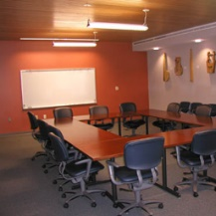
Spatial Pyramid Matching (SPM)
=
Part 1
[Lazebnik, CVPR06]
=
Part 2
=
Part 3
=
Part 4
=
Part 5

Slide 9
Outline
Introduction
The Bag-of-Feature Model
Orientational Pyramid Matching
Experimental Results
Analysis
Conclusions

Slide 10
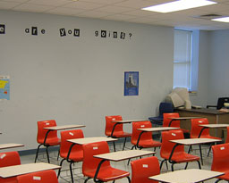
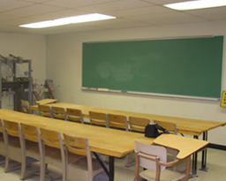
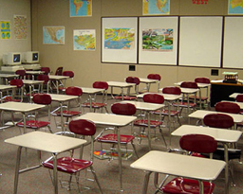
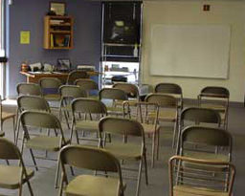
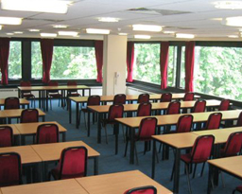
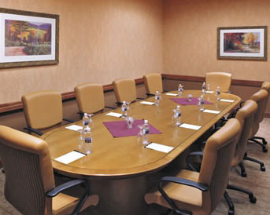
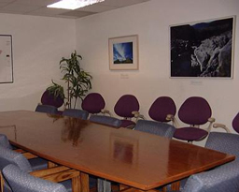
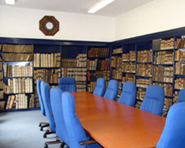
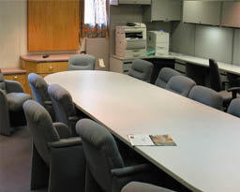
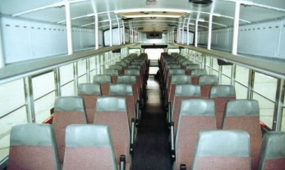
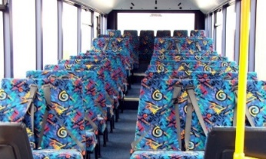
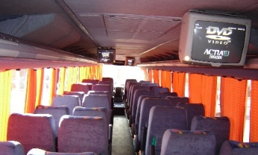
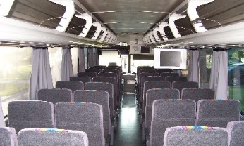
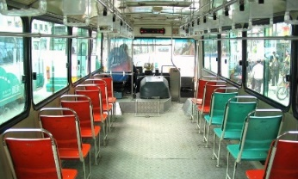
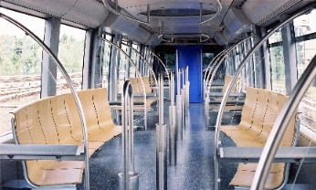
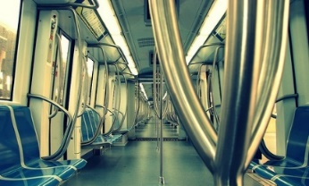
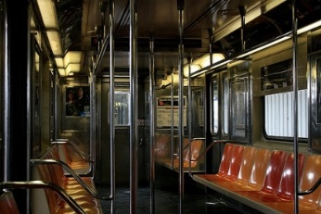
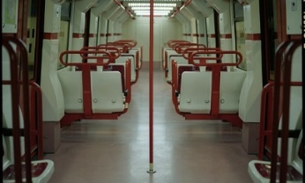
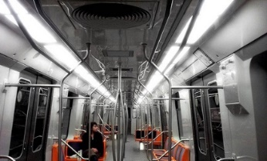
Motivation
classroom
meeting room
What’s the Main Difference
between the Confusing Pairs?
Examples
The Orientation of Chairs!
inside bus
inside subway

Slide 11
Motivation
spatial
histogram
spatial
histogram
1.0
1.0
classroom
inside bus
0.8
0.8
meeting room
inside subway
0.6
0.6
Spatial Distribution of
Chairs are Very Confusing!
0.4
0.4
0.2
0.2
0.0
0.0
upper-left
upper-right
lower-left
lower-right
upper-left
upper-right
lower-left
lower-right

Slide 12
Motivation
orient.
histogram
orient.
histogram
1.0
1.0
classroom
inside bus
0.8
0.8
meeting room
inside subway
0.6
0.6
Orientational Distribution of
Chairs are More Dipersive!
0.4
0.4
0.2
0.2
0.0
0.0
front
left
back
right
front
left
back
right

Slide 13
Spatial Pooling Revisited
spatial
space
y
x

Slide 14
Orientational Pooling
orientational
space
ϕ
θ

Slide 15
Orientational Pooling
orientational
space
ϕ
θ

Slide 16
Spatial vs. Orientational
spatial
space
orientational
space
y
ϕ
x
θ

Slide 17
How to Estimate 3D Orientation?
Still an Open Problem
Very Challenging, Especially for Small Patches
Our Solution: Data-driven Approach
Illumination might Help!
SIFT Feature: Capturing the Gradients?
Very Rough, Far from Perfect
Possible Solutions
Geometric: Vanishing Points, Line Detection, ...
3D Modeling: Kinect, ...

Slide 18
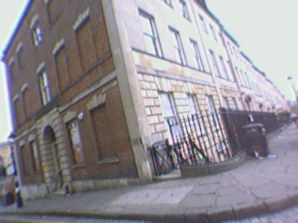
Training Image Annotation
Land-
mark
Points
Conti-nued
Planes
Plane
Orien-tation
d = (x, y, z)

Slide 19
Training Patch Collection
Non-Planar
Patch
Planar
Patch

Slide 20
Orientation Assignment
Planar
Patches
Non-Planar
Patches
New
Patch
Find K (5)
NN Patches
Planar
Patch!

Slide 21
Orientation Assignment
Planar
Patches
Non-Planar
Patches
New
Patch
Find K (5)
NN Patches
Non-Planar
Patch!

Slide 22
Statistics
100,000 Patches are Collected
50000 Planar
50000 Non-Planar
In the Testing Process
K is set as 101
About 50% Patches are Classified as Non-Planar
These Patches are Simply Ignored (not used in Pooling)

Slide 23
Outline
Introduction
The Bag-of-Feature Model
Orientational Pyramid Matching
Experimental Results
Analysis
Conclusions

Slide 24
Datasets
MIT Indoor-67 Dataset
Currently Largest Indoor Scene Dataset
67 Categories, 15620 Images
80 trainings, 20 testings, per Category
SUN-397 Dataset
A Large-scale Scene Recognition Task
397 Categories, More than 100K Images
50 trainings, 50 testings, per Category

Slide 25
MIT Indoor-67 Comparison
Algorithm
Accuracy
Kobayashi et.al, CVPR13
58.91
Juneja et.al, CVPR13
63.10
Ours (SPM)
61.22
Ours (OPM)
51.45
Ours (SPM+OPM)
63.48

Slide 26
SUN-397 Comparison
Algorithm
Accuracy
Xiao et.al, CVPR10
38.0
Sanchez et.al, IJCV13
43.2
Ours (SPM)
43.58
Ours (OPM)
34.61
Ours (SPM+OPM)
45.91

Slide 27
Caltech101 Comparison
Algorithm
Accuracy
Chatfield et.al, BMVC11
77.78
Jia et.al, CVPR12
75.3
Ours (SPM)
80.73
Ours (OPM)
65.59
Ours (SPM+OPM)
81.75

Slide 28
Outline
Introduction
The Bag-of-Feature Model
Orientational Pyramid Matching
Experimental Results
Analysis
Conclusions

Slide 29
Further Analysis
On the MIT Indoor-67 Dataset
Observing the Confusion Matrix
Two Comparisons
Confusing Pairs
Better Discriminated by SPM or OPM
A Confusing Group
Better Classified after Combining SPM and OPM

Slide 30
Confusing Pairs
Category Pairs better Discriminated by SPM
game room vs. garage (+4.78%)
restaurant kitchen vs. studio music (+4.64%)
library vs. clothing store (+4.62%)
Category Pairs better Discriminated by OPM
bookstore vs. library (+6.69%)
auditorium vs. concert hall (+5.35%)
computer room vs. office (+4.40%)

Slide 31
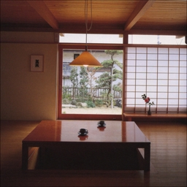
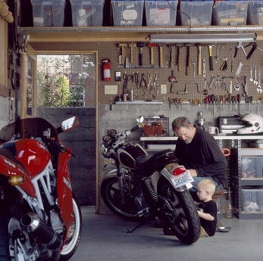
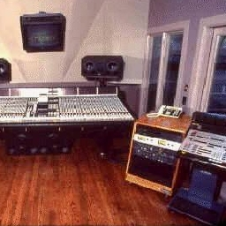
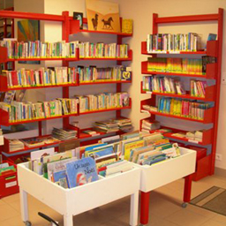
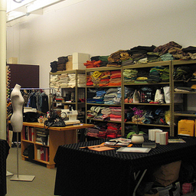
Pairs better with SPM
game room
garage
tables
OPM
SPM
+4.78%
restr. kitchen
studio music
cabinets
Spatial Distribution
are More Discriminative!
OPM
SPM
+4.64%
library
clothin. store
shelves
OPM
SPM
+4.62%

Slide 32
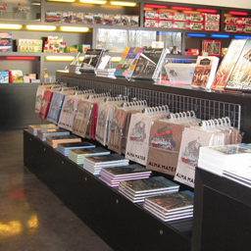
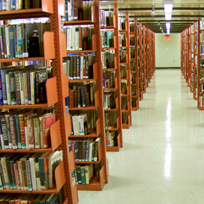
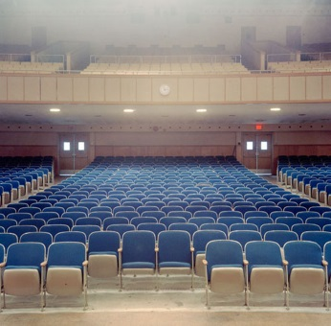
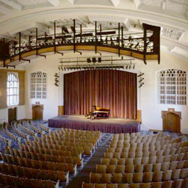
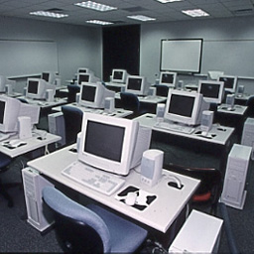
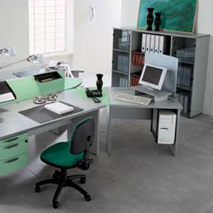
Pairs better with OPM
bookstore
library
shelves
OPM
SPM
+6.69%
auditorium
concerthall
chairs
Orientational Distribution
are More Discriminative!
OPM
SPM
+5.35%
comptr.room
office
computers
OPM
SPM
+4.40%

Slide 33
Confusing Group
A Category Group with Confusing Concepts
bedroom, children room, computer room,
hospital room, living room, meeting room,
office, waiting room
SPM can not Discriminate Very Well
SPM+OPM Works Much Better!

Slide 34
Confusing Group
bedroom
classroom
compt. room
hosptl. room
living room
meetn. room
office
waitn. room
bedroom
classroom
compt. room
hosptl. room
living room
meetn. room
office
waitn. room
bedroom
44.6
1.1
2.7
14.6
23.4
2.8
4.8
6.0
bedroom
52.7
0.6
1.2
11.7
22.6
1.8
4.1
5.3
classroom
0.9
71.8
8.5
2.1
1.8
7.9
3.6
3.3
classroom
0.9
80.9
5.8
0.6
3.0
4.8
0.6
3.3
compt. room
2.6
15.6
44.1
9.4
5.9
6.8
8.2
7.4
compt. room
5.1
19.1
44.1
4.1
3.5
3.2
10.3
4.1
hosptl. room
11.0
1.4
5.2
61.4
3.3
3.3
8.1
6.2
hosptl. room
6.2
1.4
2.4
71.4
0.5
7.1
5.2
5.7
living room
18.2
4.6
3.4
5.0
51.0
3.6
8.8
5.5
living room
17.1
2.5
2.6
4.7
58.2
2.6
6.8
5.3
meetn. room
3.6
12.2
9.1
11.0
5.5
45.5
3.9
9.3
meetn. room
1.4
10.8
4.6
6.7
6.9
59.5
3.3
6.9
office
5.9
9.0
19.3
8.6
16.2
8.3
27.2
5.5
office
5.5
6.9
14.8
6.9
15.2
6.2
36.2
8.3
waitn. room
8.6
5.6
10.0
13.1
10.3
9.4
8.9
34.6
waitn. room
5.4
3.9
5.9
10.6
8.9
9.3
8.7
47.3
Increased On-diagonal Element
Decreased Off-diagonal Element

Slide 35
Summarization
Orientational Features are Useful
OPM Provides Complementary Information
SPM+OPM Achieves State-of-the-Art Accuracy

Slide 36
Outline
Introduction
The Bag-of-Feature Model
Orientational Pyramid Matching
Experimental Results
Analysis
Conclusions

Slide 37
Main Contributions
A Novel Proposal to Scene Recognition
Orientational Features are Useful!
Spatial and Orientational Clues are Complementary
A Neat Algorithm for Orientational Features
Data-driven Method for Orientation Assignment
Pyramid Matching for Orientational Pooling
Might be Cooperated with Multiple Algorithms

Slide 38
Conclusions and Future Work
Orientation Prediction is Very Interesting
Very Challenging in 2D Images
Data-driven Method is NOT Adequate
Possible Solutions?
3D Image Modeling
Geometric Methods
Vanishing Points
Line Detection

Slide 39
Thank you!
Questions please?

