Slide 1
ACM Multimedia 2012 Spatial Pooling of Heterogeneous Features for Image Applications
Speaker: Lingxi Xie
Authors: Lingxi Xie, Qi Tian, Bo Zhang
State Key Laboratory of Intelligent Technology and Systems
Department of Computer Science and Technology
Tsinghua University
http://www.tsinghua.edu.cn

Slide 2
Outline
Introduction
The Bag-of-Features Framework
Our Proposed Framework
Analysis
Experimental Results
Conclusions

Slide 3
Outline
Introduction
The Bag-of-Features Framework
Our Proposed Framework
Analysis
Experimental Results
Conclusions

Slide 4
Image Applications
Image Classification
Image Retrieval
Scene Understanding
Image Recommendation
Image Tagging
......

Slide 5
Image Representation
Important Step for Various Applications
The Main Task
Represent Images with High-Dimensional Vectors
Find the Semantics on the Images
The Bag-of-Features (BoF) Framework
The Most Widely-Used Algorithm
A Statistical method
Very Successful in Recent Years

Slide 6
Outline
Introduction
The Bag-of-Features Framework
Our Proposed Framework
Analysis
Experimental Results
Conclusions

Slide 7
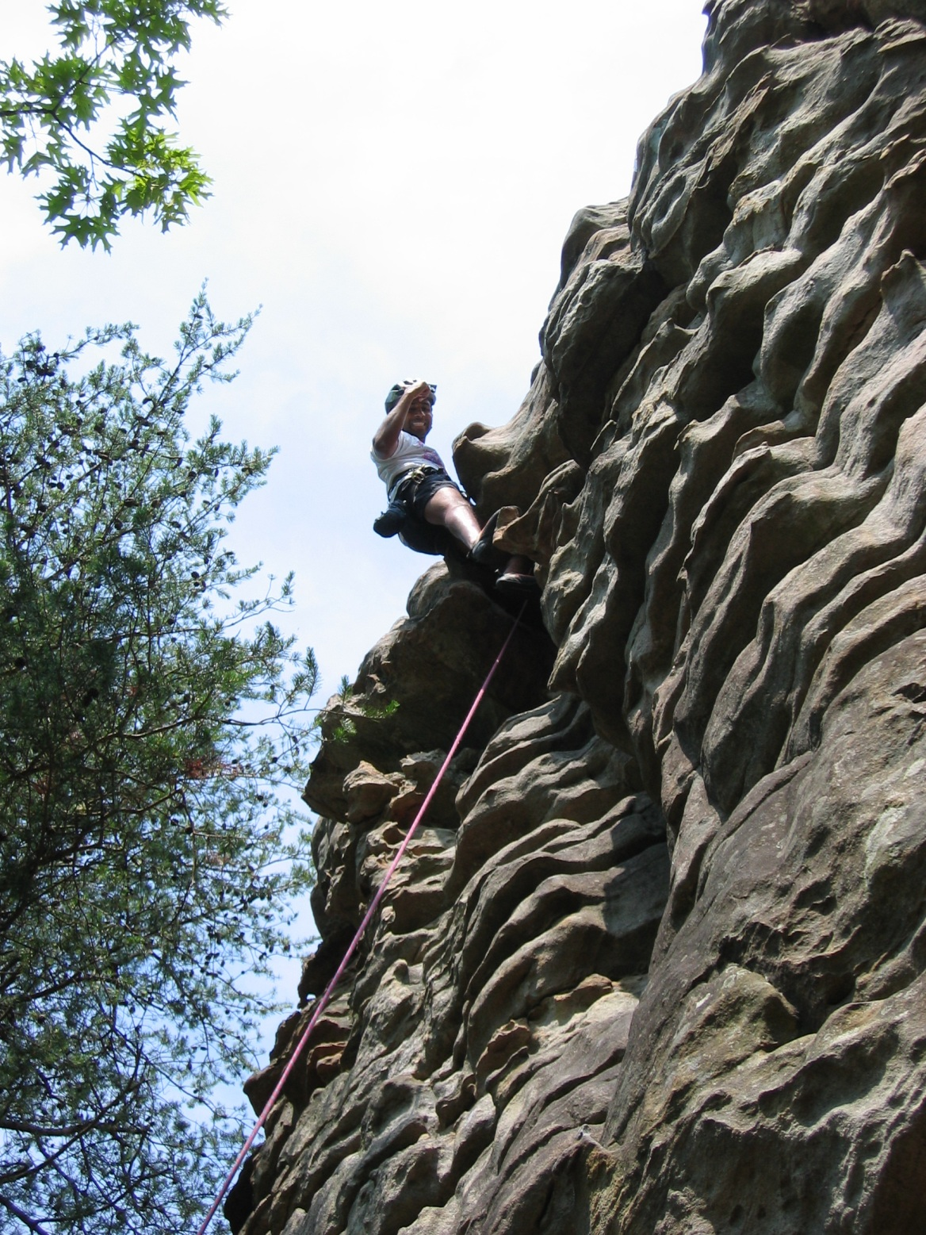
Raw Image Data

Slide 8
SIFT Descriptor
Gray scale: 128D
Color image: 384D
Texture Descriptors
SIFT
Raw Image Data

Slide 9
Visual Vocabulary
K-Mns
Texture Descriptors
SIFT
Raw Image Data
The Feature Space

Slide 10
The Codebook
0
1
2
3
4
5
6
7
Code Word
0
1
2
3
4
5
6
7
8
9
A
B
C
D
E
F
8
9
A
B
C
D
E
F
Gray scale: 128D
Color image: 384D
B
E
0
Visual Vocabulary
3
C
7
K-Mns
1
A
8
5
6
9
4
Texture Descriptors
2
D
F
SIFT
Raw Image Data
The Feature Space

Slide 11
Visual Word
Same Dimension with Codebook Size (16)
0
1
2
3
4
5
6
7
8
9
A
B
C
D
E
F
0
1
2
3
4
5
6
7
8
9
A
B
C
D
E
F
Visual Words
LLC
B
E
0
Visual Vocabulary
3
C
7
K-Mns
1
A
8
5
6
9
4
Texture Descriptors
2
D
F
SIFT
Raw Image Data
The Feature Space

Slide 12
Visual Word
Same Dimension with Codebook Size (16)
0
0
1
1
2
2
3
3
4
4
5
5
6
6
7
7
8
8
9
9
A
A
B
B
C
C
D
D
E
E
F
F
Visual Words
LLC
B
E
0
Visual Vocabulary
3
C
7
K-Mns
1
A
8
5
6
9
4
Texture Descriptors
2
D
F
SIFT
Raw Image Data
The Feature Space

Slide 13
Visual Word
Same Dimension with Codebook Size (16)
0
0
1
1
2
2
3
3
4
4
5
5
6
6
7
7
8
8
9
9
A
A
B
B
C
C
D
D
E
E
F
F
Visual Words
LLC
B
E
0
Visual Vocabulary
3
C
7
K-Mns
1
A
8
5
6
9
4
Texture Descriptors
2
D
F
SIFT
Raw Image Data
The Feature Space

Slide 14
Visual Words
LLC
B
E
0
Visual Vocabulary
3
C
7
K-Mns
1
A
8
5
6
9
4
Texture Descriptors
2
D
F
SIFT
Raw Image Data
The Feature Space

Slide 15
Pooled Vectors
MAX
Visual Words
LLC
Visual Vocabulary
K-Mns
Texture Descriptors
SIFT
Raw Image Data

Slide 16
Pooled Vectors
0
1
2
3
4
5
6
7
8
9
A
B
C
D
E
F
MAX
0
1
2
3
4
5
6
7
8
9
A
B
C
D
E
F
Visual Words
Pooled Vector
LLC
Visual Vocabulary
Same Dimension with Codebook Size (16)
K-Mns
0
1
2
3
4
5
6
7
8
9
A
B
C
D
E
F
Other Feature Codes are Ignored Here
Texture Descriptors
SIFT
Raw Image Data
0
1
2
3
4
5
6
7
8
9
A
B
C
D
E
F
0
1
2
3
4
5
6
7
8
9
A
B
C
D
E
F
0
0
0
1
1
1
2
2
2
3
3
3
4
4
4
5
5
5
6
6
6
7
7
7
8
8
8
9
9
9
A
A
A
B
B
B
C
C
C
D
D
D
E
E
E
F
F
F

Slide 17
Feature Super-Vectors
SPM
Pooled Vectors
MAX
0
1
2
3
4
5
6
7
8
9
A
B
C
D
E
F
0
1
2
3
4
5
6
7
8
9
A
B
C
D
E
F
Visual Words
LLC
Visual Vocabulary
0
1
2
3
4
5
6
7
8
9
A
B
C
D
E
F
K-Mns
Texture Descriptors
0
1
2
3
4
5
6
7
8
9
A
B
C
D
E
F
0
1
2
3
4
5
6
7
8
9
A
B
C
D
E
F
SIFT
Raw Image Data

Slide 18
Feature Super-Vectors
SPM
Pooled Vectors
0
1
2
3
4
5
6
7
8
9
A
B
C
D
E
F
MAX
0
1
2
3
4
5
6
7
8
9
A
B
C
D
E
F
0
1
2
3
4
5
6
7
8
9
A
B
C
D
E
F
0
1
2
3
4
5
6
7
8
9
A
B
C
D
E
F
Visual Words
0
1
2
3
4
5
6
7
8
9
A
B
C
D
E
F
LLC
Visual Vocabulary
0
1
2
3
4
5
6
7
8
9
A
B
C
D
E
F
0
1
2
3
4
5
6
7
8
9
A
B
C
D
E
F
K-Mns
0
1
2
3
4
5
6
7
8
9
A
B
C
D
E
F
Feature Super-Vector
Texture Descriptors
0
1
2
3
4
5
6
7
8
9
A
B
C
D
E
F
0
1
2
3
4
5
6
7
8
9
A
B
C
D
E
F
Codebook Size (16) times Number of Regions (5)
SIFT
Raw Image Data

Slide 19
Shortcomings of BoF Framework
The Poor Description of SIFT Descriptors
Synonymy and Polysemy
The Lack of Using Spatial Information
Global Structure: Image Division
Local Structure: Visual Phrase
Difficulty of Locating Interesting Objects
Noises from Background Clutters

Slide 20
Outline
Introduction
The Bag-of-Features Framework
Our Proposed Framework
Analysis
Experimental Results
Conclusions

Slide 21
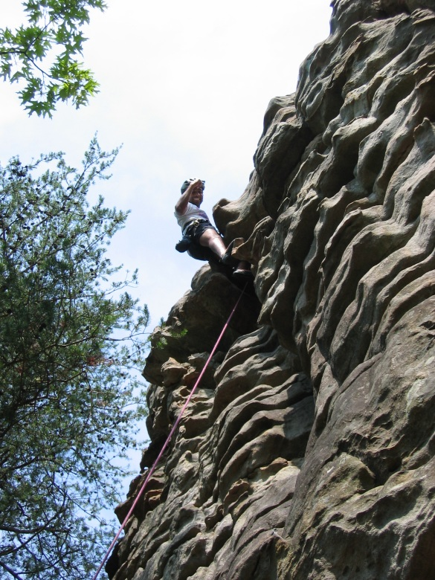
Feature Super-Vectors
SPM
Pooled Vectors
MAX
Visual Words
LLC
SIFT Descriptor
Edge-SIFT Descriptor
Visual Vocabulary
Fused Descriptors
K-Mns
#1: The Fused Descriptors
Texture Descriptor
Fused Descriptors
Shape Descriptors
Shape Descriptor
Texture Descriptors
Same Dimension
SIFT
SIFT
Raw Image Data
Edgemap

Slide 22
Feature Super-Vectors
Visual Phrase
SPM
Pooled Vectors
MAX
Phrase Vectors
GPP
Visual Words
Central Word
LLC
Side Word
Visual Vocabulary
Visual Word
K-Mns
Fused Descriptors
Shape Descriptors
Visual Phrase
Texture Descriptors
(Word Group)
SIFT
SIFT
Raw Image Data
Edgemap

Slide 23
Central Word
0
1
2
3
4
5
6
7
8
9
A
B
C
D
E
F
Side Word
0
1
2
3
4
5
6
7
8
9
A
B
C
D
E
F
Phrase Vector
for 1st Word Pair
0
0
1
1
2
2
3
3
4
4
5
5
6
6
7
7
8
8
9
9
A
A
B
B
C
C
D
D
E
E
F
F

Slide 24
Central Word
0
1
2
3
4
5
6
7
8
9
A
B
C
D
E
F
Side Word
0
1
2
3
4
5
6
7
8
9
A
B
C
D
E
F
Phrase Vector
for 2nd Word Pair
0
1
2
3
4
5
6
7
8
9
A
B
C
D
E
F
0
1
2
3
4
5
6
7
8
9
A
B
C
D
E
F

Slide 25
Central Word
0
1
2
3
4
5
6
7
8
9
A
B
C
D
E
F
Side Word
0
1
2
3
4
5
6
7
8
9
A
B
C
D
E
F
Phrase Vector
for 3rd Word Pair
0
0
1
1
2
2
3
3
4
4
5
5
6
6
7
7
8
8
9
9
A
A
B
B
C
C
D
D
E
E
F
F

Slide 26
……
0
1
2
3
4
5
6
7
8
9
A
B
C
D
E
F
0
1
2
3
4
5
6
7
8
9
A
B
C
D
E
F
0
1
2
3
4
5
6
7
8
9
A
B
C
D
E
F
Phrase Vector
for the Visual Phrase
0
0
1
1
2
2
3
3
4
4
5
5
6
6
7
7
8
8
9
9
A
A
B
B
C
C
D
D
E
E
F
F

Slide 27
Feature Super-Vectors
Visual Phrase
SPM
Pooled Vectors
MAX
Phrase Vectors
GPP
Visual Words
LLC
#2: The GPP Algorithm
Visual Vocabulary
Visual Word
K-Mns
Fused Descriptors
Shape Descriptors
Visual Phrase
Texture Descriptors
SIFT
SIFT
Raw Image Data
Edgemap

Slide 28
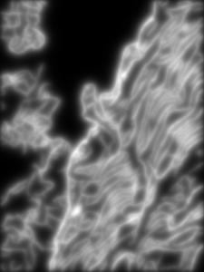
Feature Super-Vectors
SPM
Weighted Vectors
Pooled Vectors
Weighting Matrix
MAX
Blur
Phrase Vectors
GPP
#3: The Spatial Weighting
Visual Words
LLC
Visual Vocabulary
K-Mns
Fused Descriptors
Shape Descriptors
Texture Descriptors
SIFT
SIFT
Raw Image Data
Edgemap

Slide 29
Feature Super-Vectors
SPM
Weighted Vectors
Weighting Matrix
MAX
Blur
Phrase Vectors
The Improved
GPP
Visual Words
Bag-of-Features
LLC
Visual Vocabulary
K-Mns
Framework
Fused Descriptors
Shape Descriptors
Texture Descriptors
SIFT
SIFT
Raw Image Data
Edgemap

Slide 30
Outline
Introduction
The Bag-of-Features Framework
Our Proposed Framework
Analysis
Experimental Results
Conclusions

Slide 31
Analysis
The Beneficiations
Heterogeneous Descriptors
Geometric Phrase Pooling
The Complexity of Geometric Phrase Pooling
Time Complexity
Space Sparsity

Slide 32
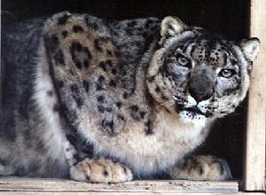
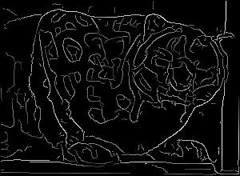
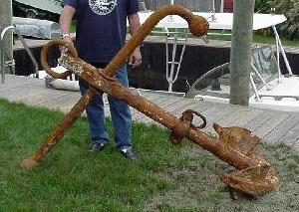
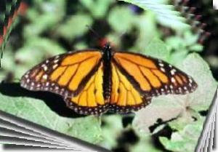
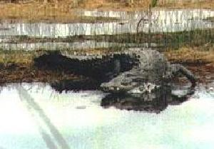
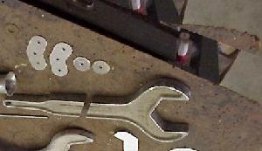
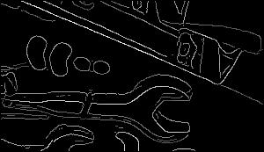
Why Multiple Descriptors?
Better on SIFT
Better using Texture
Better on Edge-SIFT
Better using Shape
wild cat
anchor
How to Classify All of Them?
water lily
butterfly
Using Both Descriptors!
crocodile
wrench

Slide 33
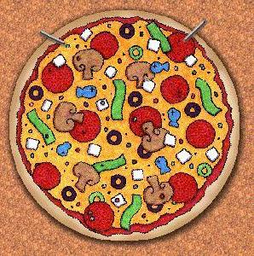
Confused using Texture Features
Confused using Shape Features
Perfect Discrimination with Both Descriptors!

Slide 34
Why Geometric Phrase Pooling (GPP)?
MAX
0
1
2
3
4
5
6
7
8
9
A
B
C
D
E
F
0
1
2
3
4
5
6
7
8
9
A
B
C
D
E
F
Central Word
Side Word
MAX and GPP
No Difference
GPP
0
1
2
3
4
5
6
7
8
9
A
B
C
D
E
F
0
1
2
3
4
5
6
7
8
9
A
B
C
D
E
F
ACM Multimedia 2012 - Oral Presentation

Slide 35
Why Geometric Phrase Pooling (GPP)?
MAX
0
0
1
1
2
2
3
3
4
4
5
5
6
6
7
7
8
8
9
9
A
A
B
B
C
C
D
D
E
E
F
F
Central Word
Side Word
Enhancing Overlapping Dimensions
GPP
0
0
1
1
2
2
3
3
4
4
5
5
6
6
7
7
8
8
9
9
A
A
B
B
C
C
D
D
E
E
F
F

Slide 36
Why Enhancing Overlapping Dimensions?
Overlapping Dimensions
Coding Phase
B
E
0
3
C
7
1
A
Neighborhood in
8
5
6
Euclidean Space
9
4
Feature Space
2
D
F
The Feature Space

Slide 37
Time / Image
Time Complexity
(s)
0.6
GPP
0.5
0.4
0.3
0.2
LLC
0.1
256
512
1024
2048
Codebook Size

Slide 38
Feature Sparsity
Non-zero Dimensions
More Time
(%)
Denser Features
50
Better Results
40
30
20
10
GPP
LLC
256
512
1024
2048
Codebook Size

Slide 39
Outline
Introduction
The Bag-of-Features Framework
Our Proposed Framework
Analysis
Experimental Results
Conclusions

Slide 40
Experimental Results
Image Classification
The Caltech101 Dataset
The Caltech256 Dataset
Image Retrieval
The Pascal VOC 2007 Challenge
Scene Understanding
The 15-Scene Dataset

Slide 41
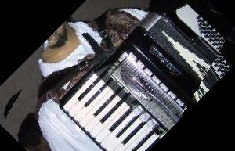
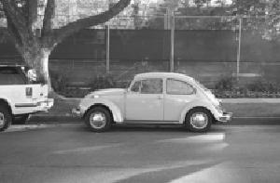
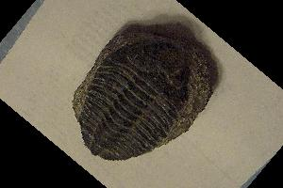
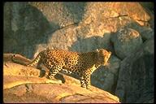
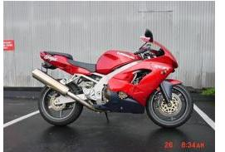
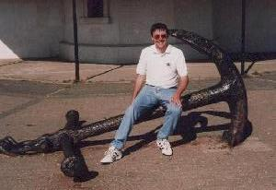
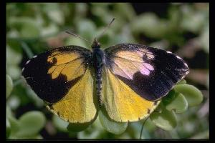
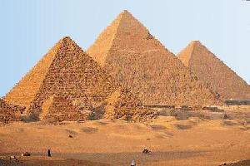
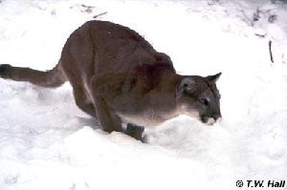
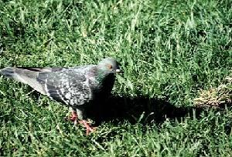
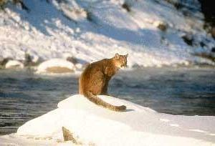
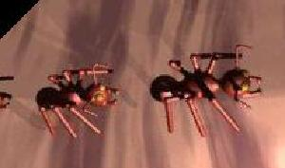
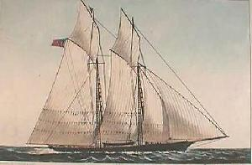
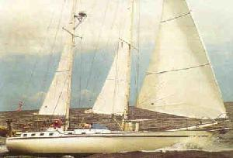
The Caltech101 Dataset
accordion
car side
trilobite
leopard
motorbike
anchor
butterfly
pyramid
cougar body
pigeon
wild cat
ant
octopus
schooner
ketch

Slide 42
The Caltech101 Dataset
#training | 5 | 10 | 15 | 20 | 30
SPM[2007] |  |  | 56.4 |  | 64.6
ScSPM[2009] |  |  | 67.0 |  | 73.2
LLC[2010] | 51.15 | 59.77 | 65.43 | 67.74 | 73.44
MFea[2011] |  |  |  |  | 75.7
RFrst[2007] |  |  |  |  | 81.3
GPP | 61.90 | 71.75 | 76.03 | 78.53 | 82.45

Slide 43
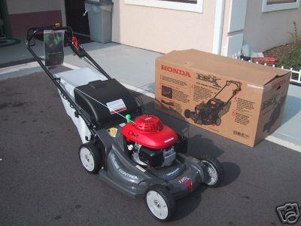
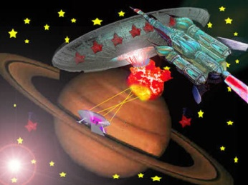
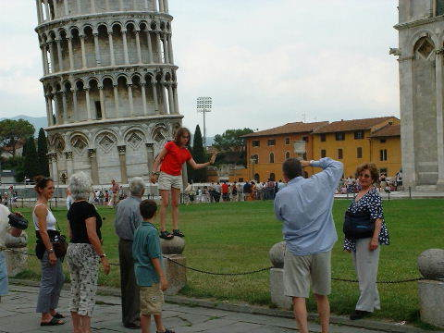
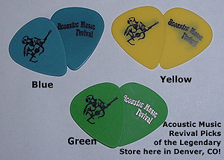
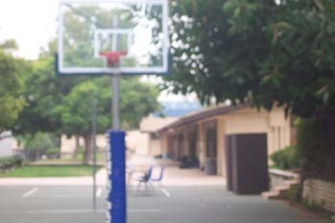
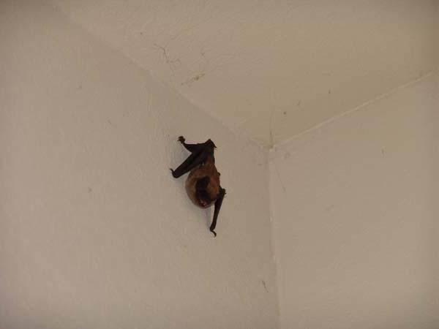
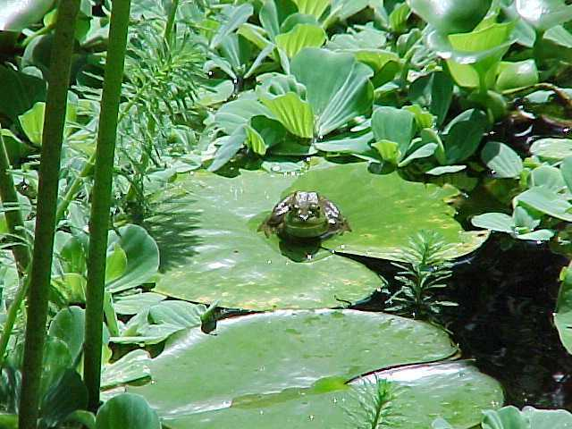
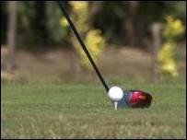
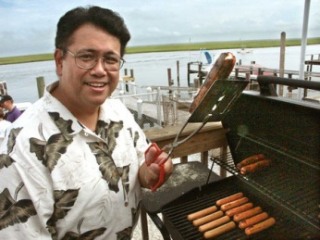
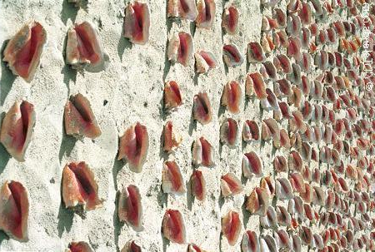
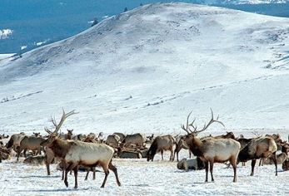
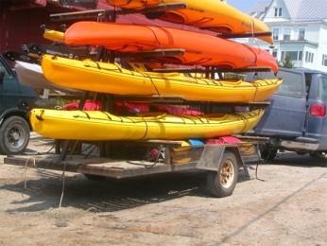
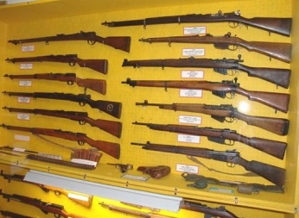
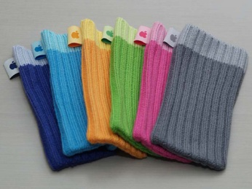
The Caltech256 Dataset
lawn mower
saturn
tower pisa
guitar pick
desk globe
basket- loop
bat
frog
golf ball
hot dog
conch
elk
kayak
rifle
socks

Slide 44
The Caltech256 Dataset
#training | 5 | 15 | 30 | 45 | 60
Baseline |  | 28.3 | 34.1 |  | 64.6
ScSPM[2009] |  | 27.73 | 34.02 | 37.46 | 40.14
LLC[2010] |  | 34.36 | 41.19 | 45.31 | 47.68
RFrst[2007] |  |  | 44.0
GPP | 26.12 | 36.35 | 45.07 | 48.02 | 50.33

Slide 45
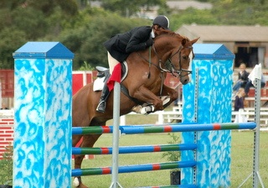
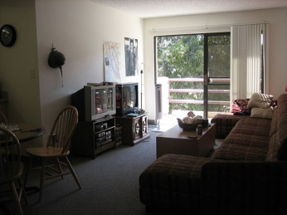
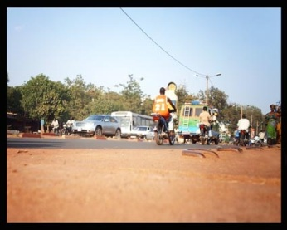
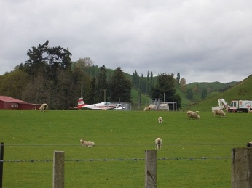
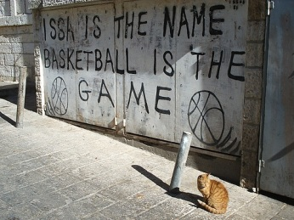
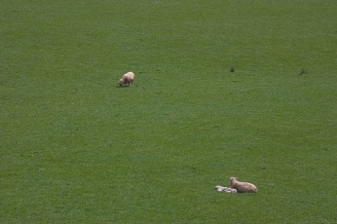
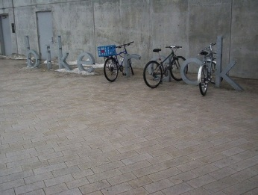
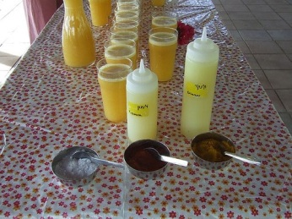
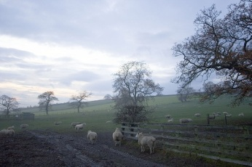
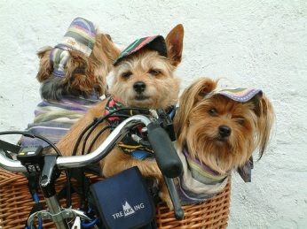
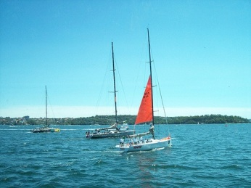
The Pascal VOC 2007 Dataset
person
dining table
sofa
person
horse
potted plant
tv monitor
sofa
chair
car
bus
motorbike
sheep
aeroplane
car
aeroplane
cat
boat
sheep
bike
bottle
sheep
dog
bird
boat

Slide 46
The Pascal VOC 2007 Challenge
category | plane | bicycle | bird | boat | bottle
LLC | 67.47 | 55.29 | 40.68 | 58.56 | 21.29
GPP | 72.29 | 56.33 | 45.41 | 61.26 | 26.24
category | bus | car | Cat | chair | cow
LLC | 44.10 | 69.43 | 46.73 | 51.50 | 31.21
GPP | 53.77 | 73.56 | 52.18 | 54.19 | 40.78
category | din.tab. | dog | horse | m.bike | person
LLC | 35.06 | 39.00 | 72.41 | 53.98 | 79.18
GPP | 47.40 | 41.58 | 74.38 | 57.52 | 83.02
category | p.plant | sheep | sofa | train | tv.mon.
LLC | 18.77 | 33.14 | 44.73 | 66.59 | 40.96
GPP | 26.03 | 37.51 | 52.30 | 69.51 | 47.50

Slide 47
The 15-scene Dataset
bedroom
suburb
industrial
kitchen
living-room
coast
forest
highway
inside-city
mountain
opn-country
street
tall-building
office
store

Slide 48
The 15-Scene Datset
#training | 10 | 20 | 30 | 50 | 100
SPM[2007] |  |  |  |  | 81.4
ScSPM[2009] |  |  |  |  | 80.4
LLC[2010] | 66.97 | 72.44 | 75.78 | 78.84 | 82.34
GPP | 70.67 | 76.12 | 78.74 | 81.72 | 85.13

Slide 49
Outline
Introduction
The Bag-of-Features Framework
Our Proposed Framework
Analysis
Experimental Results
Conclusions

Slide 50
Main Contributions
Extraction of Heterogeneous Descriptors
Introduction of Shape Description
A Simple and Efficient Method for Fusion
Construction and Pooling of Visual Phrases
A Mid-Level Structure for Image Representation
An Efficient Pooling Algorithm
Spatial Weighting
A Step towards Regions-of-Interest Detection

Slide 51
Conclusions and Future Works
An Improved Version of BoF Framework
Extraction of Heterogeneous Descriptors
Construction and Pooling of Visual Phrases
Spatial Weighting
Open Problems
Learning to Describe: Selection of Descriptors
Better Local Structures: Advanced Visual Phrases
Deep Mining in Edgemaps: Geometric Algorithms

Slide 52
Thank you!
Questions please?

